Slide 1
New Student Orientation August 18, 2023
Welcome to the Department of Educational Psychology!!!
EVERY PERSON AND EVERY
INTERACTION MATTERS
Notes:
Sue

Slide 2
Check-in and introductions (9:00-9:30)
Department Overview (9:30-9:45)
Degree Milestones (9:45-10:00)
Professionalism & Academic Integrity (10:00-10:55)
BHECN (10:55-11:00)
Counseling and School Psychology Clinic (11:00-11:15)
DEMAC (11:15-11:45)
Research Opportunity (11:45-11:55)
Lunch in Buros Library @ 12noon
Orientation
Agenda
Notes:
Sue

Slide 3
1.
Introductions
Notes:
Sue

Slide 4
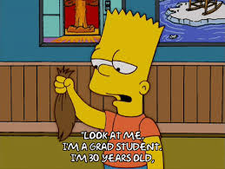
Who are you?
Name
Program and Degree (e.g., Masters, Ed.S., Ph.D.)
Where are you from?
One fun fact about you
EVERY PERSON AND EVERY INTERACTION MATTERS
Notes:
Sue

Slide 5
Do you know?
What percentage of the US population has…
A Master’s Degree
A Doctoral Degree
EVERY PERSON AND EVERY INTERACTION MATTERS
Notes:
Sue
What percentage of the US population has…

Slide 6
Masters
13.04%
US Census Bureau (2018)
Notes:
Sue

Slide 7
Doctorate
2%
US Census Bureau (2018)
Notes:
Sue

Slide 8
2.
Department Overview
Notes:
Kyle and Jules

Slide 9
Department of Educational Psychology
Eight Centers and Academic Programs:
Buros Center for Testing
Counseling Psychology (APA approved program)
Developmental & Learning Sciences
Institutional Research
Nebraska Evaluation and Research Center (NEAR)
Nebraska Internship in Professional Psychology (APA approved program)
Quantitative, Qualitative, and Psychometric Methods (QQPM)
School Psychology (APA approved program)
EVERY PERSON AND EVERY INTERACTION MATTERS
Notes:
Kyle and Jules

Slide 10
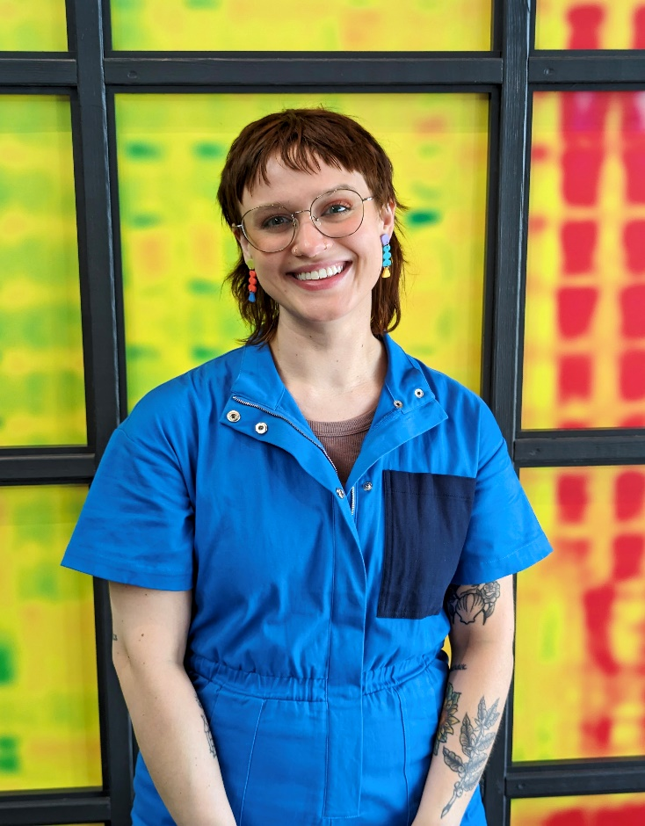
Some Very Important People …
Kyle Burke
EVERY PERSON AND EVERY INTERACTION MATTERS
Jules Meyers
Graduate Student Coordinator &
Administrative Associate jmeyers19@unl.edu
402-472-2223
Kyle Burke
Office Associate kburke57@unl.edu
402-472-2223
Notes:
Jules and Kyle: What do you do in the department? How can students reach you?

Slide 11
Other Important Resources
Center for Advocacy, Response, & Education
https://care.unl.edu/
Counseling & Psychological Services (CAPS)
https://caps.unl.edu/
International Student & Scholar Office
https://globalnebraska.unl.edu/isso
Office of Academic Success and Intercultural Services (OASIS)
https://www.unl.edu/oasis/
Services for Students with Disabilities
https://www.unl.edu/ssd/
EVERY PERSON AND EVERY INTERACTION MATTERS
Notes:
Kyle and Jules

Slide 12
You and Your Advisor
Schedule a meeting with your advisor by September 15th.
It’s never too early to get on the same page.
YOU are responsible for meeting all your degree milestones!
Office of Graduate Studies: https://www.unl.edu/gradstudies/home
Graduate Student Assembly: https://www.unl.edu/gsa/
Changing Advisors
https://www.unl.edu/mentoring/student-changing-mentors-or-advisors
EVERY PERSON AND EVERY INTERACTION MATTERS
Notes:
Sue

Slide 13
3.
Degree Milestones
Notes:
Kaitlyn

Slide 14
What are Milestones? The Office of Graduate Studies
http://www.unl.edu/gradstudies/
Contact Persons:
Jules Meyers– Graduate Student Coordinator
Kelsey Sims - Doctoral Programs Coordinator
kelsey@unl.edu
Terri Eastin - Master’s Programs Coordinator
teastin1@unl.edu
Degree requirements & milestones
https://www.unl.edu/gradstudies/current/degrees
EVERY PERSON AND EVERY INTERACTION MATTERS
Notes:
Kaitlyn
Regardless of which degree you are pursuing, you must meet UNL, CEHS, and department requirements. Mostly these are the same, but sometimes not!

Slide 15
Things you should have already done…or do ASAP!
Get your TrueYou Password
https://trueyou.nebraska.edu/SelfService/
Get your NU ID
Register for classes on MyRed
(confer with your advisor!)
https://myred.nebraska.edu/psp/myred/NBL/ENTP/?cmd=login
Get an Ncard (ID card)
https://scsapps.unl.edu/NCardOnlineApplication/
Set up an UNL email address
https://its.unl.edu/helpcenter/student-email-migration/#new-students
EVERY PERSON AND EVERY INTERACTION MATTERS
Notes:
Kaitlyn
The first steps in entering your graduate program are a lot of logistics!

Slide 16
Early tasks to accomplish in your first year (MA degree students)
Degree requirements
https://www.unl.edu/gradstudies/academics/degrees/masters
Memorandum of Courses (MA only)
Must be done before 1st half of required coursework!
https://www.unl.edu/gradstudies/current/degrees/masters#memorandum
EVERY PERSON AND EVERY INTERACTION MATTERS
Notes:
Kaitlyn
Memorandum of Courses must be signed by Dr. Scott Napolitano, Graduate Chair and your advisor

Slide 17
Early tasks to accomplish in your first year (Ed.S. degree students)
Degree requirements
https://www.unl.edu/gradstudies/academics/degrees/specialist
Supervisory Committee
Must be done prior to completion of 42 credits
Your advisor, plus two other graduate faculty
https://www.unl.edu/gradstudies/academics/degrees/specialist#committee
Program of Studies
Must be done prior to completion of 42 credits
Approved by your supervisory committee
https://www.unl.edu/gradstudies/academics/degrees/specialist#program
EVERY PERSON AND EVERY INTERACTION MATTERS
Notes:
Kaitlyn
The School Psychology Program offers the Ed.S. degree for students who are interested in being school psychologists only in a school setting. The Ed.S. is the terminal degree for a certified school psychologist in the United States. For students who want to become a licensed psychologist, they are in the Ph.D. programs in Counseling or School Psychology.

Slide 18
Early tasks to accomplish in your first year (Ph.D. degree students)
Degree requirements
https://www.unl.edu/gradstudies/academics/degrees/specialist
Supervisory Committee
Your advisor, plus three other graduate faculty
At least one must be from OUTSIDE the department
If getting a minor, must have one faculty from that area/dept.
https://www.unl.edu/gradstudies/current/degrees/doctoral#committee
Program of Studies (PhD)
Must be done before half your courses are taken
Approved by your supervisory committee
https://www.unl.edu/gradstudies/academics/degrees/doctoral#program
EVERY PERSON AND EVERY INTERACTION MATTERS
Notes:
Kaitlyn

Slide 19
During your second semester of your first year
Apply for assistantships/fellowships
Teaching assistantships (TAs)
International students: Must complete the Institute for International Teaching Assistants program https://www.unl.edu/gradstudies/current/ita
Research assistantships (RAs)
Fellowships
Tuition credit? (READ YOUR OFFER LETTER)
13 hours per week (.33 assistantship) or 19.6 hours per week (.49 assistantship)
EVERY PERSON AND EVERY INTERACTION MATTERS
Notes:
Kaitlyn
The .33 GA stipend EDPS pays is $14,000 – GAs are required to work 13 hours per week. Included with this assistantship is up to 12 hours of tuition credit towards graduate course work during the academic semesters (fall and spring ~ $8,184) and 79% of an individual student health insurance is provided (~$2,862). TOTAL = $25,046.26.
The .49 GA stipend EDPS pays is $16,725 – GAs are required to work 19.6 hours per week. Included with this assistantship is up to 12 hours of tuition towards graduate course work during the academic semesters (fall, spring, and summer ~ $10,230) and 79% of an individual student health insurance is provided (~@2,862). TOTAL = $29,817.26
Assistantship amounts vary depending on your appointment and source of funding. READ YOUR OFFER LETTER!

Slide 20
Some course planning advice…
Think and plan ahead!
Many courses are offered every other year or only occasionally
Check course schedules online
Make a 3–4-year plan with your advisor
Have a Plan B
What if a course gets cancelled?
What if you need to take a leave-of-absence?
What if your advisor leaves UNL?
EVERY PERSON AND EVERY INTERACTION MATTERS
Notes:
Kaitlyn

Slide 21
EDPS Comprehensive Exams
Master’s (3 of the following subtests)
Development; Learning Sciences; Statistical Methods; Research Methods; Measurement; Behavioral Learning; Counseling
https://cehs.unl.edu/edpsych/masters-comprehensive-exam/
Ph.D.
Talk to your advisor; Written comprehensive exams –each program has different procedures
Taken after majority of coursework completed
After completed and passed comps, submit an application for candidacy. Once you’re approved by the Office of Graduate Studies, you can write that you are a “doctoral candidate.”
EVERY PERSON AND EVERY INTERACTION MATTERS
Notes:
Kaitlyn
You are NOT a doctoral candidate until you pass your comprehensive examination. Before passing comps, you’re a “doctoral student” (how you identify yourself on your email tagline).
You must use your Husker email address. Use the signature generator to generate a professional email signature: https://newsroom.unl.edu/announce/bseunl/6314/35563

Slide 22
Thesis/Dissertation
Master’s Thesis (if applicable)
Students work with their advisor to choose an appropriate data-based project
Thesis must be read by at least one other faculty member
Ed.S. Research Project and Portfolio (NASP requirement)
Work with your program advisor and read the School Psychology Handbook!
Doctoral Dissertation
Developed in a research group or independently under the supervision of your advisor (Chair)
Both proposal and defense will be in front of the Supervisory Committee and will include 2 readers
Your committee will include an outside member…who will yours be?
EVERY PERSON AND EVERY INTERACTION MATTERS
Notes:
Kaitlyn
It helps to begin thinking about your thesis and/or dissertation now!
Keep in mind – this process usually takes a year…maybe longer, depending on the project and the student. You will go through many rounds of revision. “A lack of planning on your part does not constitute an emergency on your advisor’s part!”
Keep your deadlines in mind!
SUPERVISORY COMMITTEE – make connections with faculty outside the department!

Slide 23
Other Program Requirements
Notes:
Jack
Graduate school is going to be some of the hardest work you will do in your life.

Slide 24
Other Program Requirements
Research
Usually with your advisor … but check out other professors!
Essential to your training as a research scientist
Theory
Methodological Design/Measurement Development
IRB applications & Ethics
Recruitment
Data collection
Grant management
Analyses
Writing and defending your research
Every lab/group is different, but a good estimate is about 8-10 hours/week (more if you have an assistantship)
Complete the CITI certification course
http://research.unl.edu/researchcompliance/required-and-optional-training-with-human-subjects/
EVERY PERSON AND EVERY INTERACTION MATTERS
Notes:
Jack
CITI: Collaborative Institutional Training Initiative

Slide 25
Other Program Requirements
Research requirement(s):
Discuss with your advisor
Must register for one EDPS 995 (Doctoral Seminar; three credits) before you will be approved to graduate with a degree in Educational Psychology
Will be graded “IN PROGRESS” until completion
Completion means a conference presentation and/or journal publication submission. Exact requirements vary by program and degree track. Students should consult their advisor and program handbook.
EVERY PERSON AND EVERY INTERACTION MATTERS
Notes:
Jack

Slide 26
Professional Development
Get involved!
Your area-specific student organization
The Diversity and Ethnic Minority Affairs Committee (DEMAC)
https://cehs.unl.edu/edpsych/demac/
The Graduate Student Assembly (GSA)
https://www.unl.edu/gsa/
At least get on the email list
Attend Conferences—Networking matters!
May be reimbursed up to $250/year for travel
https://cehs.unl.edu/edpsych/educational-psychology-travel-application/
CEHS Travel Grants
https://cehs.unl.edu/documents/edpsych/CEHSStudentTravelGrants.pdf
EVERY PERSON AND EVERY INTERACTION MATTERS
Notes:
Jack
You’ll learn more about DEMAC later in this presentation

Slide 27
Annual Student Review
Each area’s program faculty conduct an Annual Student Review at the end of Spring of each academic year to ensure that all students are progressing successfully through their program.
Criteria for satisfactory progress in the program include (varies by program):
achieving grades of B or better in all coursework
promptly completing required Graduate School paperwork
successfully passing the comprehensive exam
successfully defending a thesis or dissertation
EVERY PERSON AND EVERY INTERACTION MATTERS
Notes:
Jack
See the graduate student handbook

Slide 28
It is YOUR responsibility to read and know this information!
The Graduate & Professional Catalogue (Policies)
https://catalog.unl.edu/graduate-professional
Educational Psychology Department Website and Graduate Student Handbook
http://cehs.unl.edu/edpsych/ (under “student resources”)
https://cehs.unl.edu/EdPsych/Documents/GraduateHandbook.pdf
UNL’s Student Code of Conduct
https://studentconduct.unl.edu/student-code-conduct
Graduate Professional Development
https://www.unl.edu/gradstudies/professional-development
EVERY PERSON AND EVERY INTERACTION MATTERS
Notes:
Jack
It is the STUDENT’S REPSONSIBILITY TO KNOW THIS!

Slide 29
Student Rights and Responsibilities
Read these documents:
Guidelines for Good Practice in Graduate Education
https://catalog.unl.edu/graduate-professional/graduate/general/guidelines/
Graduate and Professional Student Bill of Rights
https://www.unl.edu/gradstudies/current/rights
EVERY PERSON AND EVERY INTERACTION MATTERS
Notes:
Jack

Slide 30
Other Important Websites
Canvas
https://canvas.unl.edu
Microsoft Teams and OneDrive
https://its.unl.edu/emailhome/welcome-office-365
Parking
https://parking.unl.edu/
Campus Recreation
https://crec.unl.edu
EVERY PERSON AND EVERY INTERACTION MATTERS
Notes:
Jack

Slide 31
Other Important Resources
Technology Services
https://its.unl.edu/students/
For your software/technology needs
Sign up for WiFi
Love Library & Interlibrary Loan
https://libraries.unl.edu/
Dr. Erica DeFrain
Resource Librarian for Ed Psych
edefrain2@unl.edu
402-472-5254
EVERY PERSON AND EVERY INTERACTION MATTERS
Notes:
Jack
ADD Zotero

Slide 32
Other Important Resources
The Nebraska Evaluation and Research (NEAR) Center
https://cehs.unl.edu/edpsych/near-center/
FREE!
Located on the 2nd floor of Teacher’s College
Where you go for statistics help & consulting
The UNL Writing Center
https://www.unl.edu/writing/home
FREE!!!
Located in Andrews hall (and other places)
Schedule an appointment online
Where you go for writing and editing support
EVERY PERSON AND EVERY INTERACTION MATTERS
Notes:
Jack

Slide 33
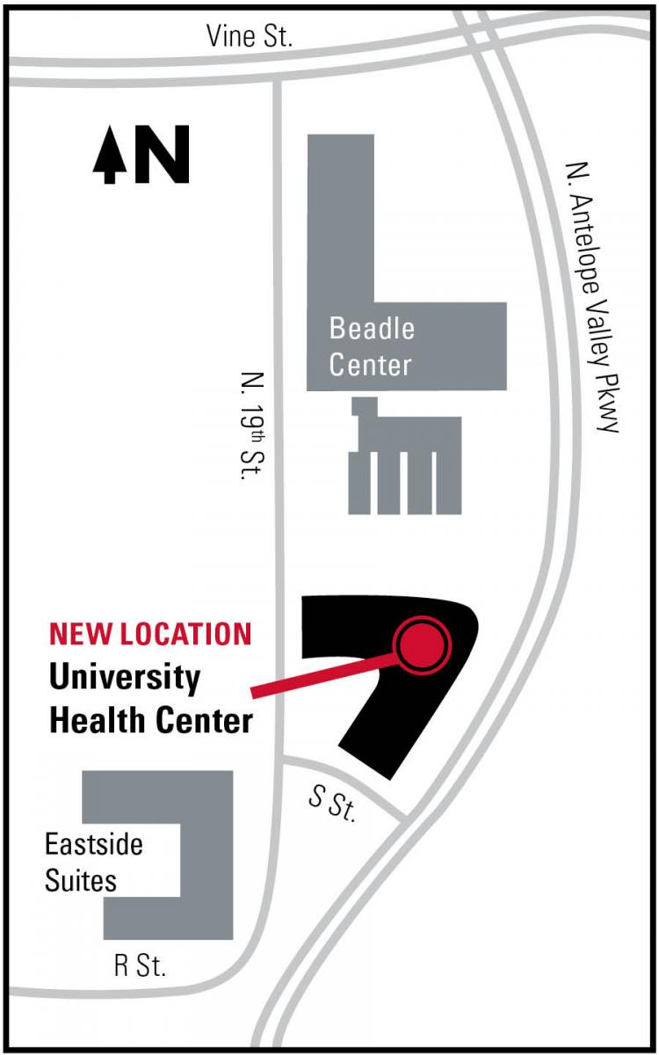
Focus on your Health!
Graduate Student Health Insurance
https://health.unl.edu/studentinsurance
Read this carefully
Enrollment ends Sept. 12th at midnight
Accept your coverage or waive here:
https://studentaccounts.unl.edu/student-health-insurance
Student Health and Facilities Fee each semester
EVERY PERSON AND EVERY INTERACTION MATTERS
Notes:
Jack

Slide 34
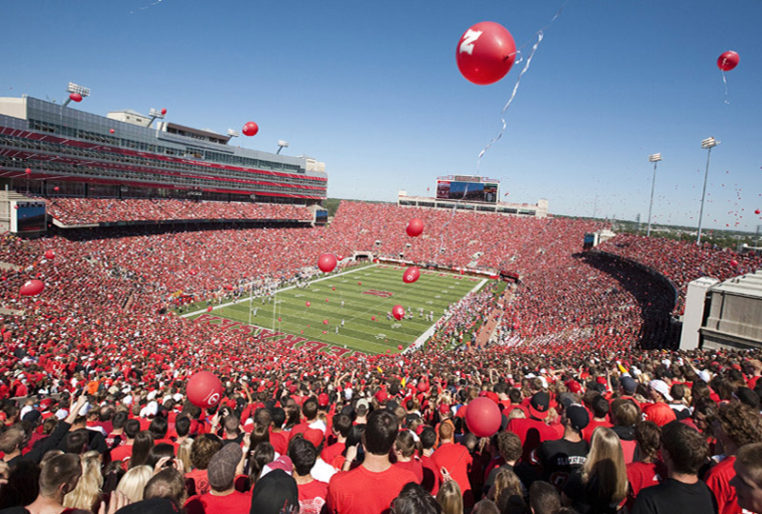
Football Game Days
The campus “shuts down” on game days. Seriously.
Schedule for games: http://www.huskers.com/SportSelect.dbml?DB_OEM_ID=100&SPID=22&SPSID=3
Notes:
Jack

Slide 35
Some Useful Resources
Karen Kelsky (2015) - The Professor is In: The Essential Guide To Turning Your Ph.D. Into a Job
Consider signing up for her newsletter:
http://theprofessorisin.com/
Notes:
Jack
ADD Podcasts

Slide 36
4.
Professionalism & Academic Integrity
Notes:
Carrie Clark

Slide 37
Professional Email Etiquette
Create a professional signature line:
https://newsroom.unl.edu/announce/cehs-news/6351/35625
Professional email communication
http://newsroom.unl.edu/announce/beyondjd/4432/25857
Remember…people are watching!
Personal information, opinions, or communications that students make in public, or that are posted on websites, in chatrooms, on electronic bulletin boards, or any social media should never be offensive to the community, immoral within accepted community standards, or insulting to any person or groups of persons
EVERY PERSON AND EVERY INTERACTION MATTERS
Notes:
Carrie
You represent the University and our department from this point until you are no longer a student.
You may be working with parents, teachers, children, community members, and many other people.

Slide 38
Professional Writing
APA Publication Manual (7th ed.)
And Purdue OWL:
https://owl.purdue.edu/owl/research_and_citation/apa_style/apa_formatting_and_style_guide/general_format.html
The Writing Center
https://www.unl.edu/writing/home
Recommended Resources
Hancock (2003). Ideas Into Words; Mastering the Craft of
Science Writing
Schimel (2012). Writing Science
Silvia (2007). How to Write a Lot: A Practical Guide to
Productive Academic Writing
Notes:
Carrie
Mention AI and ChatGPT---not YOUR work = plagarism

Slide 39
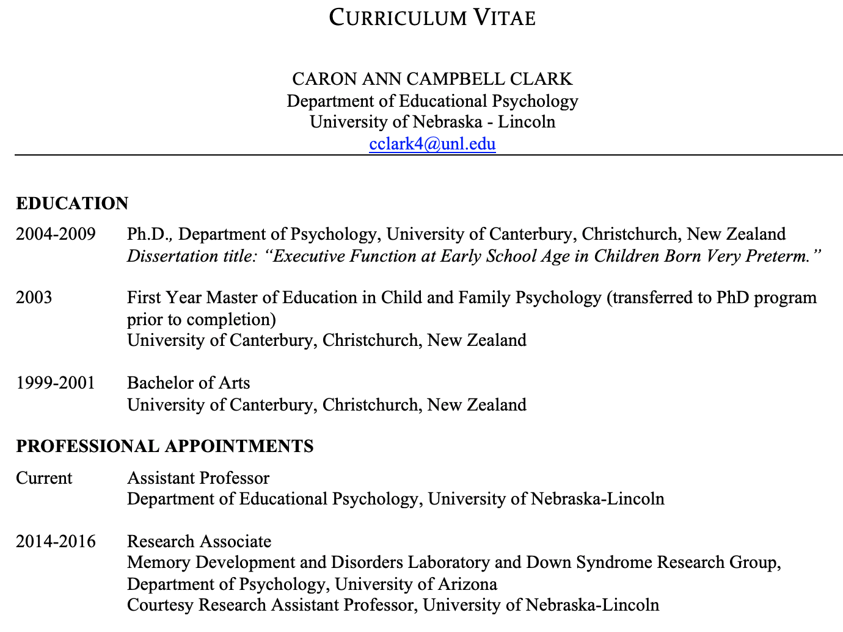
Your Curriculum Vitae
A CV is NOT a resume!
EVERY PERSON AND EVERY INTERACTION MATTERS
Notes:
A CV is NOT a resume!

Slide 40
Your Curriculum Vitae
What to include:
Educational background
Research Activities
Publications (articles, books)
Conference presentations (posters, talks)
Grant money or funding
Awards and honors
Teaching & TA-ships
Professional membership affiliations
EVERY PERSON AND EVERY INTERACTION MATTERS
Notes:
Carrie
The organization and emphasis will vary depending on the job you are applying for…so keep it all for now
*As you move through the program, keep a list of EVERYTHING you do. Dates, titles, speakers, trainings, etc
You may be working with parents, teachers, children, community members, and many other people.
Do NOT include your babysitting jobs, bartending jobs, etc.

Slide 41
Speaking of professional affiliations…
Think about which professional organizations to join
Suggestions:
American Education Research Association (AERA)
American Psychological Association (APA)
Society for Research in Child Development (SRCD)
Other regional and state organizations
Why?
Listservs
Student groups
Conferences
Professional networking
Funding opportunities
EVERY PERSON AND EVERY INTERACTION MATTERS
Notes:
Carrie
LOOK for student discounts – also for things like statistics software!

Slide 42
Conference like a boss…
Calendar of CEHS conferences:
https://events.unl.edu/confscehs/
Read “Nebraska Today” for UNL events
First few years:
Posters (approximately one per year)
Turn these into manuscripts!
Attend graduate student events
Also consider:
Paper submission (give a talk)
Chair a symposium
Attend early career events/actively network
Join a student group
EVERY PERSON AND EVERY INTERACTION MATTERS
Notes:
Carrie

Slide 43
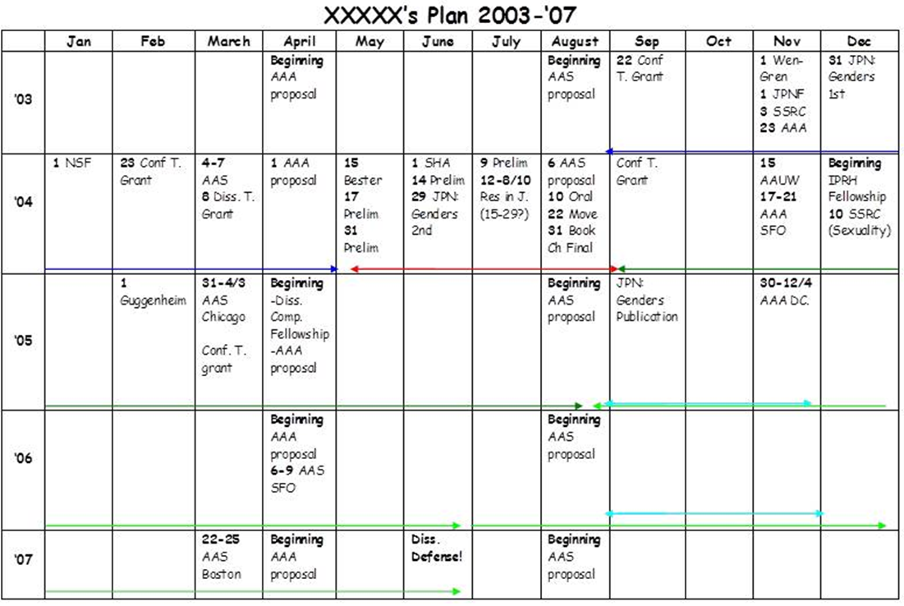
Creating a Five-Year Plan
Example from: https://theprofessorisin.com/2014/05/09/in-response-to-popular-demand-more-on-the-5-year-plan/
Notes:
Carrie
This is a living document
WHY:
Keeps you on target for your timeline
Helps you to remember milestones
Focuses your work on things that matter for the job market
See the big picture – are you missing anything?
Helps you be on the same page with your advisor
Helps you to build progressively…
Eventually, you need to build a clear research identity…is this activity helping you do this?

Slide 44
Actively seek out multiple mentors
You have an advisor, but…
You’ll need three (or four!) letters of recommendation
Advisors have only their own experience to draw on
More mentors = more opportunities
If you do have a conflict with your advisor, you have a built-in support network
If you can, establish a mentorship with someone else on campus and/or with someone from another university
Attend formal mentorship events (e.g., at conferences)
Take opportunities to collaborate
Maintain connections with former mentors
EVERY PERSON AND EVERY INTERACTION MATTERS
Notes:
Carrie

Slide 45
Apply for funding/awards
Even a $100 fellowship looks good on your CV
Grants, Awards and Funding
https://www.apa.org/about/awards/index
http://www.psychwiki.com/wiki/Dissertation_grants/awards
http://www.aera.net/Division-F/Awards
Research Grants
https://www.apa.org/research/funding/index
https://buffettinstitute.nebraska.edu/our-people/graduate-scholars
https://researchtraining.nih.gov/career/graduate
EVERY PERSON AND EVERY INTERACTION MATTERS
Notes:
Carrie
The department will send out funding announcements in the “Weekly Wednesday” newsletter.

Slide 46
Grad school is hard. Writing is a really tough part of the job.
Notes:
Carrie
It can be super stressful.
It also involves a lot of reading and writing. And writing is stressful and difficult

Slide 47
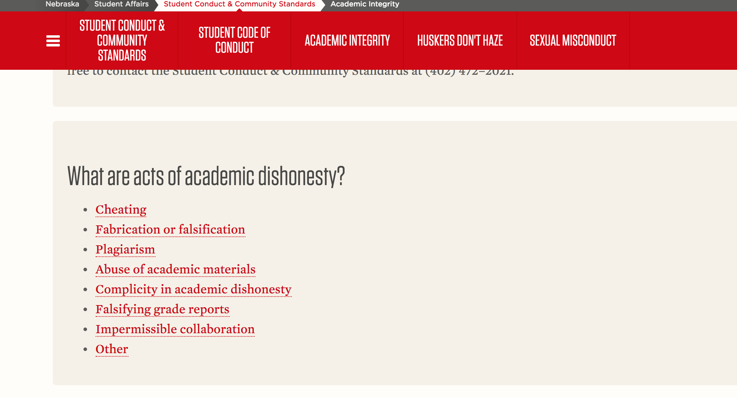
Notes:
Carrie
Like commit acts of academic dishonesty.
Perhaps not cheating on tests or colluding with friends in grad school. But things like plagiarism and fabrication become a much bigger deal because you are joining academia.
Mention AI and ChatGPT
WHY:
Keeps you on target for your timeline
Helps you to remember milestones
Focuses your work on things that matter for the job market
See the big picture – are you missing anything?
Helps you be on the same page with your advisor
Helps you to build progressively…
Eventually, you need to build a clear research identity…is this activity helping you do this?

Slide 48
What is plagiarism?
Plagiarism: “Presenting the work of another as one’s own (i.e., without proper acknowledgement of the source) and submitting examination, theses, reports, speeches, drawings, laboratory notes or other academic work in whole or in part as one’s own when that work has been prepared by another person or copied from another person.”
University of Nebraska Office of Graduate Studies (2021). Types of plagiarism. Retrieved July 24th, 2021 from:
https://www.unl.edu/gradstudies/connections/types-plagiarism
EVERY PERSON AND EVERY INTERACTION MATTERS
Notes:
Carrie
This is the university’s definition of plagiarism

Slide 49
What is plagiarism?
Submitting another person’s ideas/work as though it is yours
Copying someone’s ideas and not acknowledging them
Not putting words/phrases in quotation marks
Reorganizing a sentence but not acknowledging that it is someone else’s idea
Using so many of another person’s ideas that it becomes the best part of your work
https://www.plagiarism.org/article/what-is-plagiarism
EVERY PERSON AND EVERY INTERACTION MATTERS
Notes:
Carrie
It can involve all of the following
You may be working with parents, teachers, children, community members, and many other people.

Slide 50
You may say I’m a dreamer, but I’m not the only one.
You may say I’m a dreamer, but I’m not the only one.
EVERY PERSON AND EVERY INTERACTION MATTERS
Notes:
Carrie
Is this plagiarism? Yes. Direct quote. Not cited

Slide 51
You may say I’m a dreamer, but I’m not the only one.
“You may say I’m a dreamer, but I’m not the only one”.
EVERY PERSON AND EVERY INTERACTION MATTERS
Notes:
Carrie
Yes. Direct quote. No citation

Slide 52
You may say I’m a dreamer, but I’m not the only one.
You may say I’m a dreamer, but I’m not the only one (Lennon, 1971, track 1) .
EVERY PERSON AND EVERY INTERACTION MATTERS
Notes:
Carrie
Yes, direct quote. No quote marks

Slide 53
You may say I’m a dreamer, but I’m not the only one.
“You may say I’m a dreamer, but I’m not the only one” (Lennon, 1971, track 1) .
EVERY PERSON AND EVERY INTERACTION MATTERS
Notes:
Carrie
No. BUT.. Not very academic to use direct quotes either. Try not to use them too often.

Slide 54
You may say I’m a dreamer, but I’m not the only one.
Some people call me a dreamer. However, many people are dreamers (Lennon, 1971, track 1).
EVERY PERSON AND EVERY INTERACTION MATTERS
Notes:
Carrie
Yes. I would say so. This is essentially a ‘find and replace’ type of plagiarism. The words are changed but it is essentially the same as what the song says. In academia, we don’t want to repeat other peoples’ ideas verbatim. We actually want to capture the essence of their ideas and combine them with other ideas to create arguments of our own

Slide 55
You may say I’m a dreamer, but I’m not the only one.
Many people would like to see the world change, for there to be less war and more of a sense of humanity and kindness (Lennon, 1971, track 1).
EVERY PERSON AND EVERY INTERACTION MATTERS
Notes:
Carrie
No. This is a better way of doing things. We’re capturing the nature of the argument. And we would probably want to add more authors to the citation e.g., Ghandi, Black-Eyed Peas, to show that this is a general argument

Slide 56
Things you shouldn’t cite in academic writing
Pinterest
Your grandma’s Twitter feed
You mom’s Facebook page
Reddit
Wikipedia
Notes:
Jack
You need to treat the web as you would a print source. If you take something off of the web for an assignment, make sure you acknowledge it. Always ask yourself whether you can really identify the source of what you are reading. My friends constantly quote facts at me from reddit. Not what we want in an essay. In fact, you should be very reluctant to frame anything as a ‘fact’ in psychology (never use words like proven, it is a known fact) because, generally, we recognize that the limitations of our methods mean that things are factual only within the parameters of the population we have studied. Be very careful when citing off the web.

Slide 57
Lectures and presentations:
But you can cite…
(who knew?)
Author, A. (Publication Year). Name or title of lecture [file format]. Retrieved from URL
Lectures and presentations:
Last name, FI. (Year, Month day). Interview type. [email, phone, personal interview).
Notes:
Jack
BUT surprisingly, you don’t have to limit citations to just journals or books. You can, and should (although sparingly in essays), cite info you get from lectures, personal correspondence

Slide 58
Government reports
But you can cite…
Author Surname, FI. SI./ Government Name. Name of Government Agency (Year). Title: Subtitle (Report No. xxxx). Place of publication: Publisher.
Dissertations
Author, FI, SI. (year). Title of thesis/dissertation (Unpublished doctoral dissertation/Unpublished master’s thesis). Academic Institution, City, State/country.
Notes:
Jack
Government reports are great to cite in grants and as openers in a paper. Dissertations can be cited.

Slide 59
Unsplash.com
Patrick Fore
@patrickian4
Notes:
Jack
You have to buy a copy of the APA manual. I use mine everyday.
Grad school is expensive, and you might not have a lot of cash. If you are tempted to go for a drink or buy the APA manual, buy the manual.
WHY:
Keeps you on target for your timeline
Helps you to remember milestones
Focuses your work on things that matter for the job market
See the big picture – are you missing anything?
Helps you be on the same page with your advisor
Helps you to build progressively…
Eventually, you need to build a clear research identity…is this activity helping you do this?

Slide 60
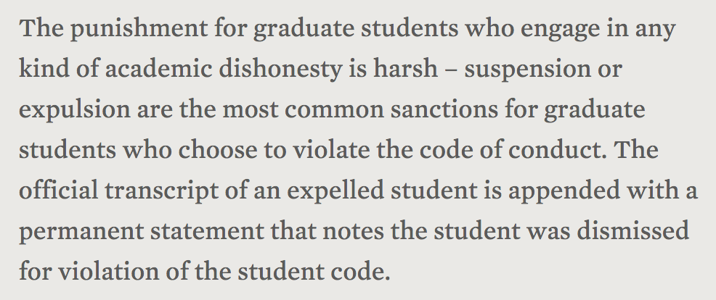
What are you risking?
The University of Nebraska (2018). Academic Integrity. Retrieved from: https://www.unl.edu/gradstudies/current/integrity
Notes:
Jack
IN grad school, the penalty for plagiarism is particularly high. Much higher than we might see for undergrads.
Think about that. Just one little essay where you think you don’t feel like writing that one paragraph – it’s just too hard. And that is it. Game over.

Slide 61
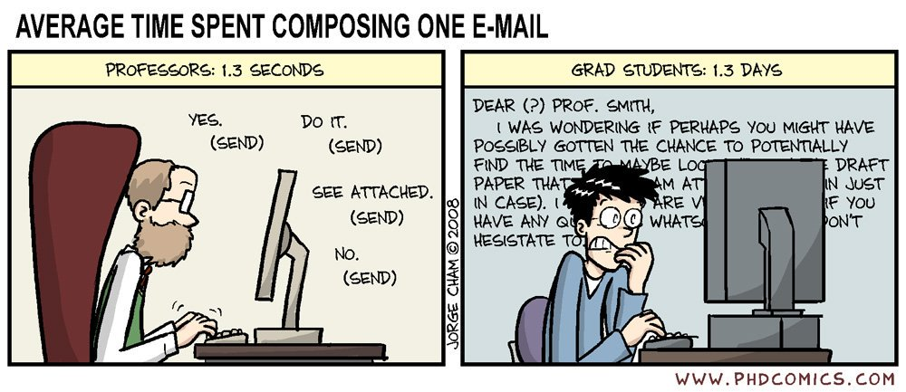
Your professors have been there…
Created by George Cham http://phdcomics.com/comics/archive.php?comicid=1047
Notes:
Jack
Believe it or not, we have been there. Your professors have been through the same thing that you’re going to experience. We know that things get stressful. We know that grad students have other things going on in life and that things get tough. It isn’t shameful to feel stress in grad school. It is normal. If you aren’t feeling like it’s difficult, you might be doing it wrong.

Slide 62
And We Want You To Do Well!!!
Created by Carl2141989. https://www.someecards.com/usercards/viewcard/i-really-do-respect-you-because-people-like-you-make-me-look-good-6f4e2/?tagSlug=confession
Notes:
Jack
Also, while most of us are good people, we actually want you to do well for nefarious reasons too.
You doing well makes your professors and the department look good. Second to professor’s winning the Nobel prize, the next best thing would be for our grad student to win the Nobel prize because they can ride that train with you.
Seriously, if you are having difficulties with your course work, if you can’t get an essay done in time, if you think an assignment is going to be late or something happens in your home life that just makes things seem like it would be so much easier to copy a paper from the internet or something, come and talk to your faculty and mentors. Do NOT risk getting expelled from university. We will help.

Slide 63
Useful Websites to Help You
You may say I’m a dreamer, but I’m not the only one.
http://www.easybib.com
https://www.mendeley.com
https://www.zotero.org/
https://www.plagiarism.org/teaching-about-plagiarism
EVERY PERSON AND EVERY INTERACTION MATTERS
Notes:
Jack
These are all awesome tools and websites to look at.

Slide 64
5.
BHECN
Notes:
Heather

Slide 65
6.
Counseling and School Psychology Clinic
Notes:
Heather

Slide 66
What We Do
You may say I’m a dreamer, but I’m not the only one.
Provide therapy and assessment services
Conduct mental health outcomes research
Support students’ clinical growth and development
Develop community partnerships
Promote mental health within and outside the department
EVERY PERSON AND EVERY INTERACTION MATTERS

Slide 67
Who We Are
You may say I’m a dreamer, but I’m not the only one.
Clinic Team Members:
Kellan Willet (Clinic Coordinator)
Millie Myers (Counseling Psych Clinic GA),
Samantha Kesselring (School Psych Clinic GA)
Teagan Wilson (Swanson GA)
Riley Hauch (Student Worker)
Heather Hruskoci (Clinic Director)
EVERY PERSON AND EVERY INTERACTION MATTERS

Slide 68
Connect with Us
You may say I’m a dreamer, but I’m not the only one.
Website: https://cehs.unl.edu/cspc/
Facebook: UNL Counseling and School Psychology Clinic
Social Teams Page
End of Semester Mental Health De-Stress Activities
EVERY PERSON AND EVERY INTERACTION MATTERS

Slide 69
7.
Diversity &
Ethnic
Minority
Affairs
Committee
Notes:
Rin
Mention Eric and Patricia

Slide 70
DEMAC’s Mission
You may say I’m a dreamer, but I’m not the only one.
To promote, encourage, and advocate for the understanding and respect of challenges faced by racial, ethnic, sexual, gender, ability, and other socially marginalized identity groups within the Educational Psychology Department, College of Education and Human Sciences, the University of Nebraska, and the community at large. DEMAC also advocates for culturally sensitive solutions to issues faced by the socially minoritized groups.
EVERY PERSON AND EVERY INTERACTION MATTERS
Notes:
Rin

Slide 71
DEMAC’s Structure
You may say I’m a dreamer, but I’m not the only one.
Student Executive Board:
Two (2) Co-Chairs
One (1) Vice Co-Chair Secretary
One (1) Vice Co-chair Treasurer
One (1) Vice Co-Chair Outreach Coordinator
+ DEI GA
Faculty Advisory Board:
One (1) faculty from CoPsych
One (1) faculty from School Psych
One (1) faculty from DLS
One (1) faculty from QQPM
+ DEI Chair
EVERY PERSON AND EVERY INTERACTION MATTERS
Notes:
Rin

Slide 72
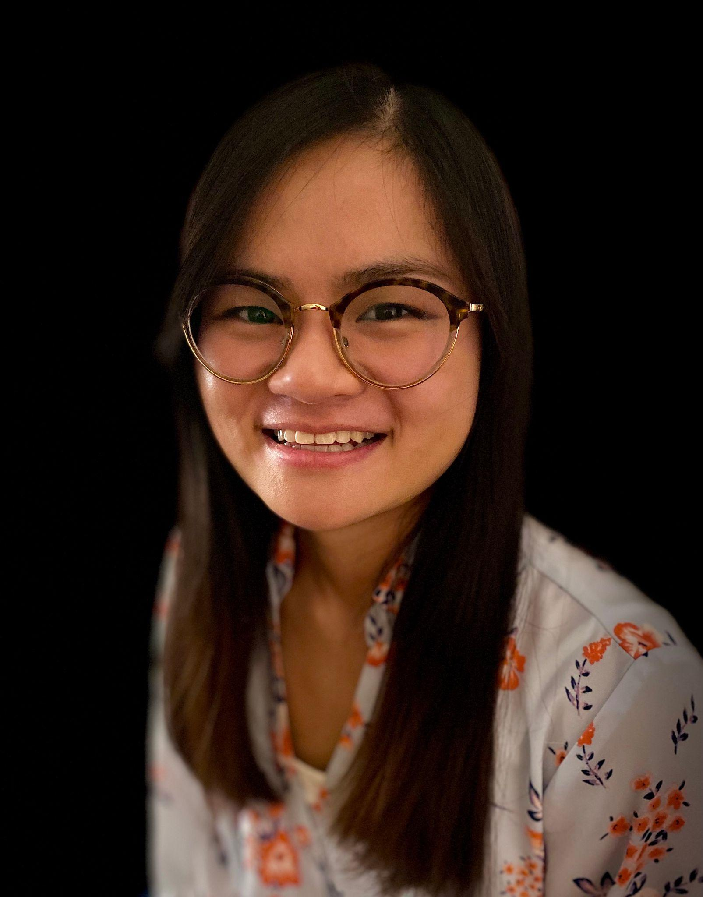
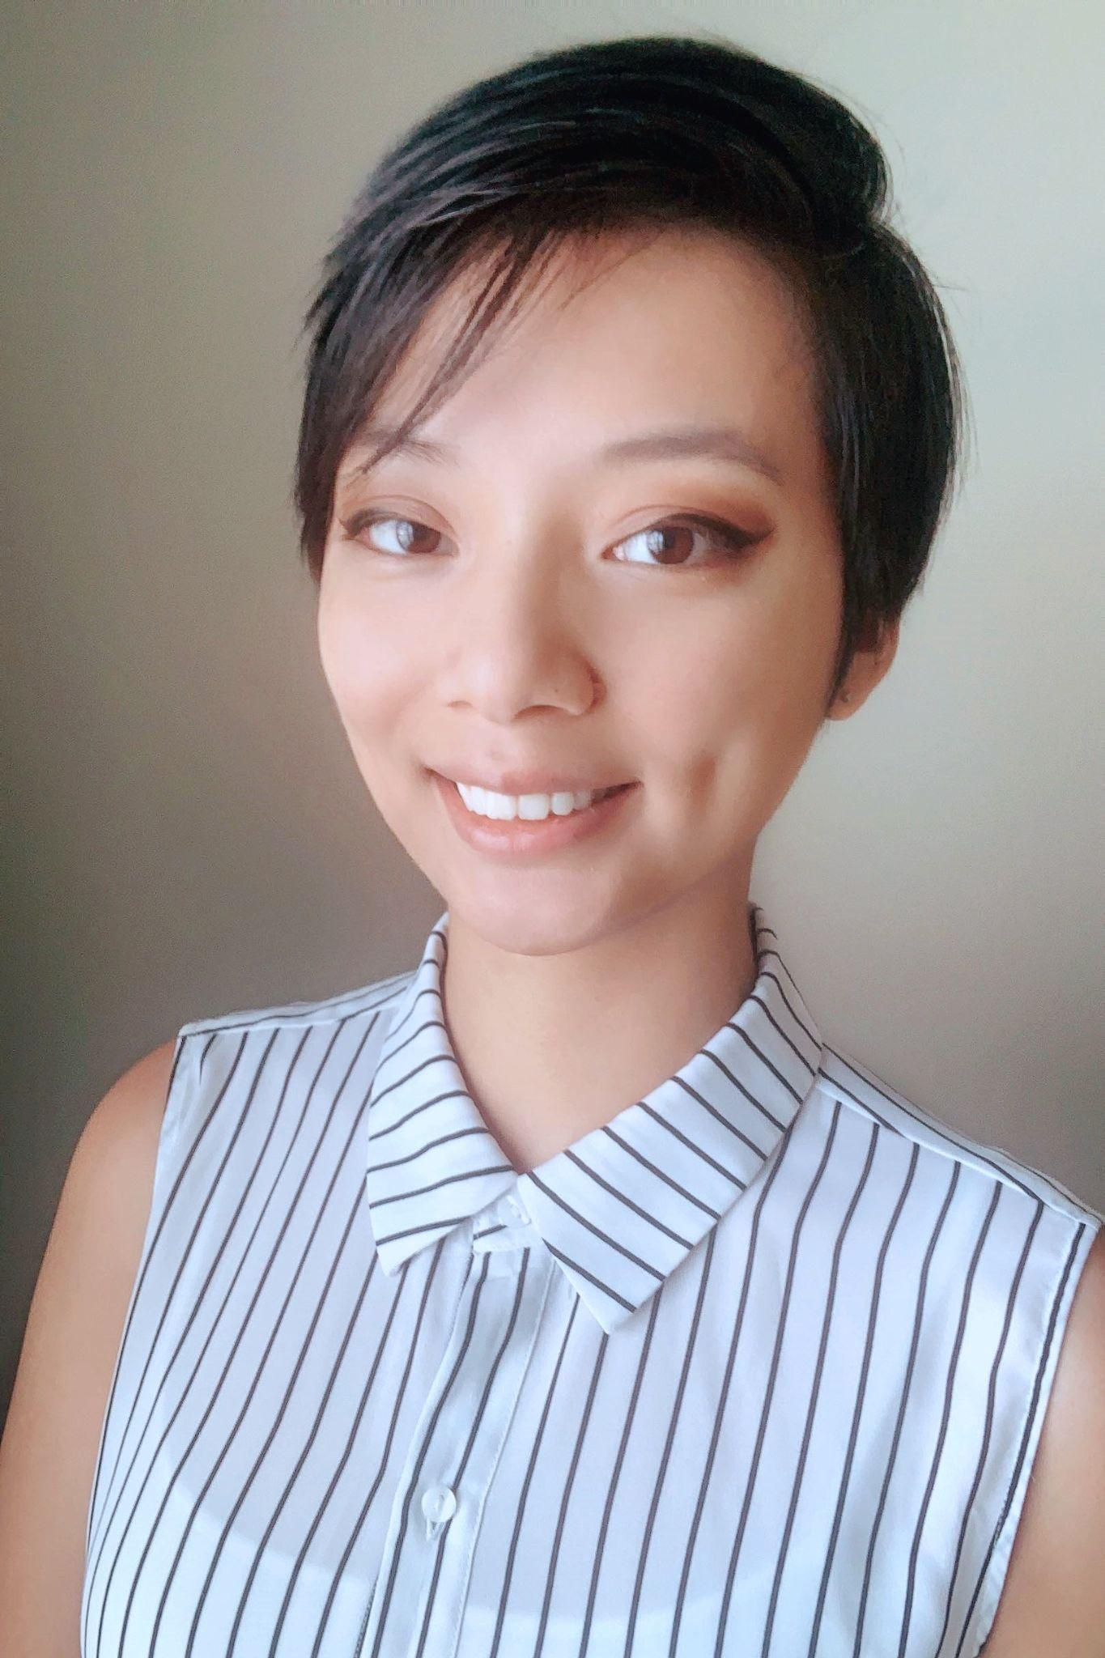
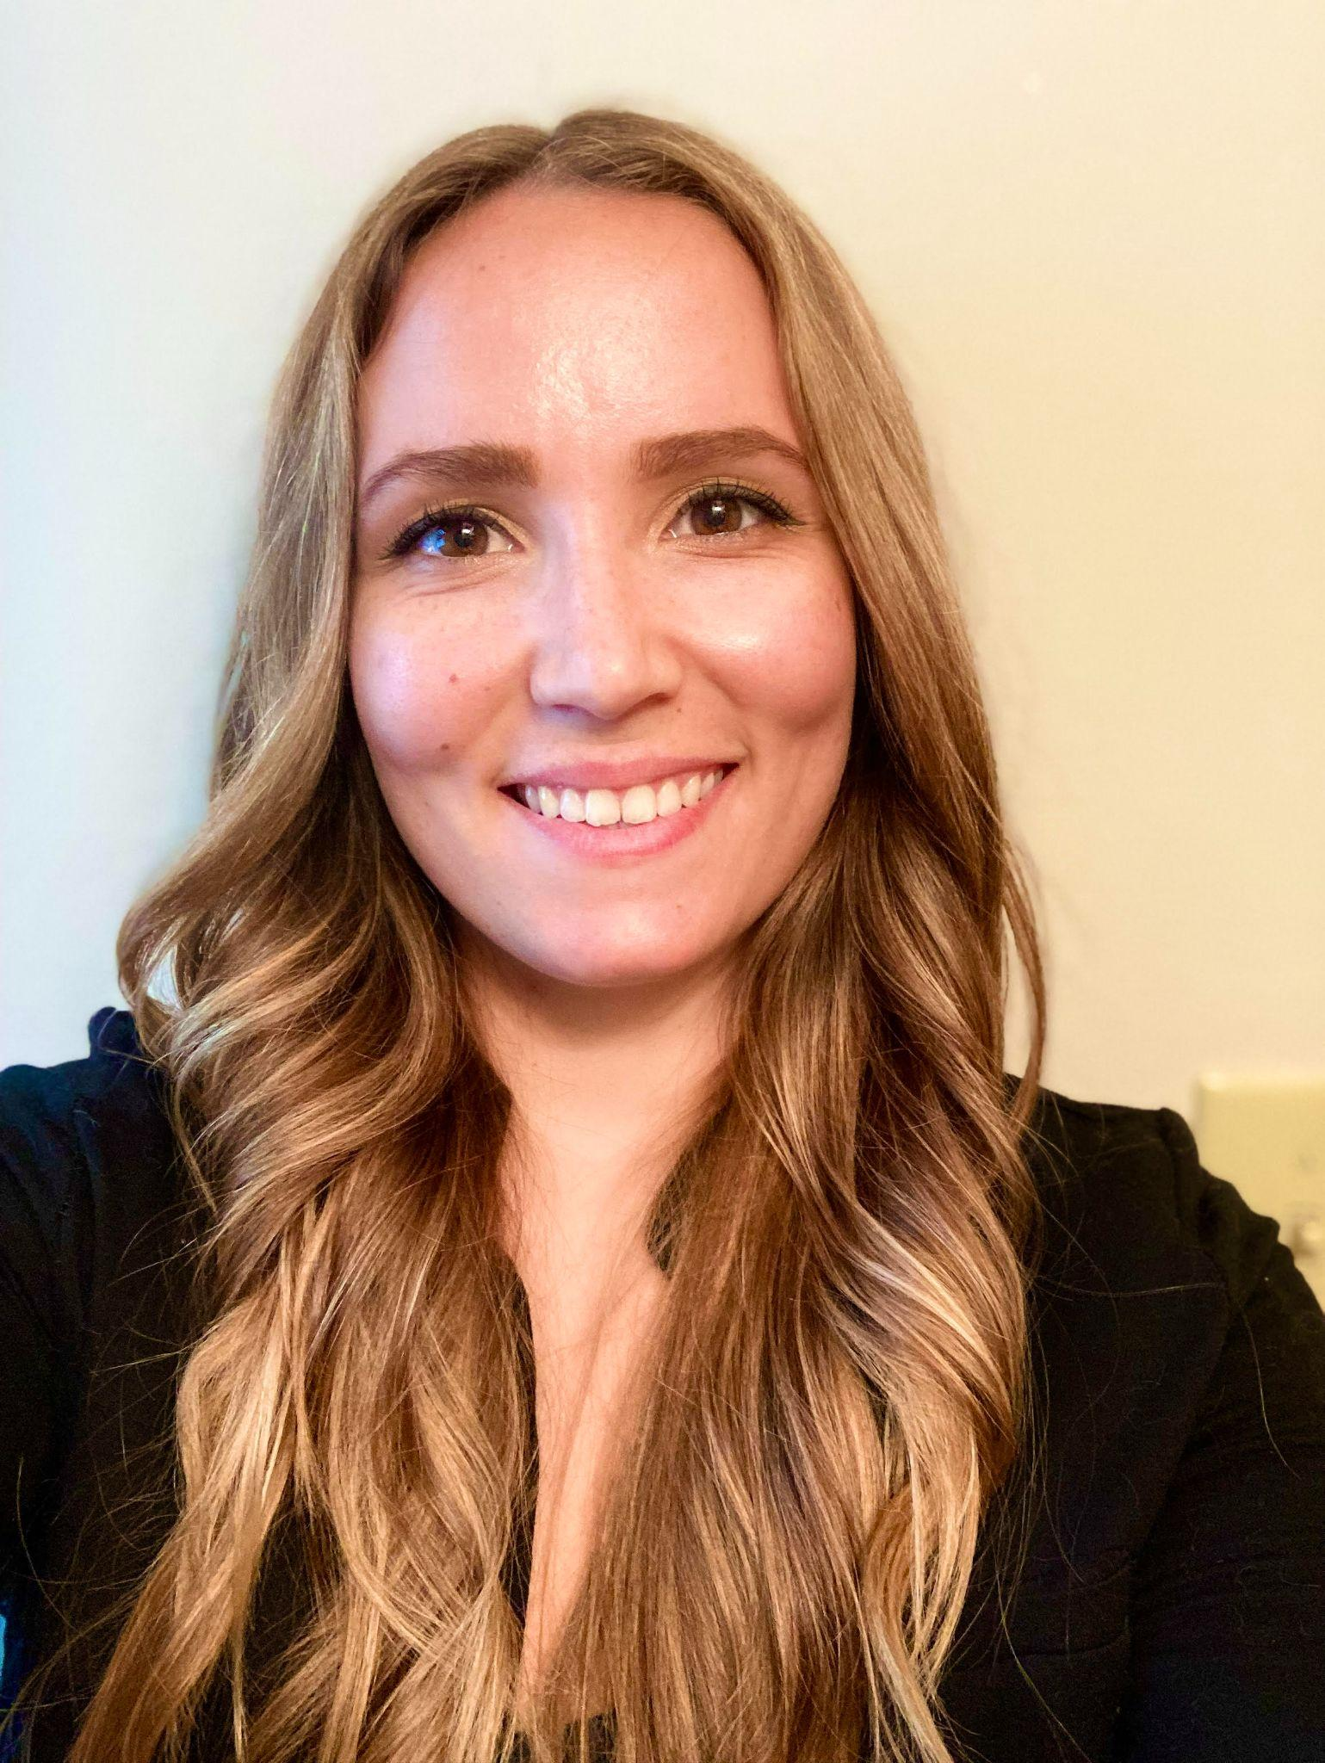
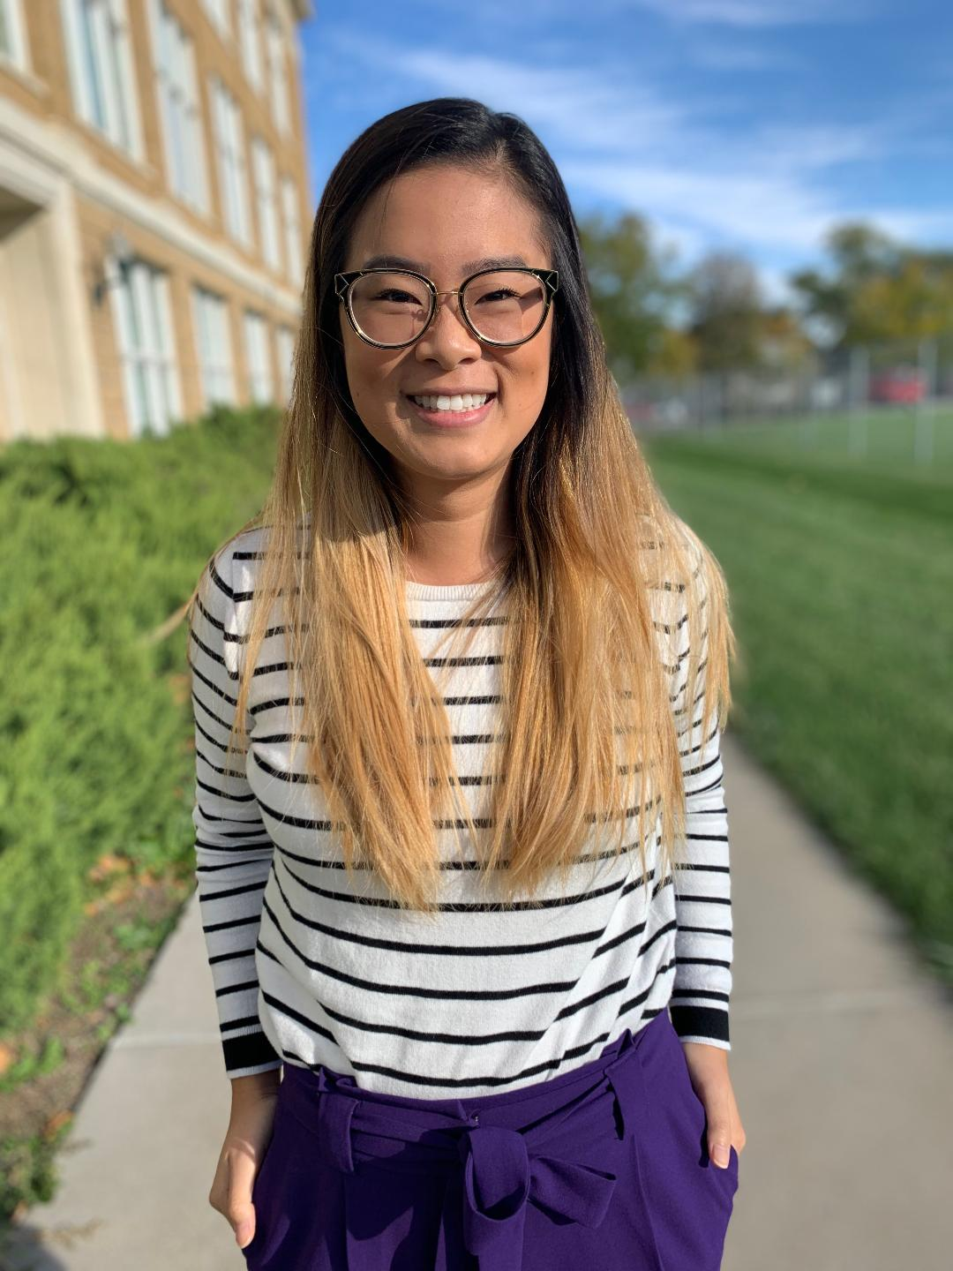
2022-2023 Executive Student Board
You may say I’m a dreamer, but I’m not the only one.
Thank you, 2022-2023 Executive Student Board!
EVERY PERSON AND EVERY INTERACTION MATTERS
Notes:
Rin

Slide 73
Meet the 2023-2024 Executive Student Board!
You may say I’m a dreamer, but I’m not the only one.
EVERY PERSON AND EVERY INTERACTION MATTERS
Notes:
Rin

Slide 74
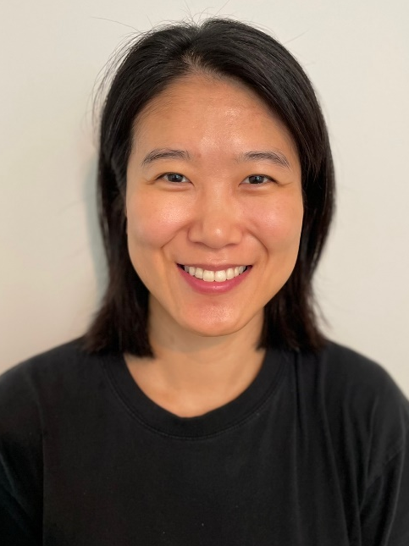
Contact Information
You may say I’m a dreamer, but I’m not the only one.
DEMAC - demac.edps@gmail.com
Alexis Chavez - achavez20@huskers.unl.edu
Jack Riley - jhebner2@huskers.unl.edu
Kristen Hunt - kristen.hunt@huskers.unl.edu
Soyeon Kim - skim34@huskers.unl.edu
Rin Nguyen - knguyen21@huskers.unl.edu
EVERY PERSON AND EVERY INTERACTION MATTERS
Notes:
Rin

Slide 75
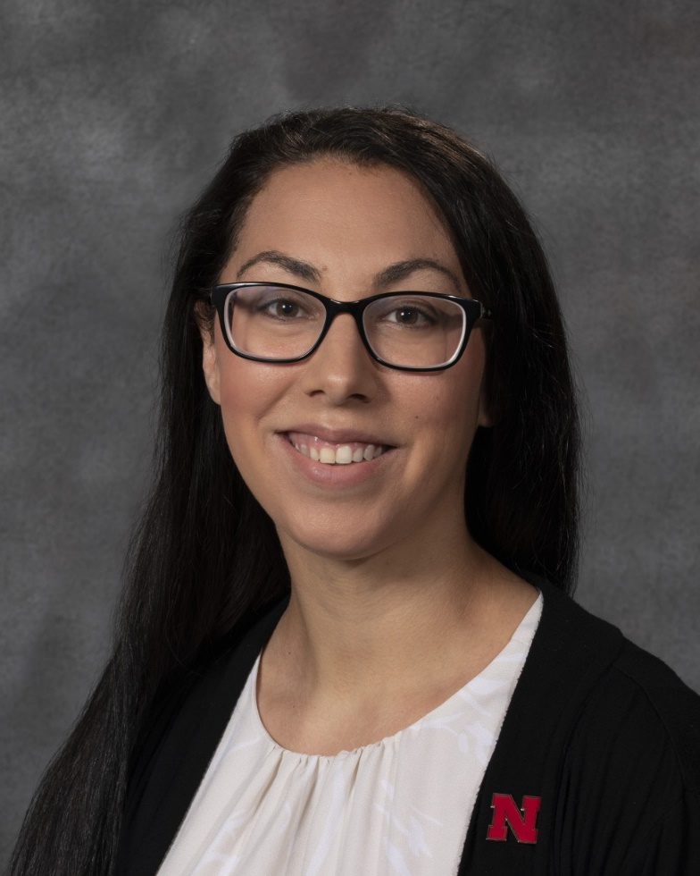
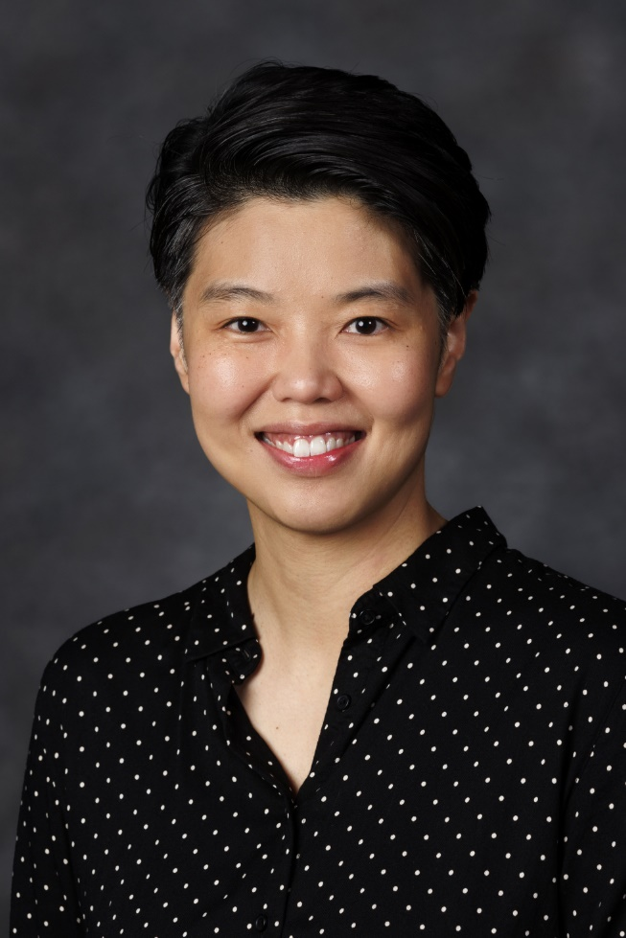
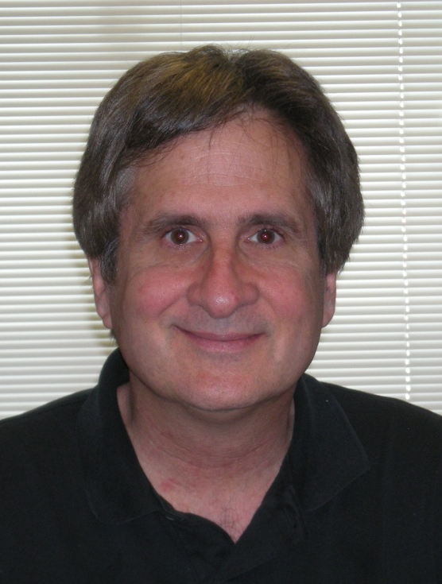
2023 – 2024 Faculty Board
You may say I’m a dreamer, but I’m not the only one.
DEMAC - demac.edps@gmail.com
Eric Buhs - ebuhs@unl.edu
Heather Hruskoci - hhruskoci2@unl.edu
Mun Yuk Chin - munyuk.chin@unl.edu
Wayne Babchuk - wbabchuk1@unl.edu
EVERY PERSON AND EVERY INTERACTION MATTERS
Notes:
Rin

Slide 76
Last year’s programming
Involvement in faculty searches
Created a shared library
Recruited mentors for high schoolers
Diversity potluck party
Formed a near comprehensive resource list
Collaborated with DEI Chair and GA on climate survey
EVERY PERSON AND EVERY INTERACTION MATTERS
Notes:
Rin (pictures of the potluck EOY Spring 2022)

Slide 77
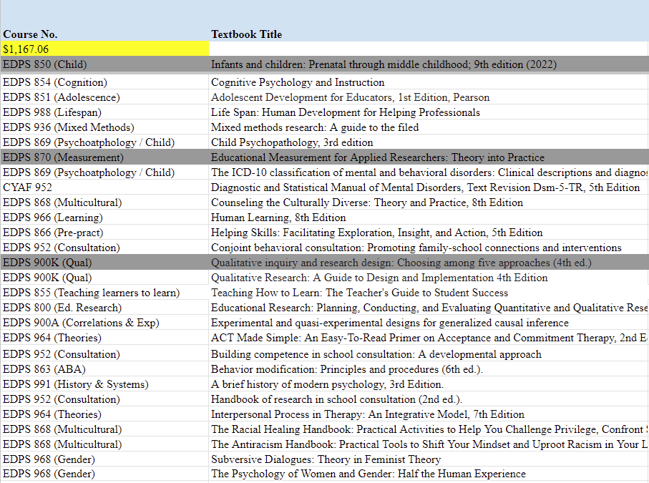
Shared Library in TEAC 114
EVERY PERSON AND EVERY INTERACTION MATTERS
Notes:
Rin (pictures of the potluck EOY Spring 2022)

Slide 78
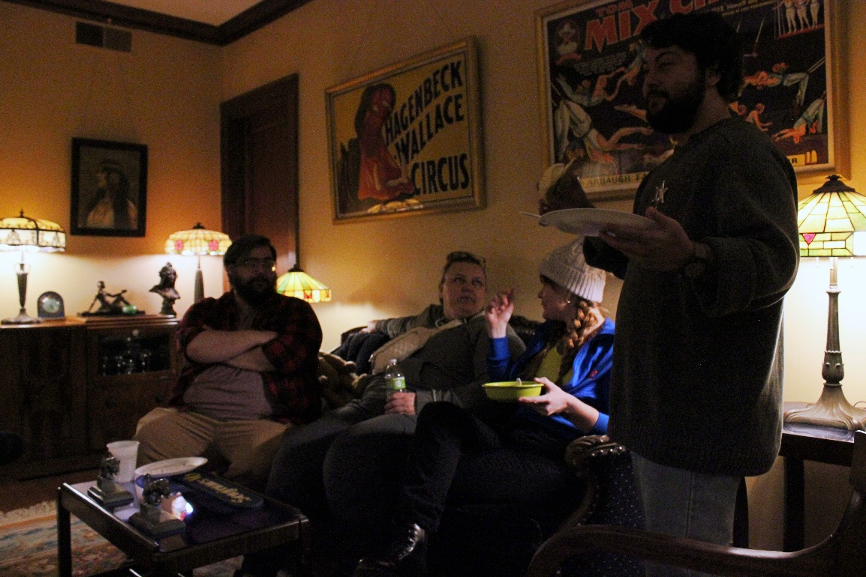
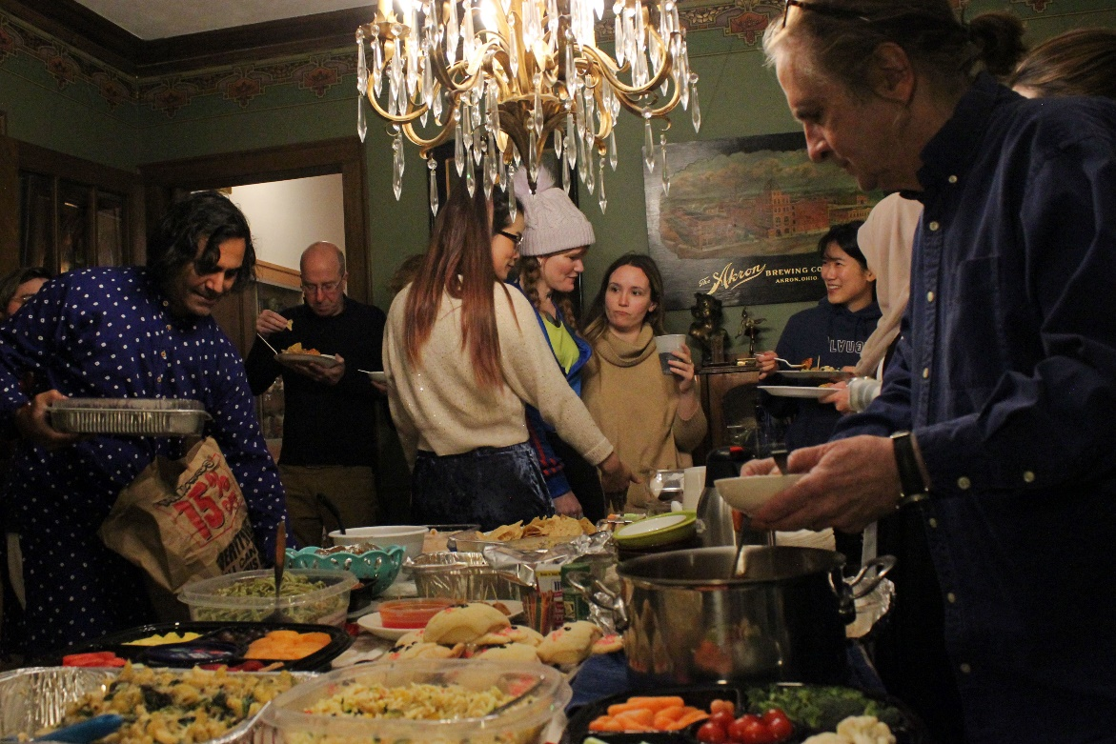
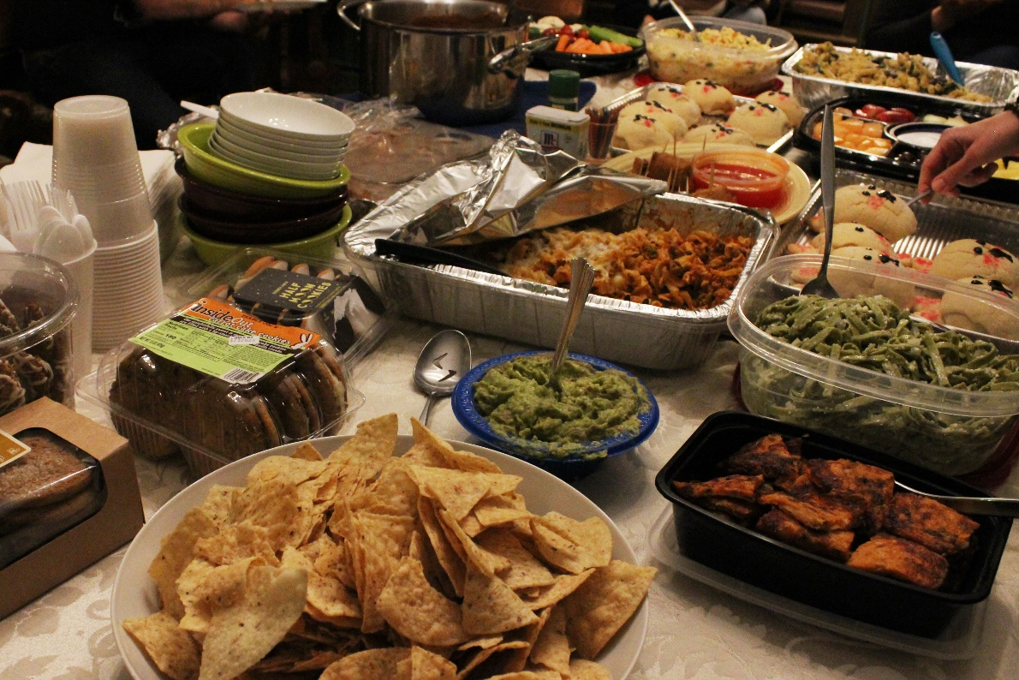
Last year’s programming
Involvement in faculty searches
Created a shared library
Recruited mentors for high schoolers
Diversity potluck party
Formed a near comprehensive resource list
Collaborated with DEI on climate survey
EVERY PERSON AND EVERY INTERACTION MATTERS
Notes:
Rin (pictures of the potluck EOY Spring 2022)

Slide 79
Last year’s programming
Involvement in faculty search
Created a shared library
Recruited mentors for high schoolers
Diversity potluck party till sundown at Wayne’s
Formed a near comprehensive resource list
Collaborated with DEI on climate survey
EVERY PERSON AND EVERY INTERACTION MATTERS
Notes:
Rin (pictures of the potluck EOY Spring 2022)

Slide 80
Last year’s programming
Involvement in faculty search
Created a shared library
Recruited mentors for high schoolers
Diversity potluck party till sundown at Wayne’s
Formed a near comprehensive resource list
Collaborated with DEI on climate survey
EVERY PERSON AND EVERY INTERACTION MATTERS
Notes:
Rin (pictures of the potluck EOY Spring 2022)

Slide 81
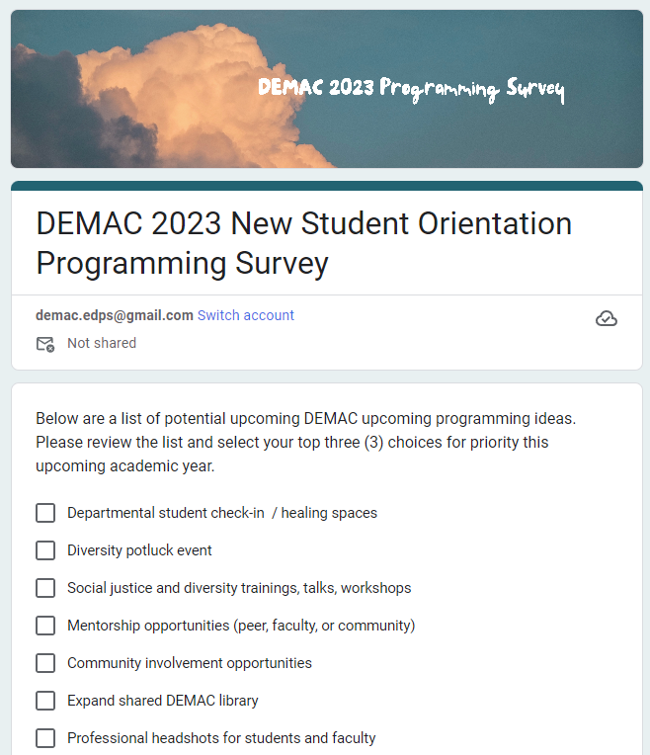
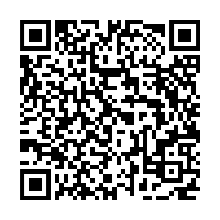
What would you like to see next?
EVERY PERSON AND EVERY INTERACTION MATTERS
Notes:
Rin

Slide 82
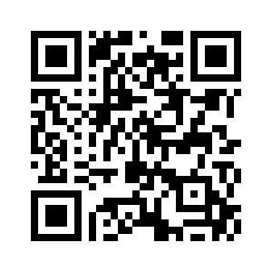
Connect with us!
You may say I’m a dreamer, but I’m not the only one.
Follow us on Facebook at @unl.demac
EVERY PERSON AND EVERY INTERACTION MATTERS
Notes:
Rin

Slide 83
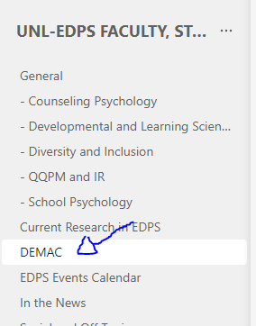
Connect with us. Welcome to DEMAC!
You may say I’m a dreamer, but I’m not the only one.
Check the EDPS Teams page for news, updates, reminders, photos, and opportunities to get involved!
EVERY PERSON AND EVERY INTERACTION MATTERS
Notes:
Rin

Slide 84
8. Research Opportunity
Notes:
Jay

Slide 85
Frequent Student Feedback to Graduate Teaching Assistants
Please participate in our study!
Investigators: Om Joshi, Jay Jeffries, Justin Andersson, PhD, Eric Buhs, PhD
Notes:
Jay

Slide 86
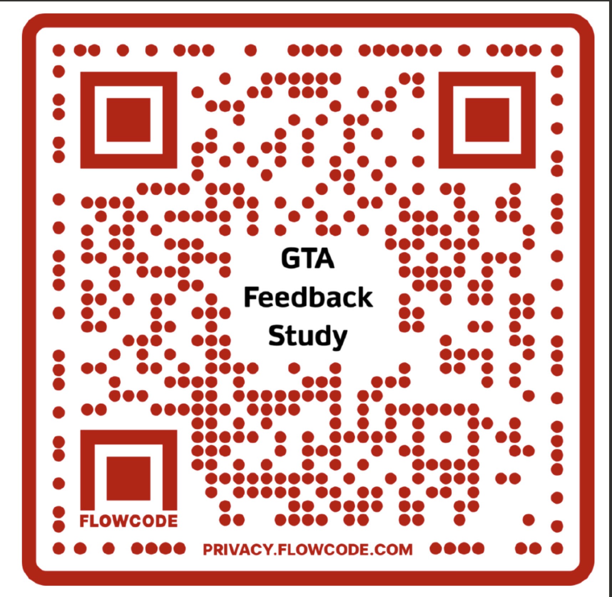
Study Invitation Dear University of Nebraska-Lincoln Graduate Student, We are conducting a study on the effects of frequent student feedback to their graduate teaching assistant (GTA) during an academic semester. You are eligible to participate if you are at least 17 years old, a GTA at UNL who is teaching an undergraduate course for the College of Education and Human Sciences and are currently residing in the United States. Compensation Participating GTAs will receive a $50 Visa gift card. Please scan the QR code to express your interest, Or contact Om Joshi om.joshi@huskers.unl.edu, Jay Jeffries jayjeffries13@huskers.unl.edu, Justin Andersson jandersson@unomaha.edu with questions.
Notes:
Jay

Slide 87
References
You may say I’m a dreamer, but I’m not the only one.
Lennon, J. (1971). Imagine [Recorded by J. Lennon]. Imagine [Vinyl]. London, UK: Abbey Road Studios.
The University of Nebraska (2018). Academic Integrity. Retrieved from: https://www.unl.edu/gradstudies/current/integrity
University of Nebraska Office of Graduate Studies (2008). Types of plagiarism. Retrieved Aug. 15th, 2018, from:
https://www.unl.edu/gradstudies/current/news/types-plagiarism
Turnitin (2017). Plagiarism.org. Retrieved Aug. 15th, 2018, from: https://www.plagiarism.org/
Wakefield, A.J, Murch, S.H., Anthony, A., Linnel,J. Casson, D.M., Malik, M….& Walker-Smith, J.A. (1998). Ileal-lymphoid-nodular hyperplasia, non-specific colitis, and pervasive developmental disorder in children. The Lancet, 637-641.
EVERY PERSON AND EVERY INTERACTION MATTERS
Notes:
Sue.
Here some references from today.

Slide 88
You Can Do It!!!!
Notes:
Sue

