Slide 1
Transfer New Student Enrollment
College of Education and Human Sciences

Slide 2
ADVISING IN CEHS
HOW
WHEN
Assigned a professional advisor
Individual advising appointments
Walk-in Wednesdays
Priority registration
Adding a new degree component
Struggling in classes
Education abroad
Undergraduate research

Slide 3
WHATS NEXT
MEET WITH AN ADVISOR
REGISTER FOR CLASSES
Learn about your major
Select appropriate classes for upcoming semester
Send final transcripts
Course registration
Class scheduler
Return to advising room, if needed
Assigned advisor with check your schedule & email you after NSE

Slide 4
TIPS FOR CLASS SCHEDULING
Classes vary by credit hours
Classes can have multiple components
Lectures – labs – recitations
Not all classes run the full semester
Be Flexible
Choose on-line classes carefully
Hybrid – on campus testing – fully online
Class location
CITY, EAST, INNOVATION CAMPUS

Slide 5
DEGREE COMPONENTS
ACHIEVEMENT CENTER EDUCATION (ACE)
MAJOR REQUIREMENTS
ELECTIVES
STUDENTS MUST EARN 120 CREDIT HOURS TO GRADUATE FROM UNL

Slide 6
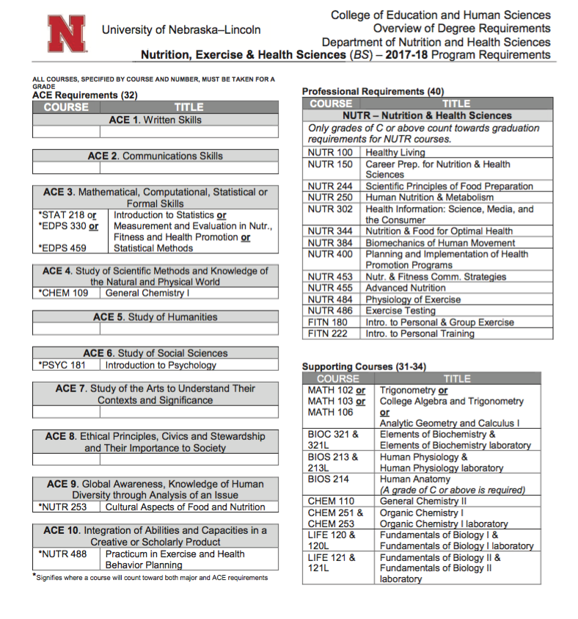
PROGRAM SHEET

Slide 7
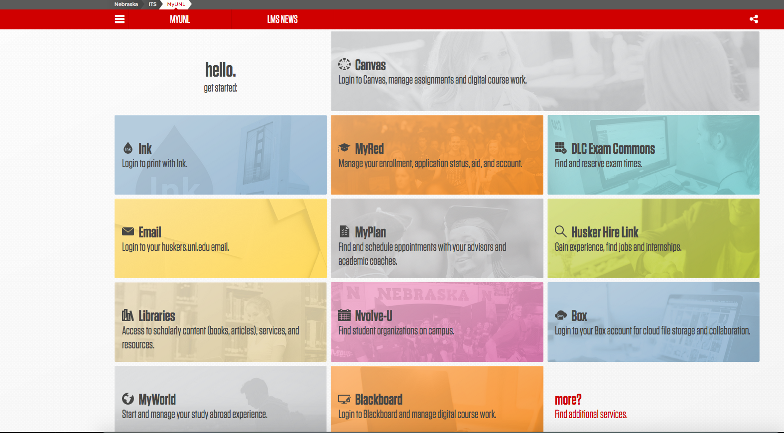
MAKE APPOINTMENTS & LEARN MORE ABOUT CAMPUS SERVICES ON:
MYPLAN
Assigned Academic Advisor
Career Services
First- Year Experience & Students in Transition Office

Slide 8
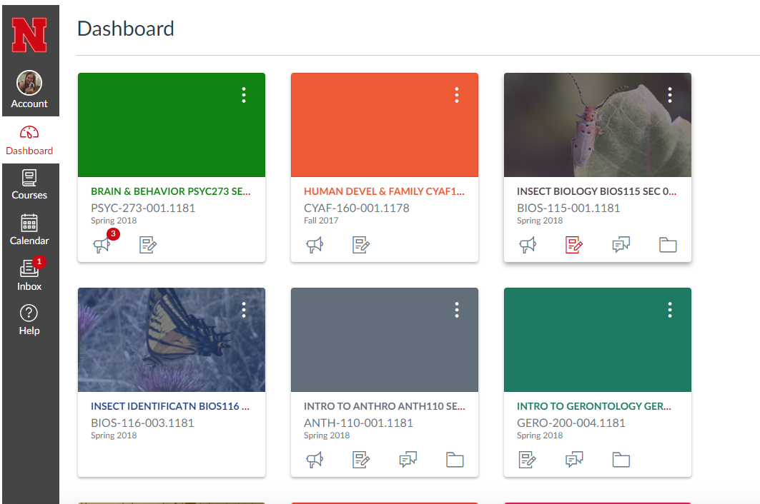
CANVAS

Slide 9
ACADEMIC INTEGRITY
UNL expects academic honesty for all students at all times.
Honesty and Responsibility for your own work
Resources
Writing Center
Chemistry Resource Center
Math Resource Center
UNL Libraries
Study stops

Slide 10
GETTING INVOLVED
Student Organizations
SEAN
Student Advisory Board
Ambassadors
Study Abroad with CEHS 2020
India
Indonesia
Finland & Estonia
Japan
Amsterdam

Slide 12
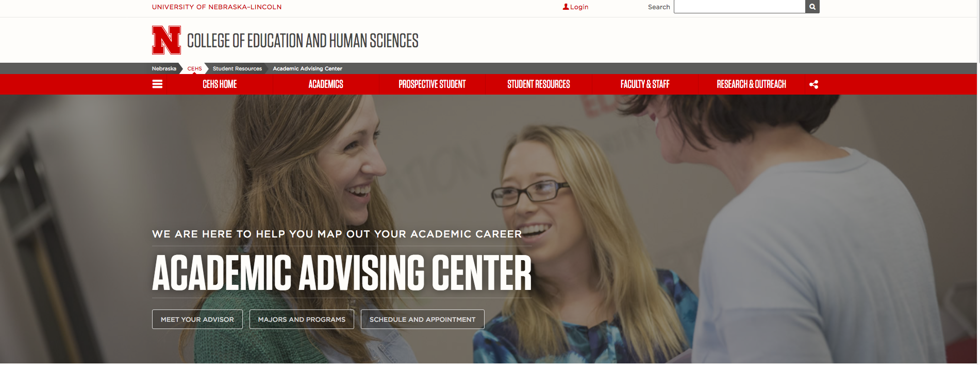
INFORMATION OVERLOAD
Where do I go to find answers after today?
Use search feature on UNL Website
Still can’t find it? Let your advisor know, they can assist.

