Slide 1
Transfer New student enrollment 2018
College of education & human sciences

Slide 2
What's Next ?
Meet with an advisor
Register for classes
Learn about your major
Select appropriate classes for fall
Reminder to Send Final transcripts
Course registration
Return to our advising room if needed
Assigned advisor will check your schedule & email you after NSE

Slide 3
Advising in cehs
how
when
Assigned a professional advisor
Individual advising appointments
Walk-in Wednesdays
Priority registration
Adding a new degree component
Struggling in classes
Education abroad
Undergraduate research
Notes:
We are your one stop shop
You will see us on your NSE tour ☺
Appointments versus walk-ins

Slide 4
TIPS for class scheduling
Classes vary by credit hours
Classes can have multiple components
Lectures – labs – recitations
Not all classes run the full semester
Be Flexible
Choose on-line classes carefully
Hybrid – on campus testing – fully online
Classes location
East & city campus

Slide 5
Degree components
Achievement centered education (ACE)
Major requirements
Electives
Students must earn 120 credit hours to graduate from UNL
Notes:
120 to graduate
Four year graduation - full schedule if that is your goal
Small majors versus large majors

Slide 6
Program sheet

Slide 7
make appointments & learn more about campus services on My Plan
my.unl.edu
Assigned academic advisor
Career services
first-year experience and students in transition

Slide 8
Canvas

Slide 9
Academic Integrity
The University expects academic honesty from students at all times
Honesty and Responsibility for your own work
Resources
Writing Center
Chemistry Resource Center
Math Resource Center
UNL Libraries

Slide 10
Getting involved
STUDENT ORGANIZATIONS
EDUCATION ABROAD – Spring Deadline Oct. 1st
Italy (May) Nicaragua(August)
Greece (Spring Break) Costa Rica (May)
China(May) Brazil (May)
Netherlands (June) South Africa(July)
Belize (Spring Break) South Korea (June-July)
Indonesia(Spring Break) Northern Europe (May)
Oman &UAE (Spring Break) Zambia (May-June)

Slide 12
Our goal is your goal! we look forward to seeing you at graduation!
College of education and human sciences advising center
located in 105 henzlik hall

Slide 13
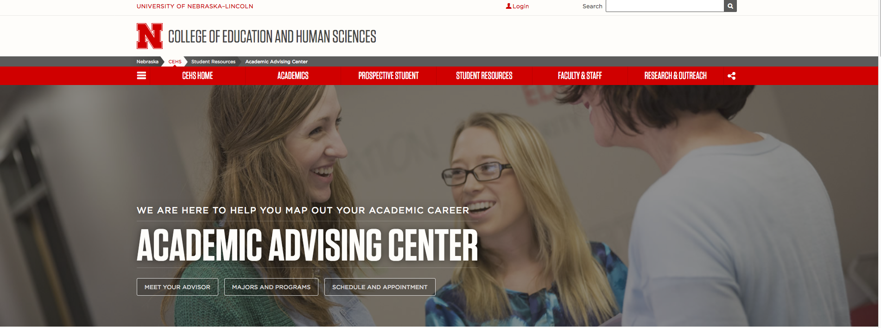
Information overload? Where do I go to find answers after today
Use the search feature of the UNL website. All information should be posted online
Still can’t find it? Let your advisor know and we can help out.

