Slide 1
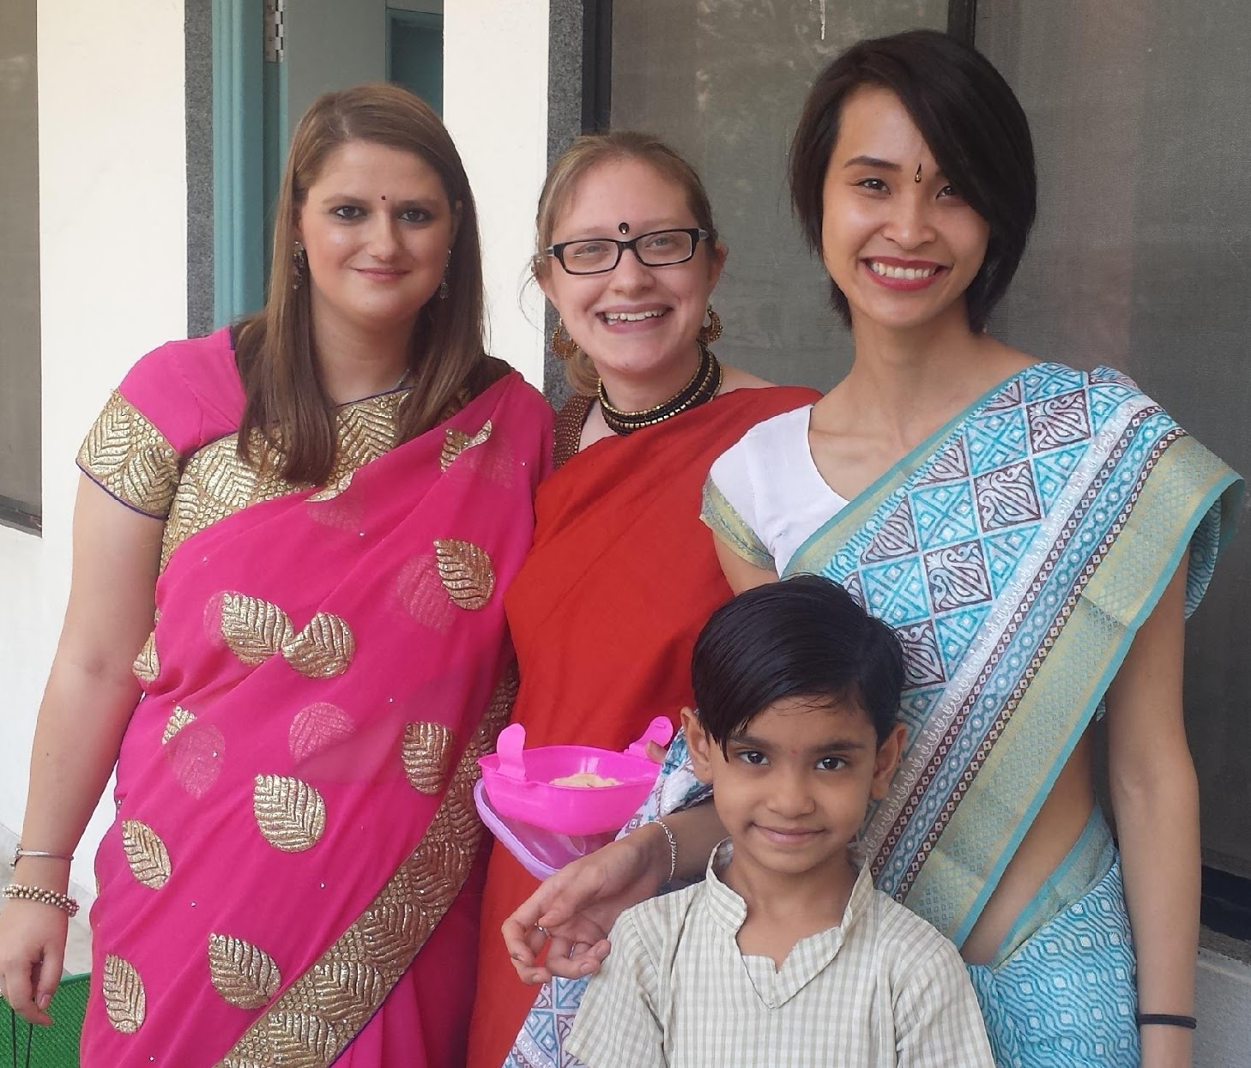
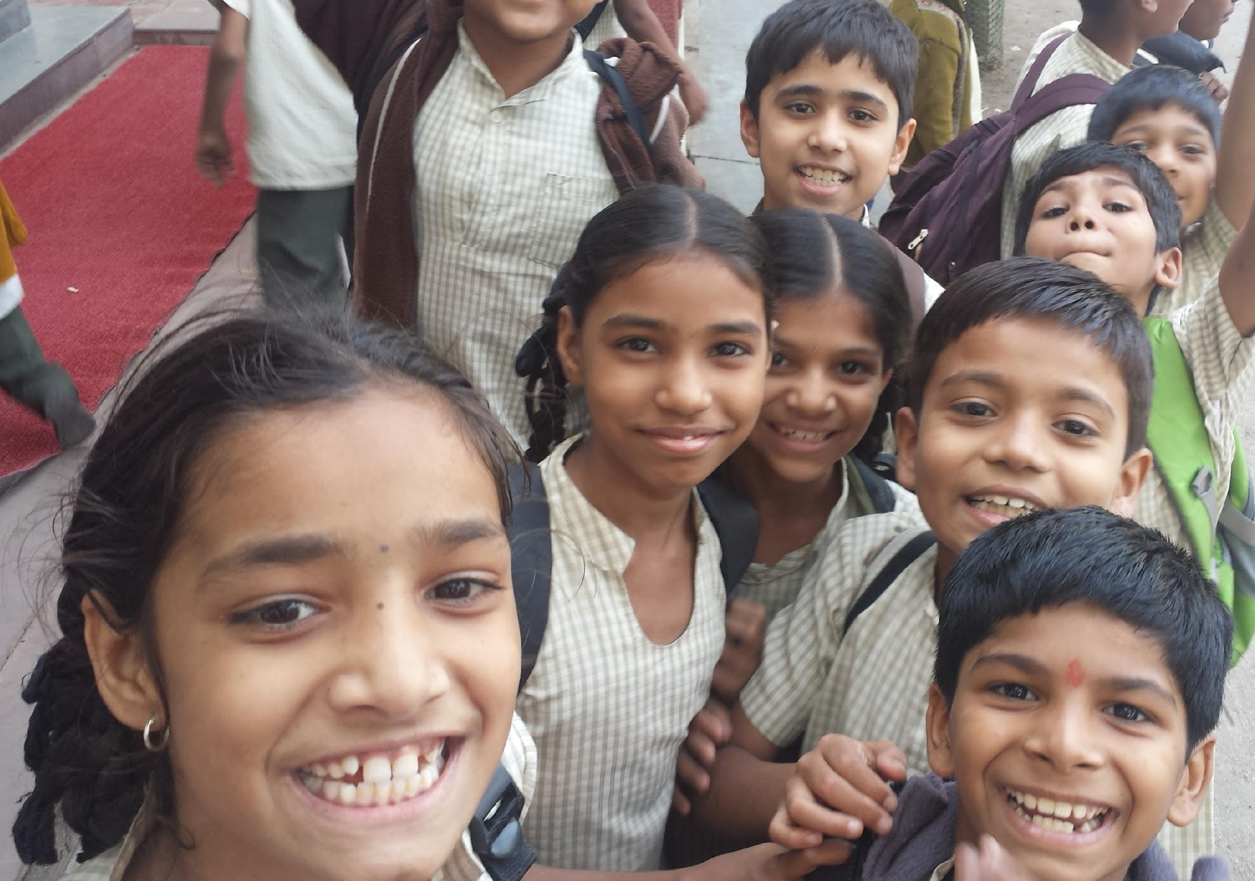
CEHS 2015 India Study Tour: Anubhuti Schools

Slide 2
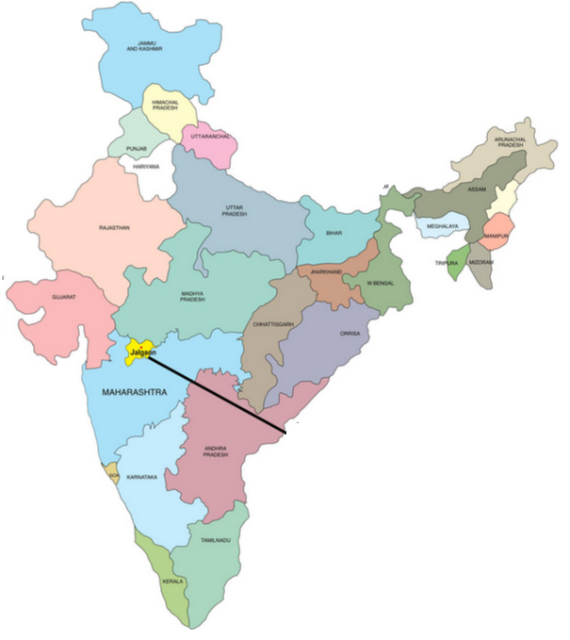
We lived and worked at the Anubhuti schools in Jalgaon, India.

Slide 3
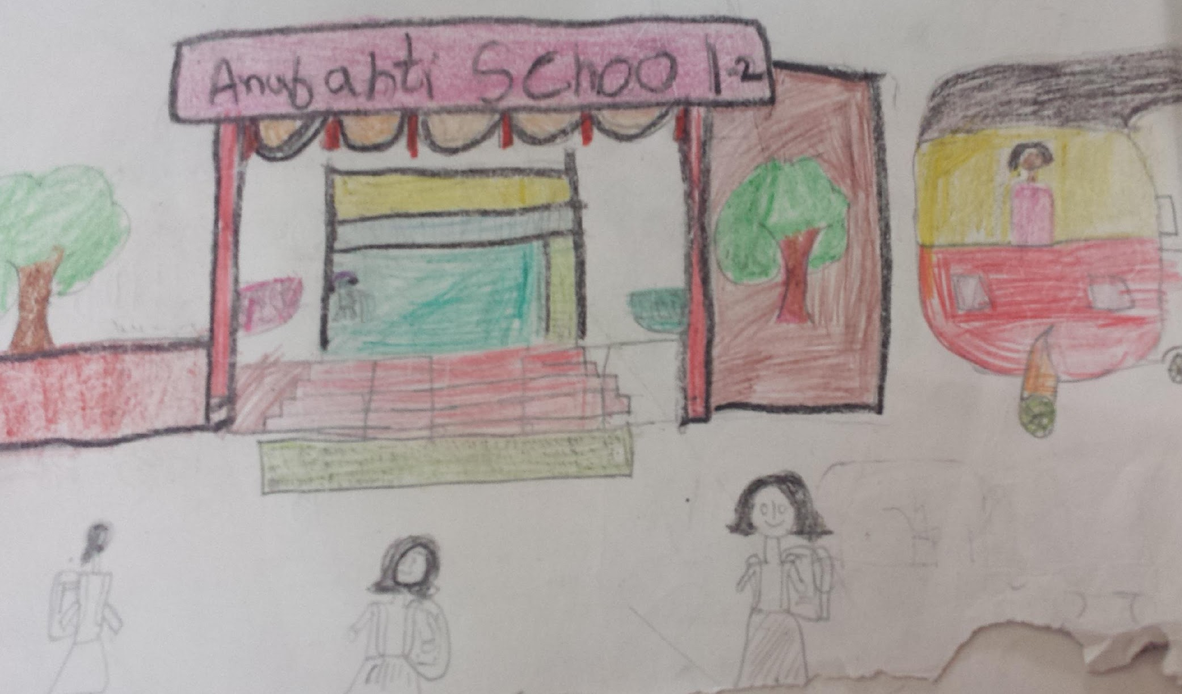
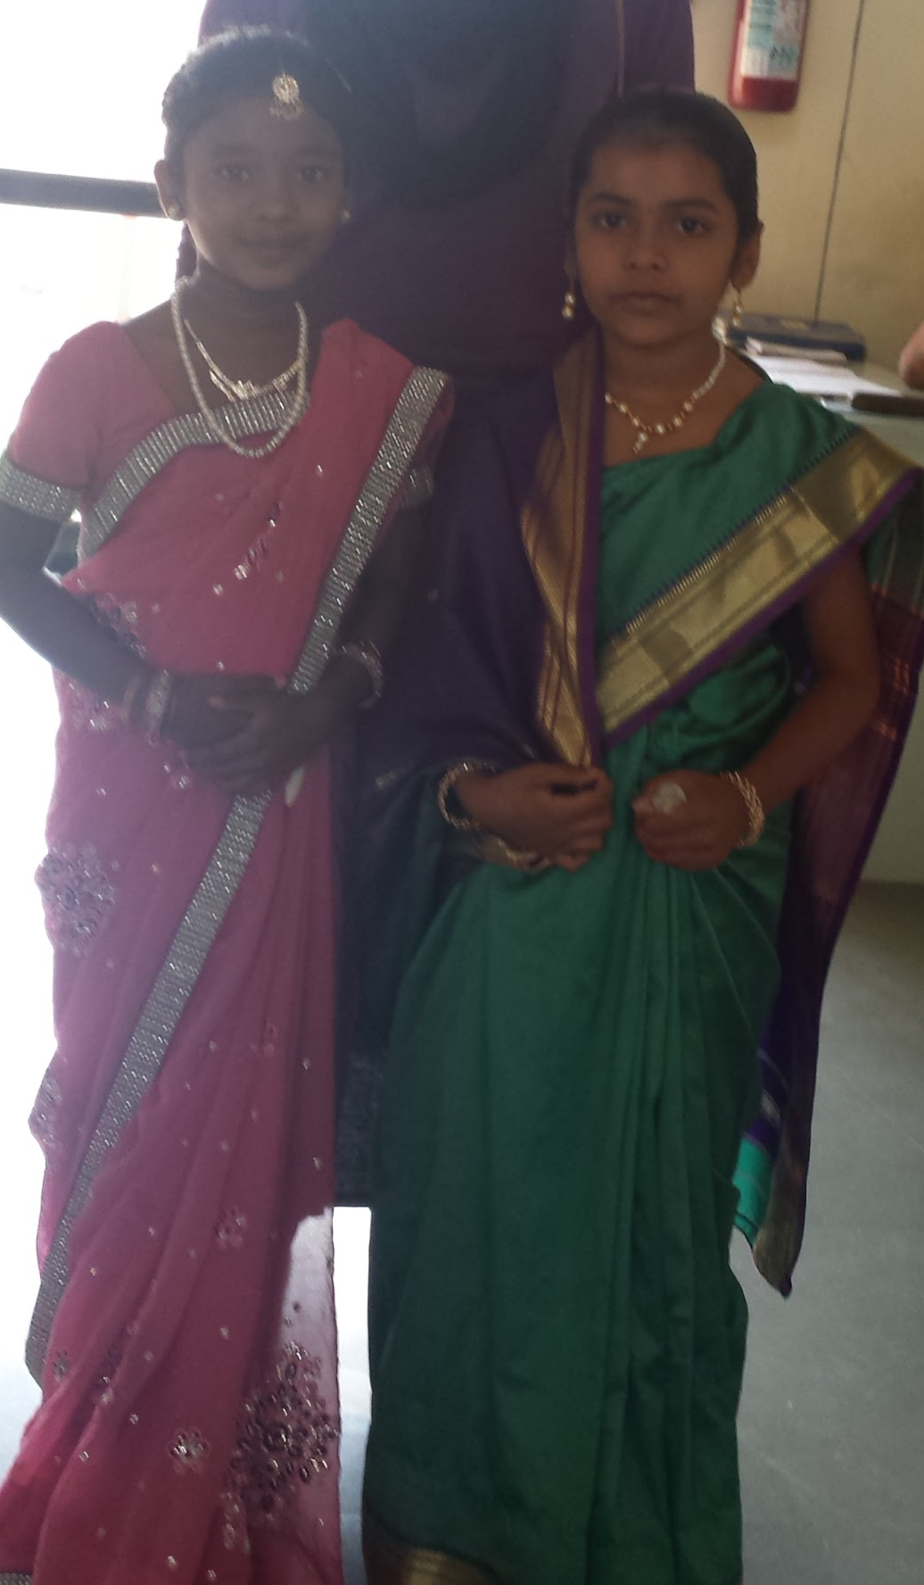
Anubhuti II
Founded by Bhavarlal H. Jain, the chairman of Jain Irrigation
Currently 1st through 5th grade
Accept 30 students 2-3,000 applicants. In other words, students have a 1% chance of getting in.
Notes:
-growing school; expanding as the oldest cohort gets older
-ranking of classes
-fifth grade they start receiving instruction from specialized teachers
-all homeroom teachers female except for 1
-30 students out of 2-3,000 applicants a year
-home visits by GRF to decide who gets in
-4 categories: (1) one or both parents a disability or chronic illness which subsumes a large portion of the family income, (2) slum girl child, (3) slum boy child, (4) intact but “socially backward”—poor. Only are able to accept students from the first three categories.

Slide 4
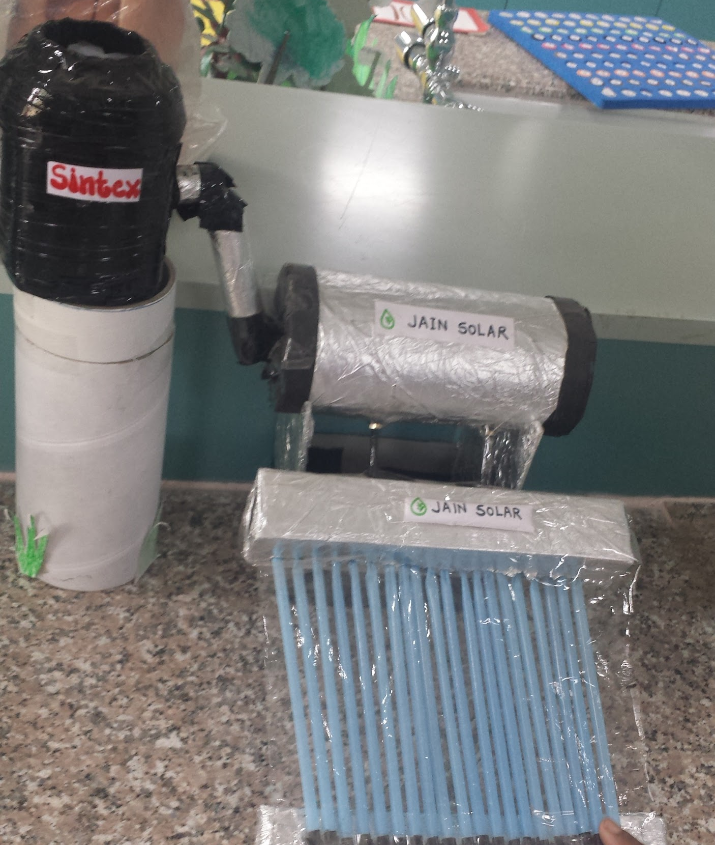
Philosophy of the Anubhuti Schools
Experiential learning
Sense of community and family
Teachers & families live on campus with the students at Anubhuti I
Sustainability
Composting
Cleaning the school
Recycled water & solar panels
Respect for nature (monkeys)
Well-rounded child (will discuss further)

Slide 5
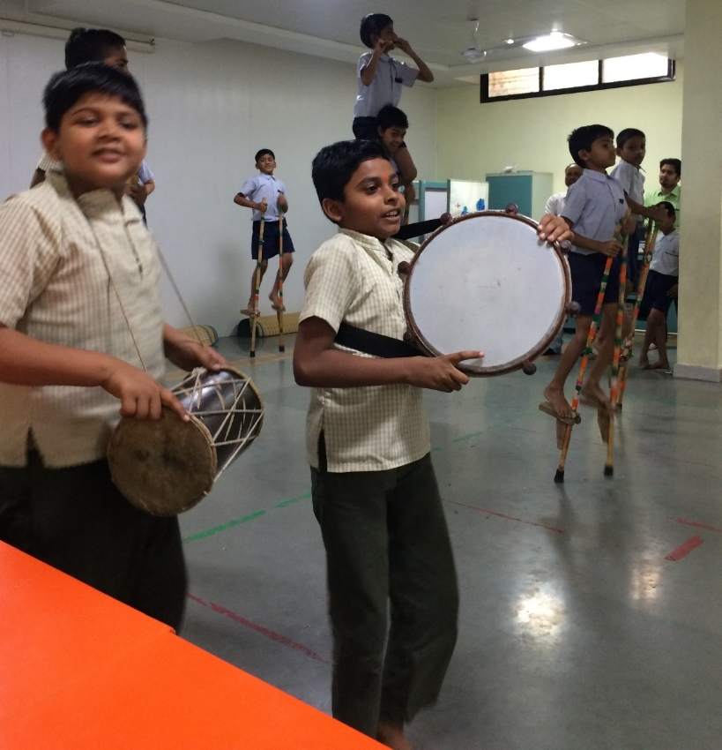
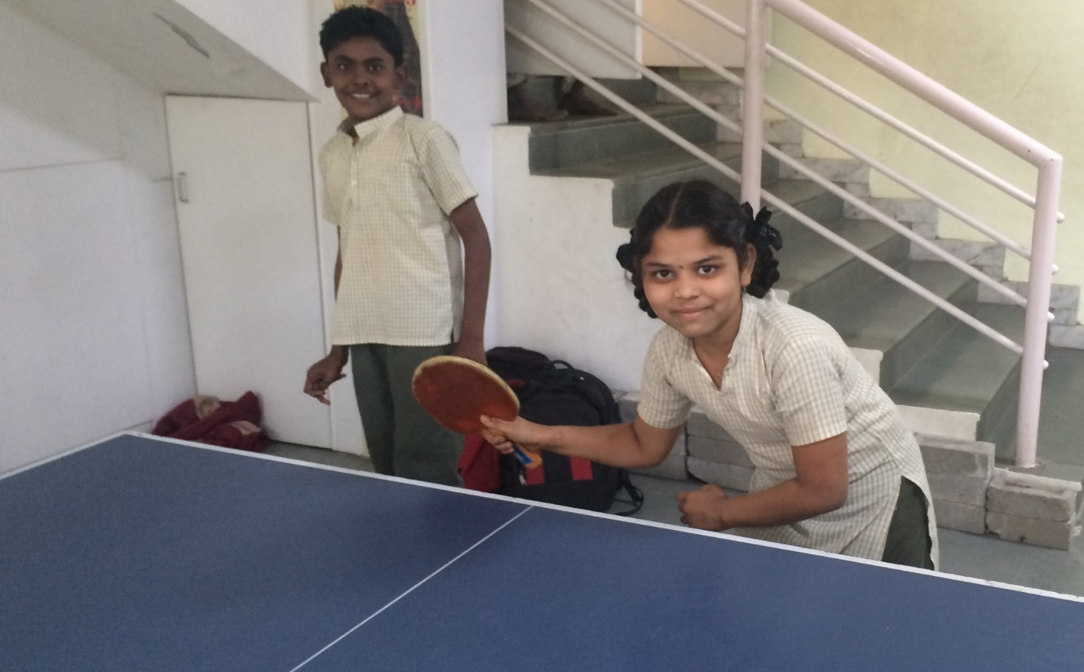
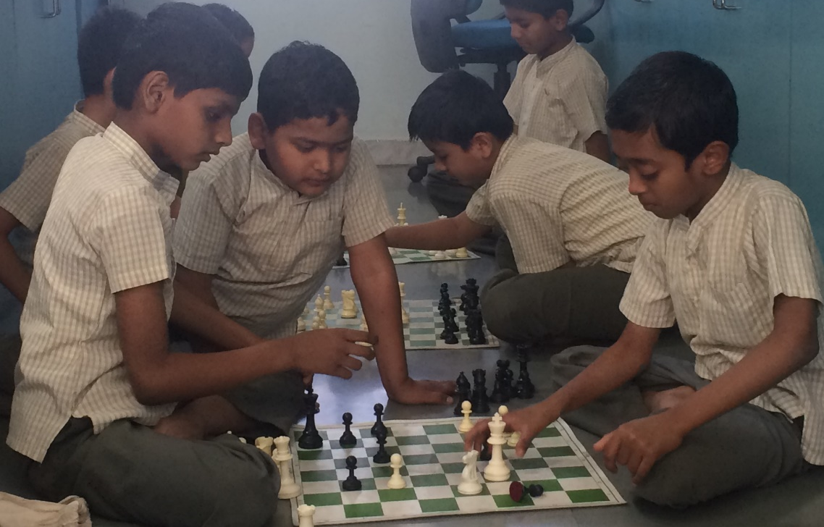
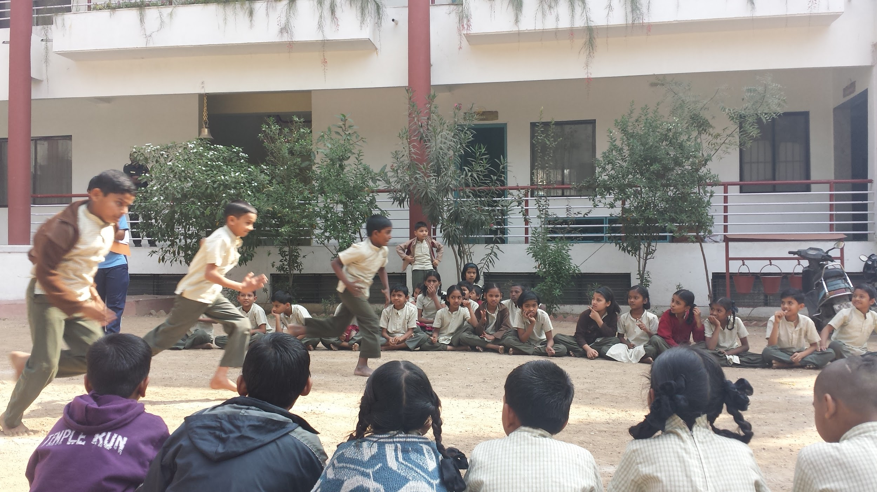
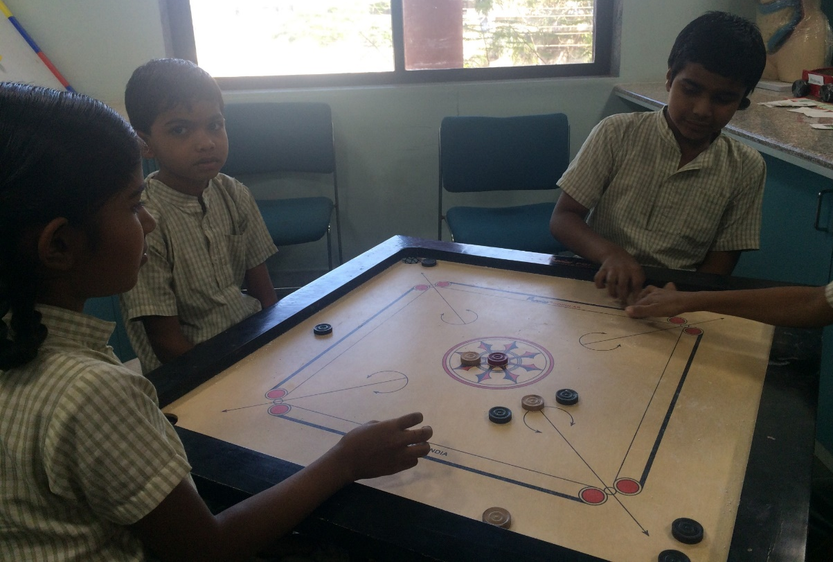
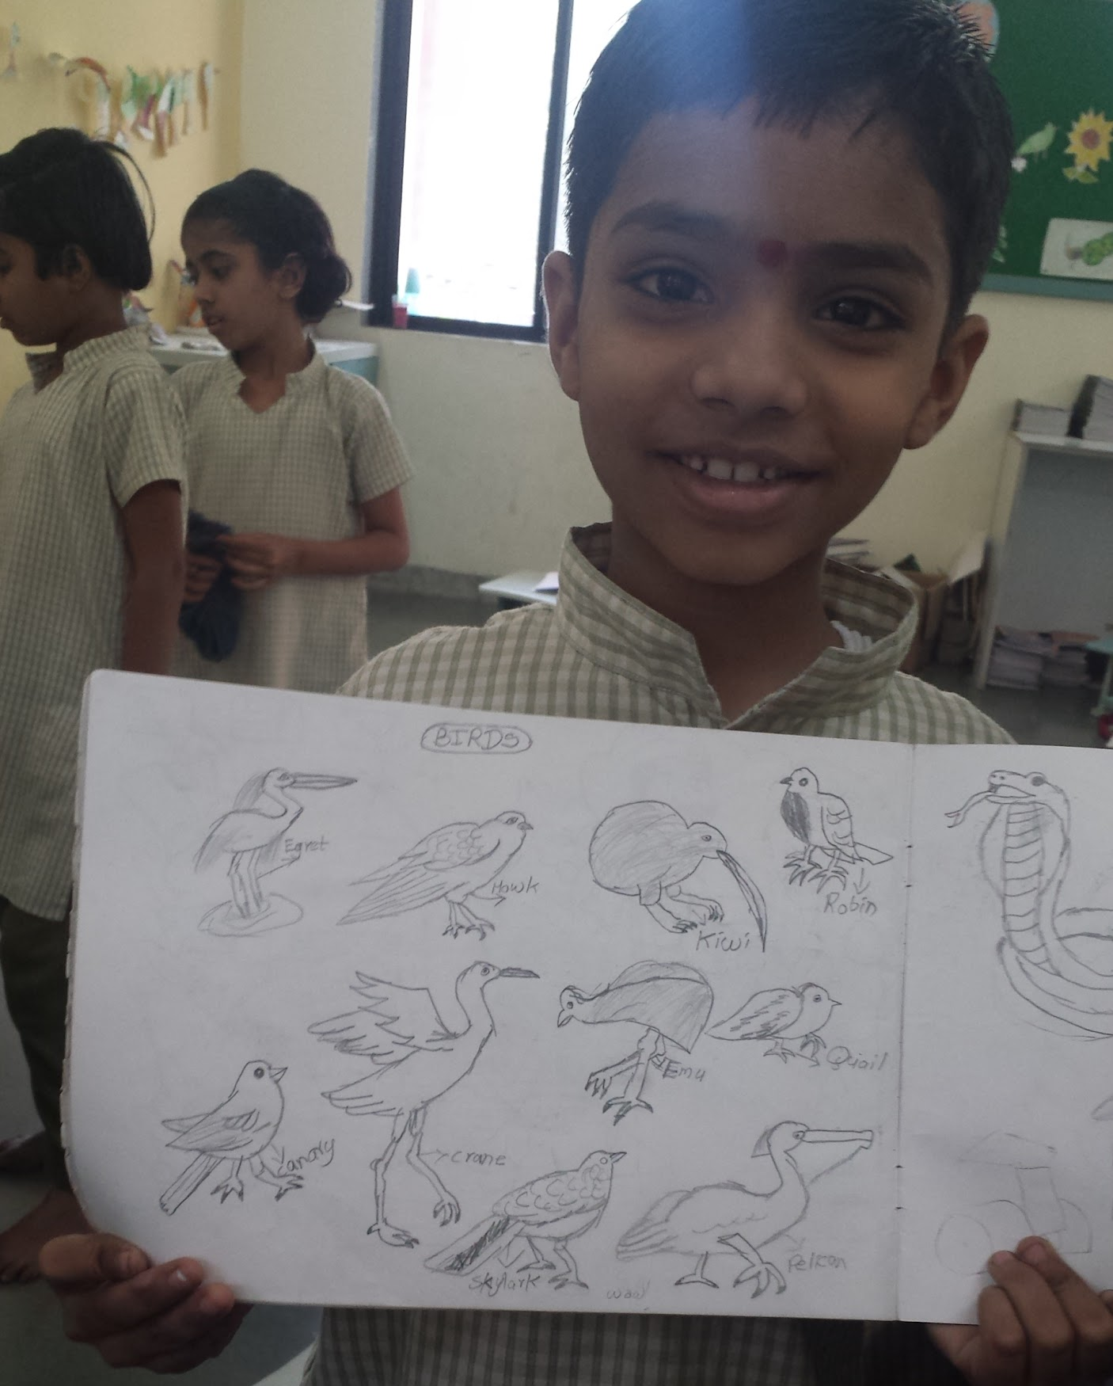
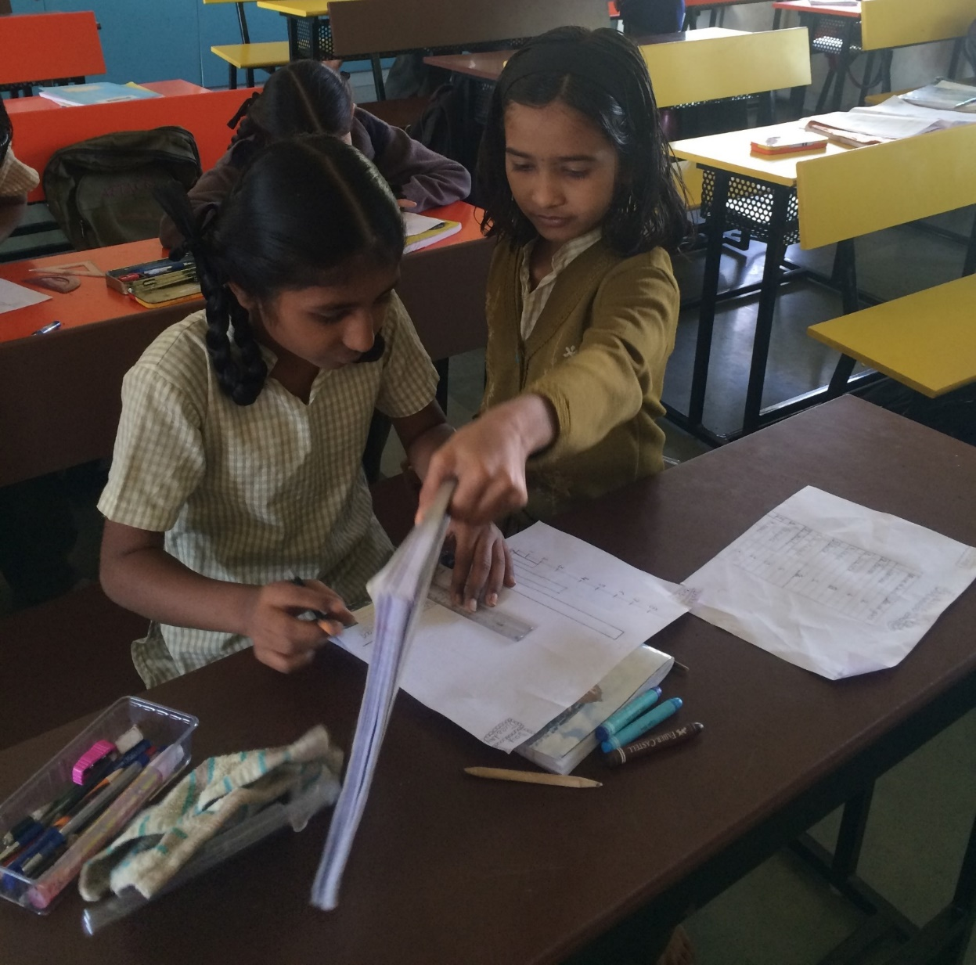

Slide 6
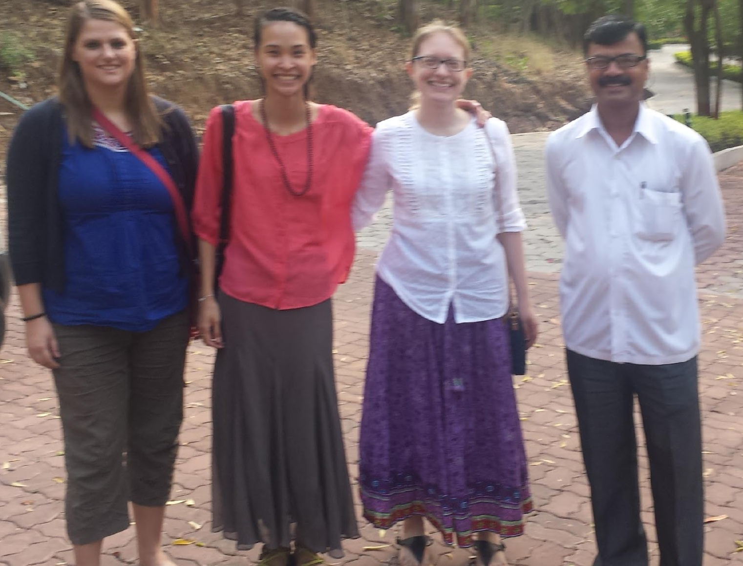
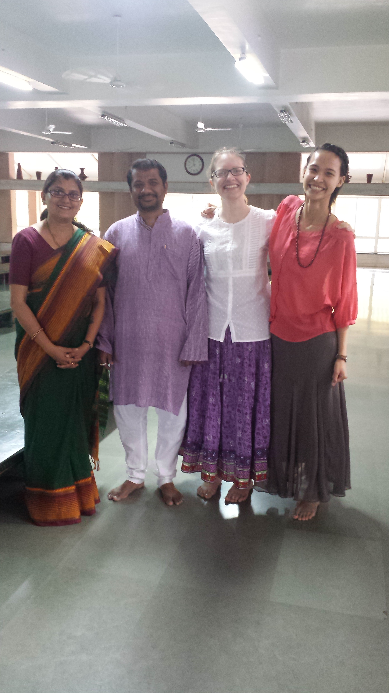
Typical Schedule
7:15-8:00-Breakfast at Anubhuti I
8:15-Pick-up by driver with some of the teachers’ kids
8:30-9:00-Arrival at Anubhuti II/School assembly
9:00-10:20-Classroom observations
10:20-10:30-Banana break
10:30-12:30-Classroom observations
12:30-1:30-Lunchtime with the children
1:30-3:00-Classroom observations
3:00-4:00-Observing extracurricular activities with the children
4:00-Pick-up by driver
4:30-5:00-Snack break with senior class & teachers at Anubhuti I
5:00-7:00-Reflections & schoolwork
7:00-Dinner at Anubhuti I
8:00-bedtime-Schoolwork

Slide 7
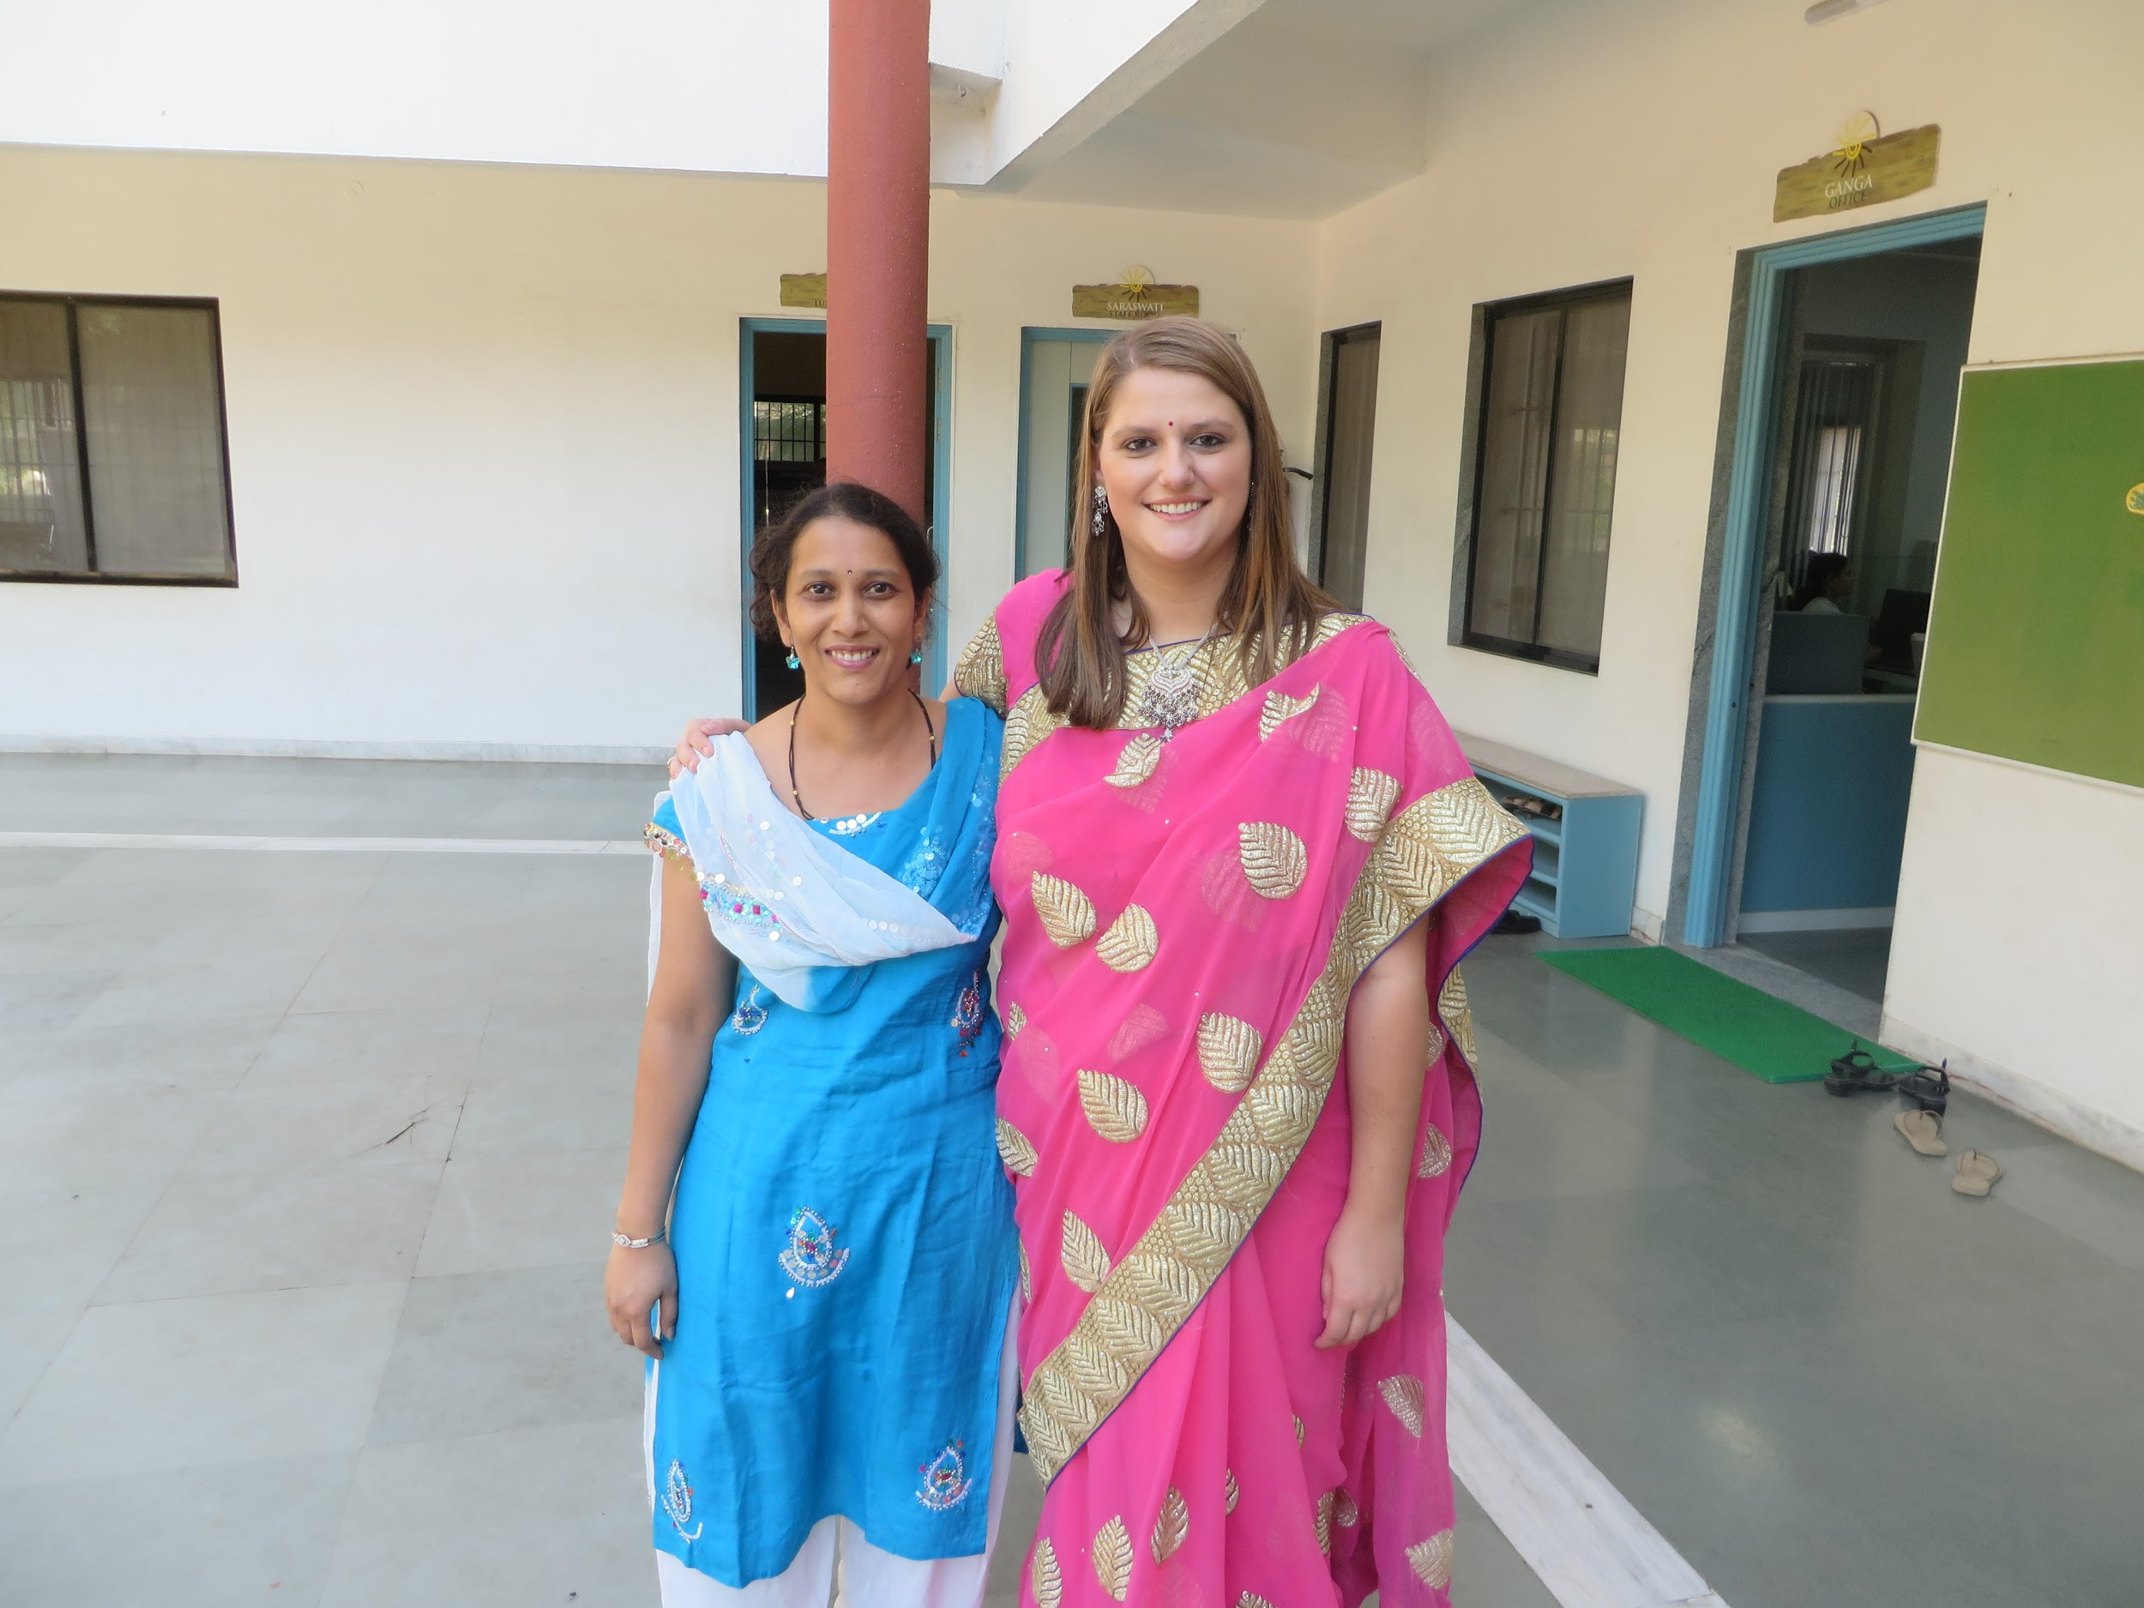
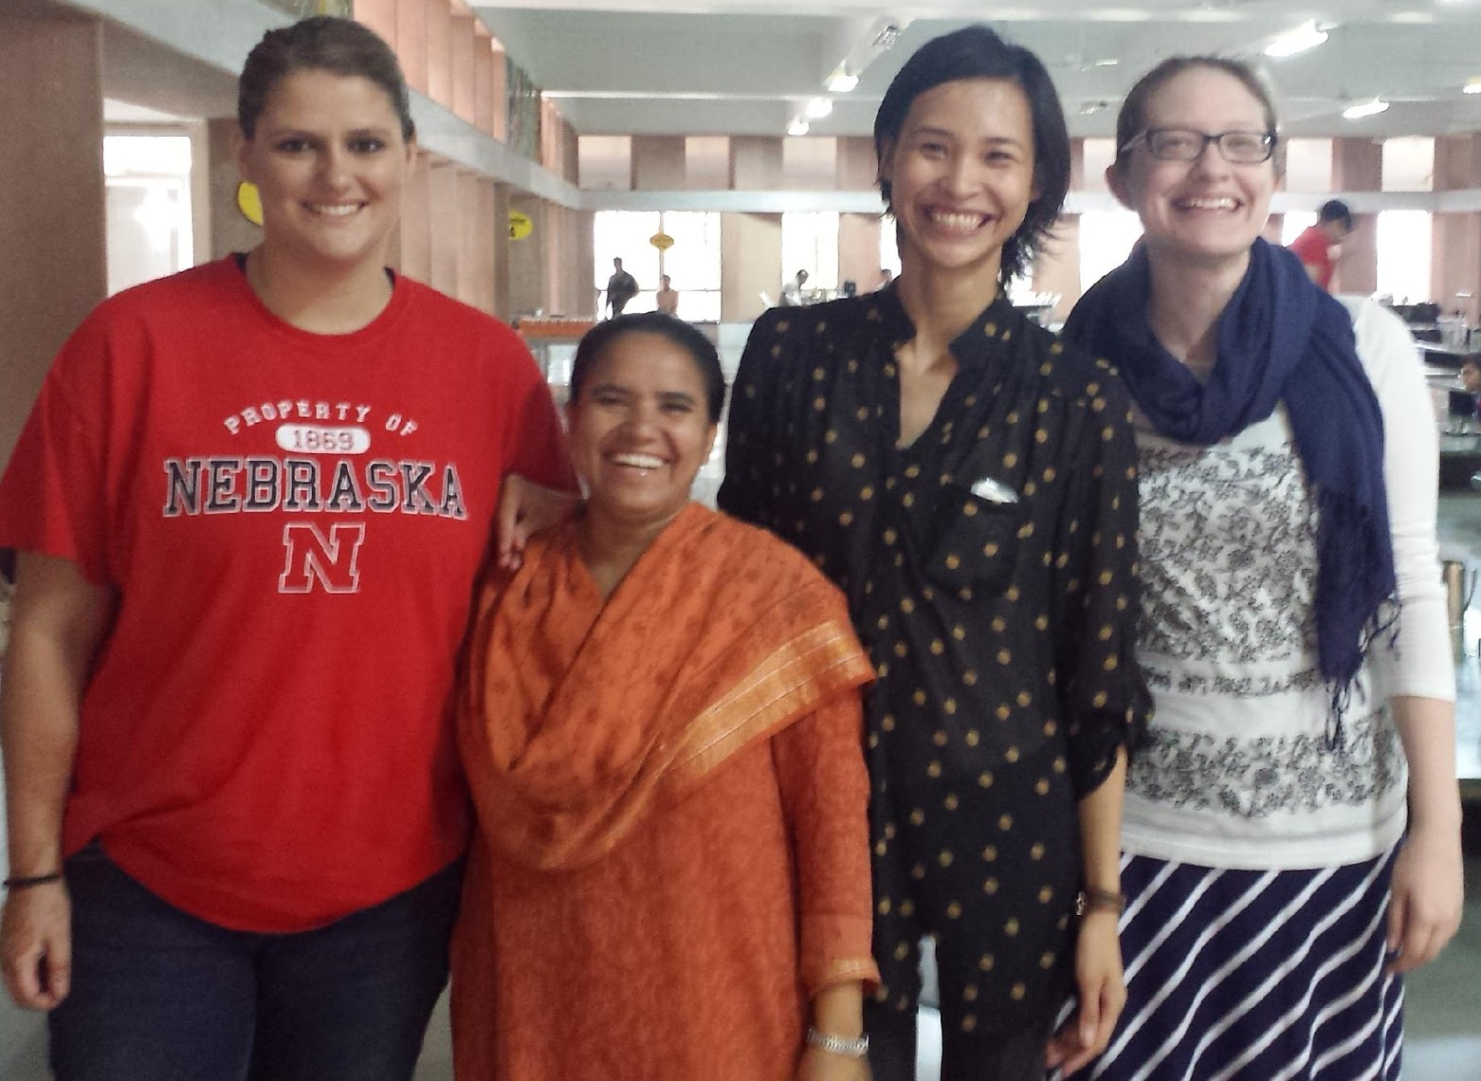
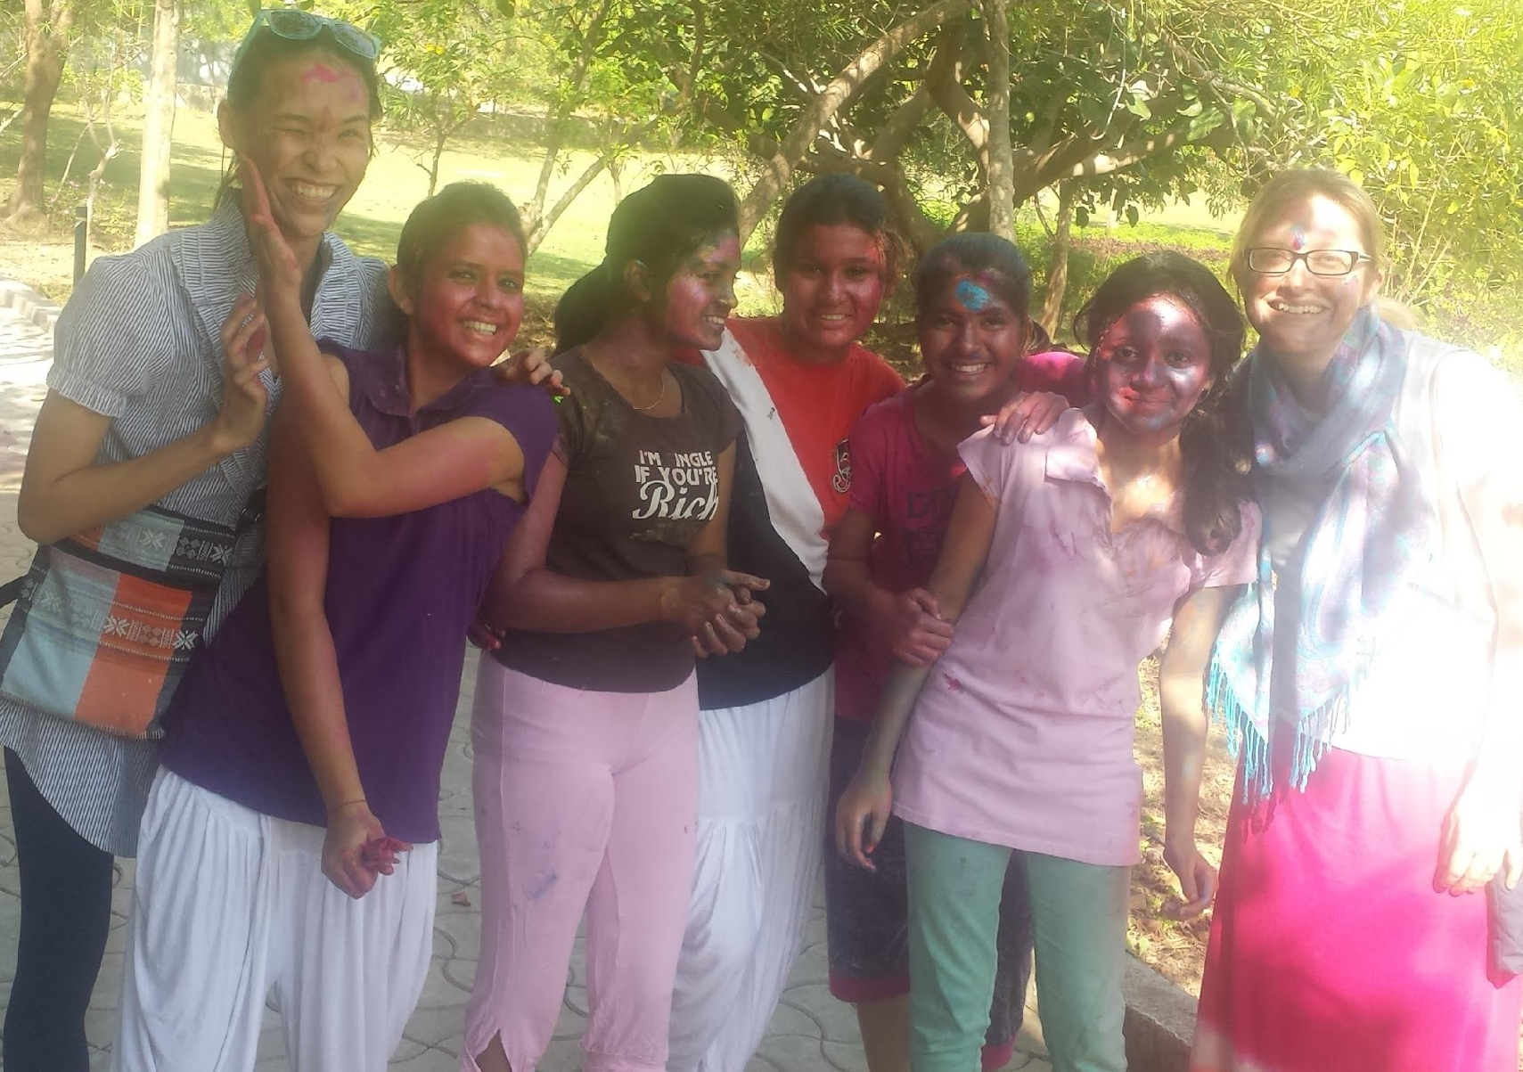
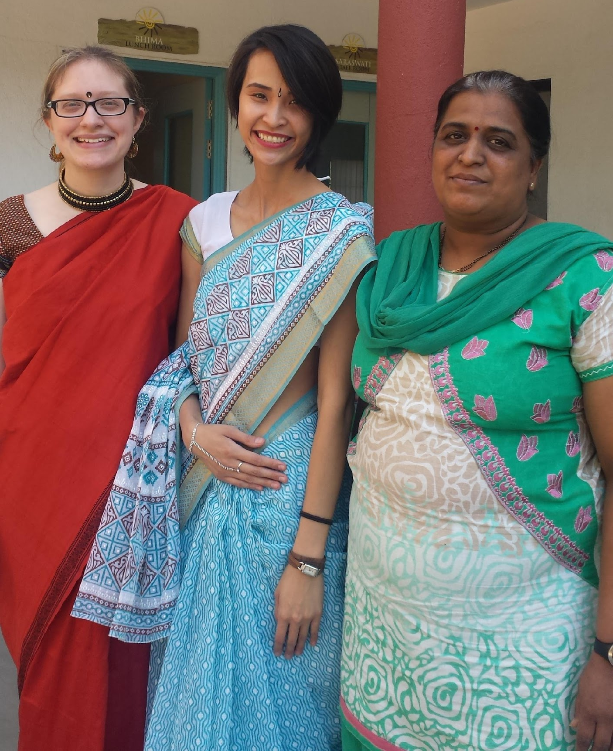
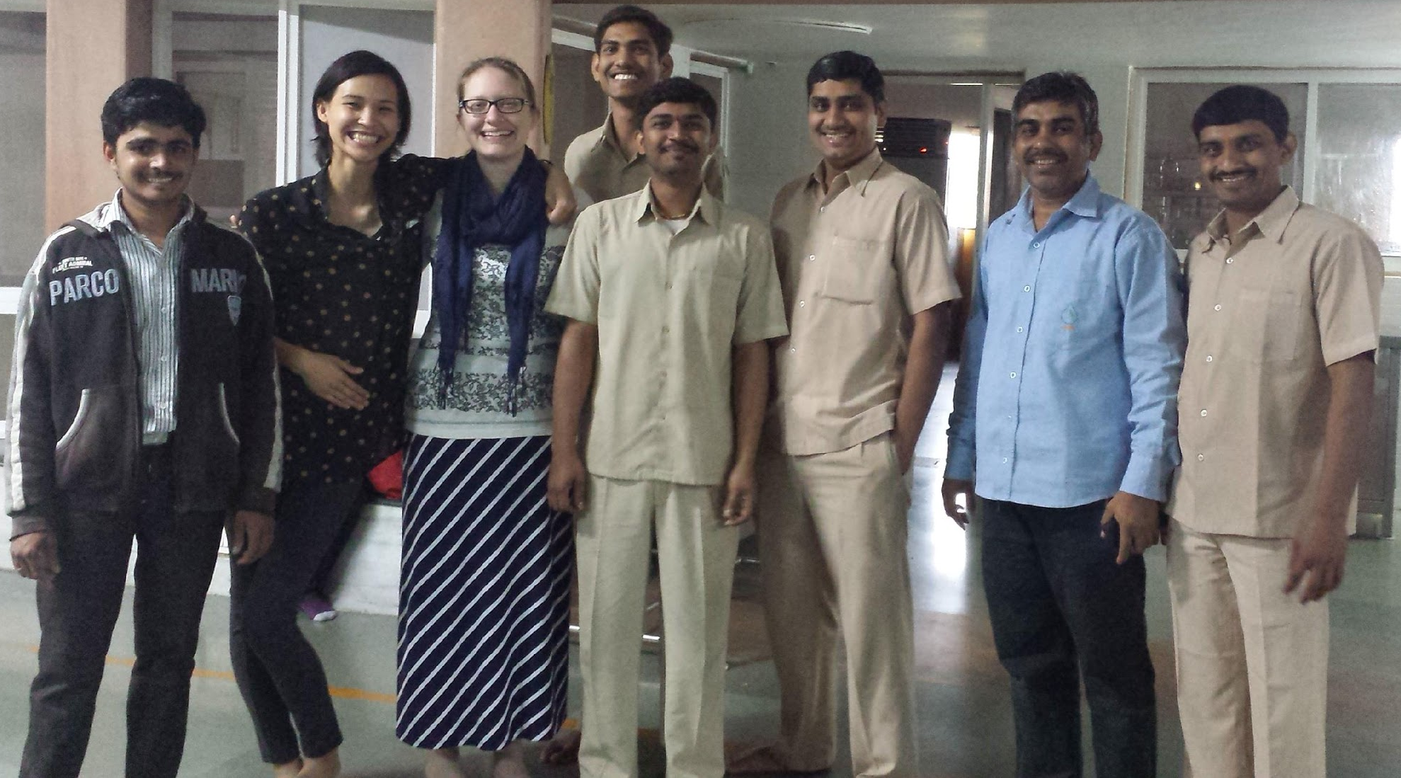
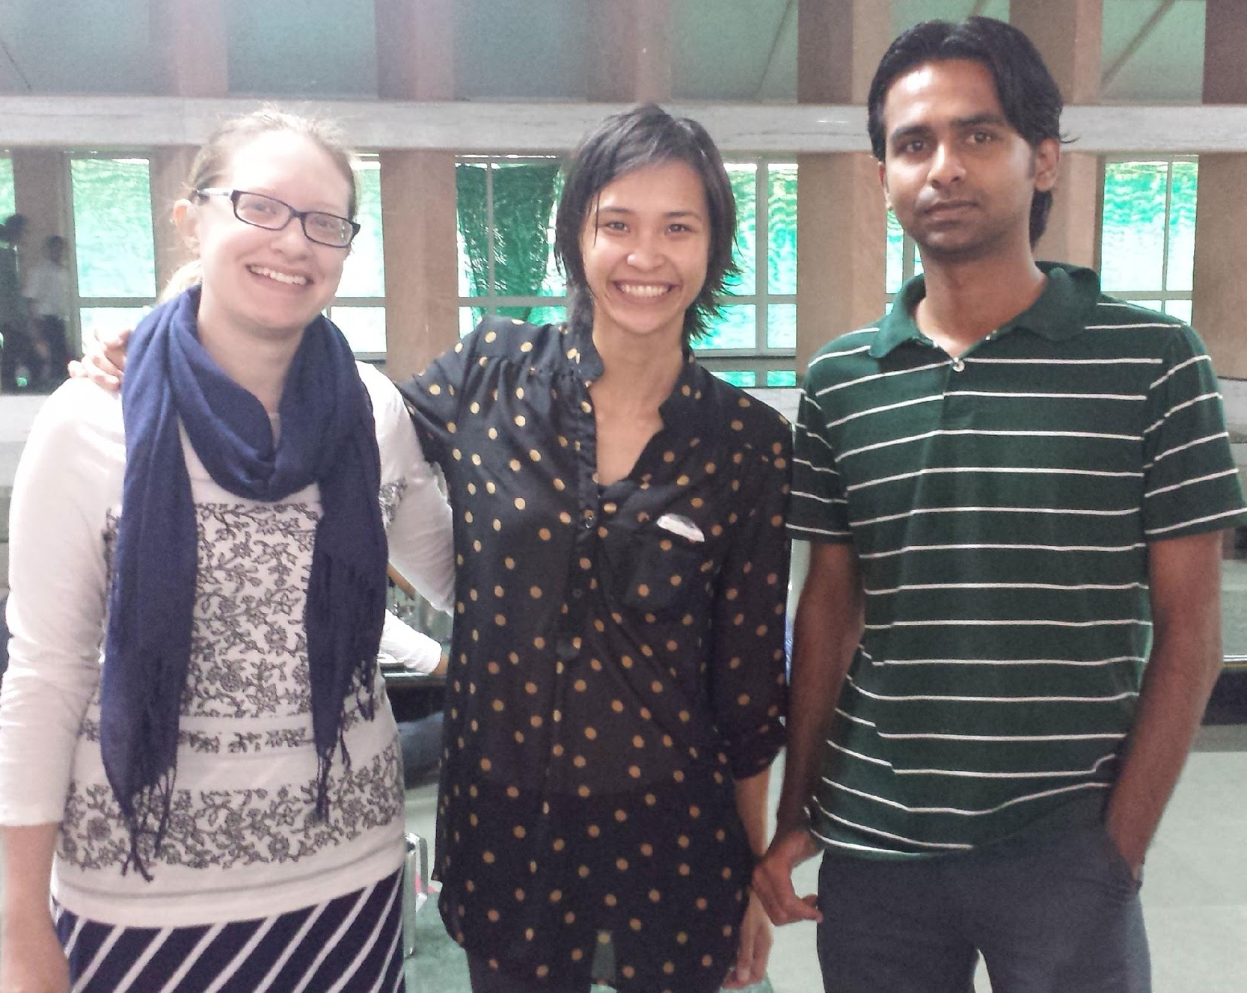
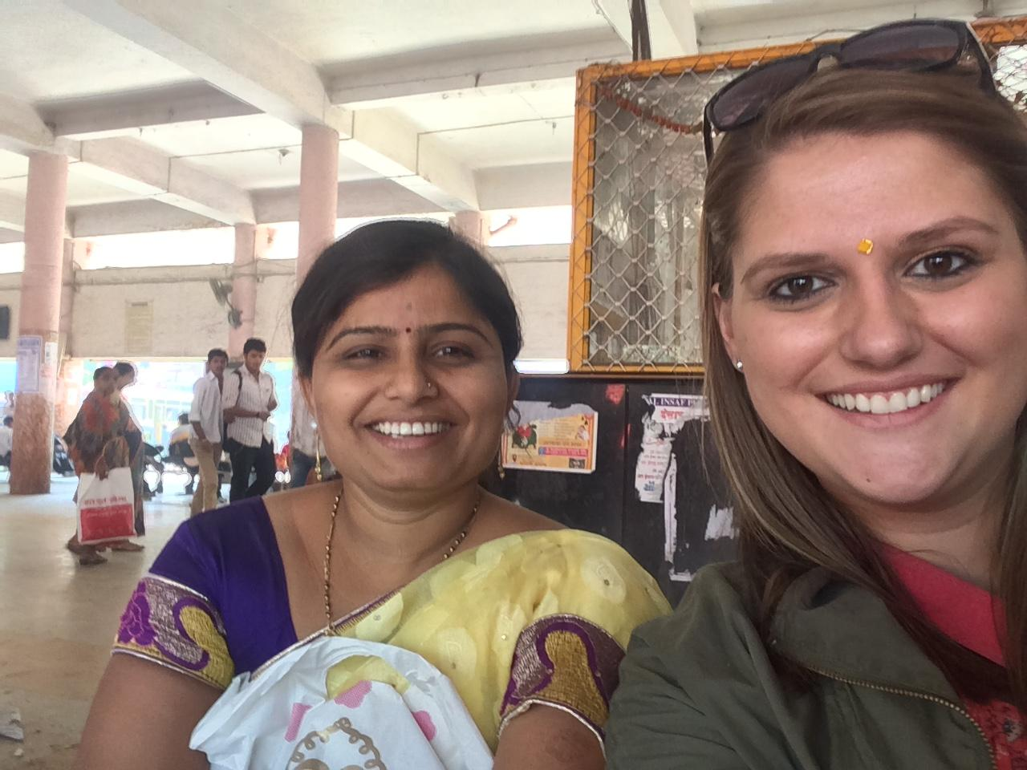
Building
Relationships

Slide 8
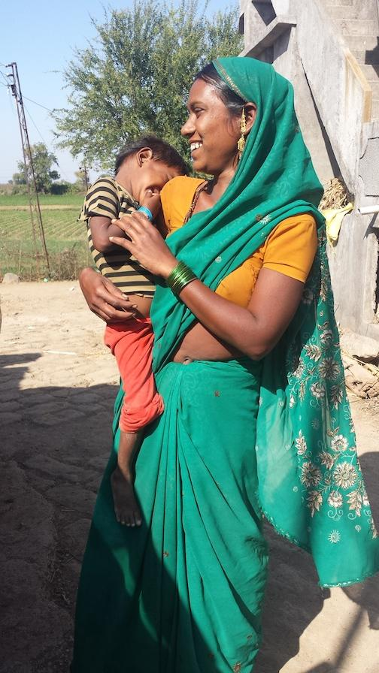
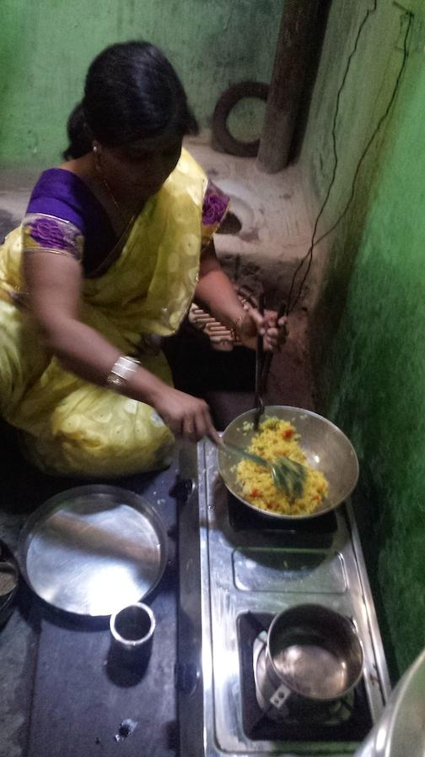
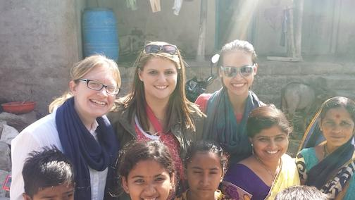
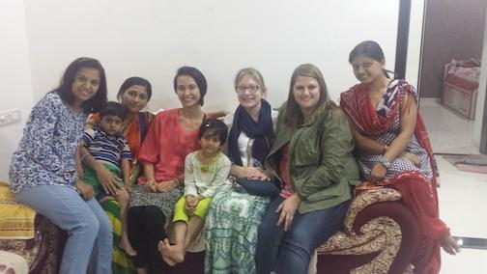
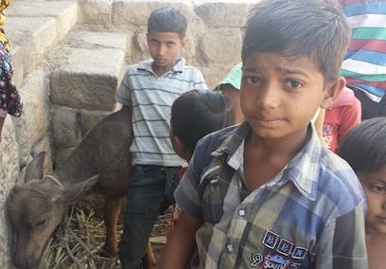
Excursion to Sangita’s Home

Slide 9
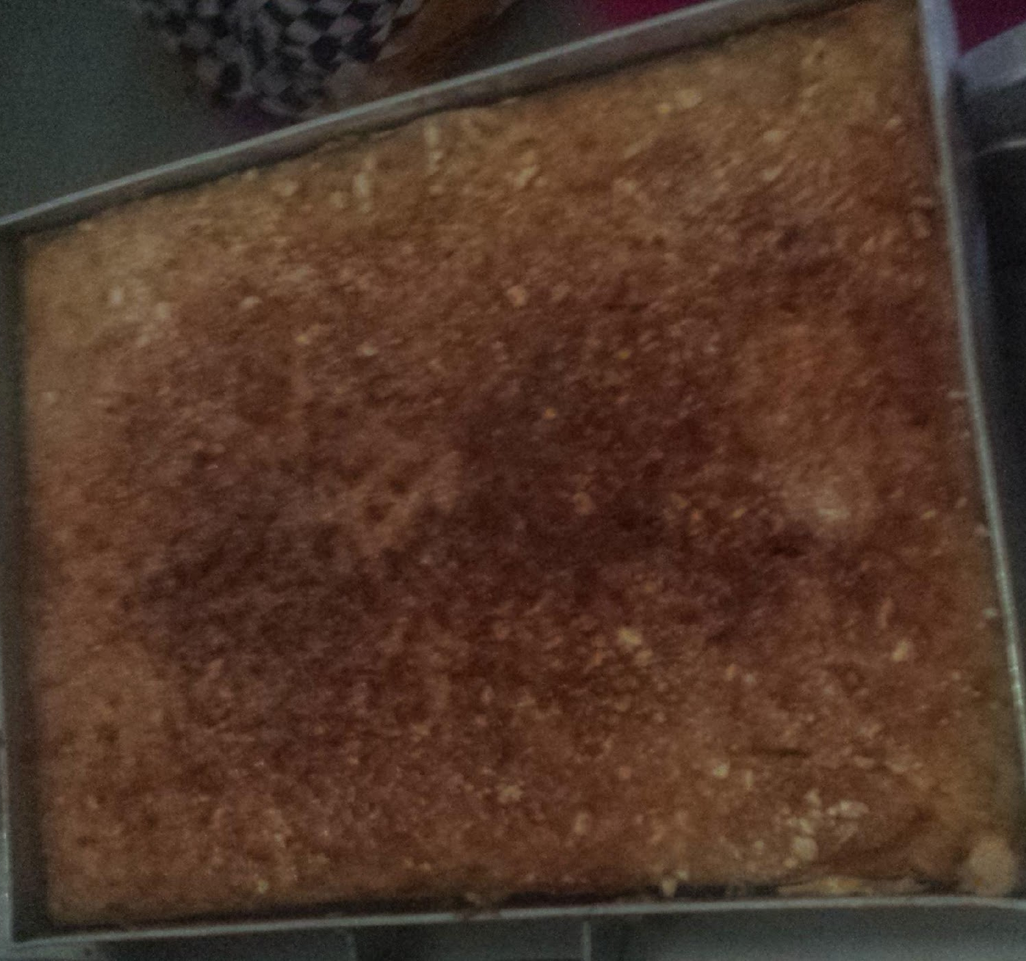
Cooking a Snack for Anubhuti I
Using one of India’s main crops, we made a sweetened banana bread that ended up more like a banana cake.
We developed a relationship with the kitchen staff at Anubhuti I and had the opportunity to have a cultural exchange as we cooked snack for 250-300 students on Holi.

Slide 10
Anubhuti II Home Visits

Slide 11
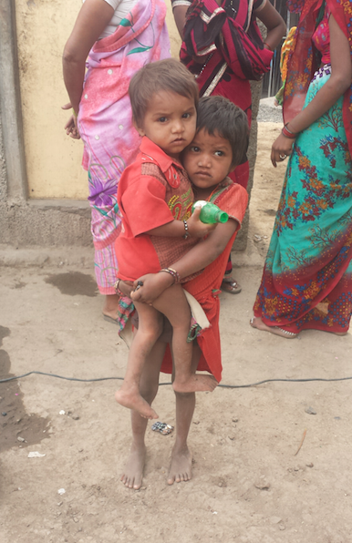

Slide 12
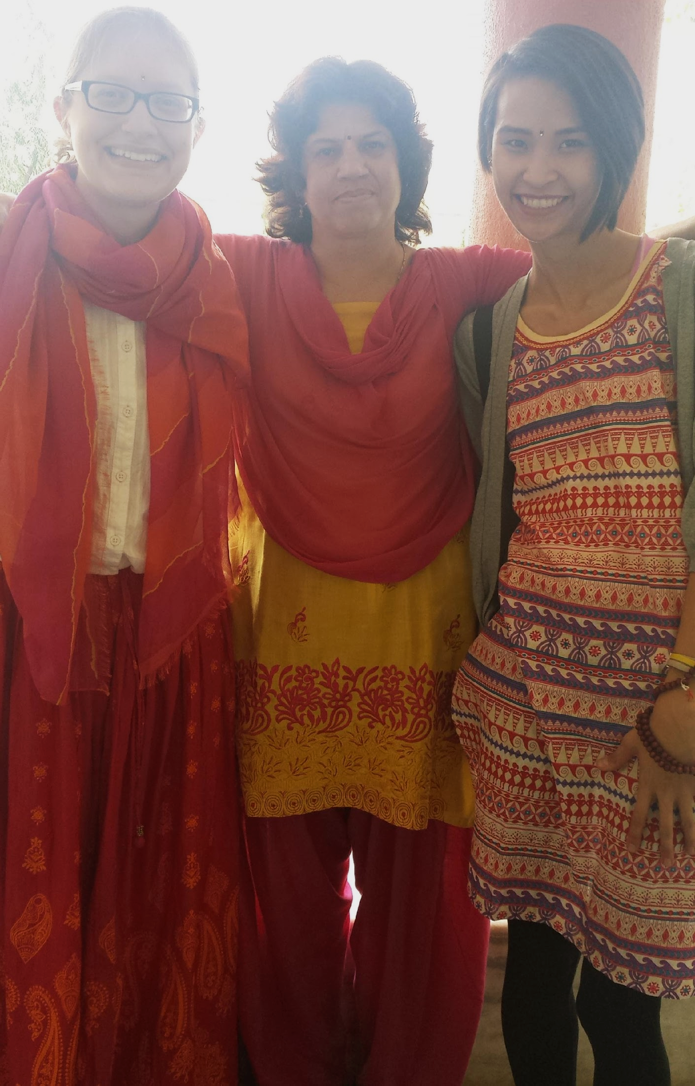
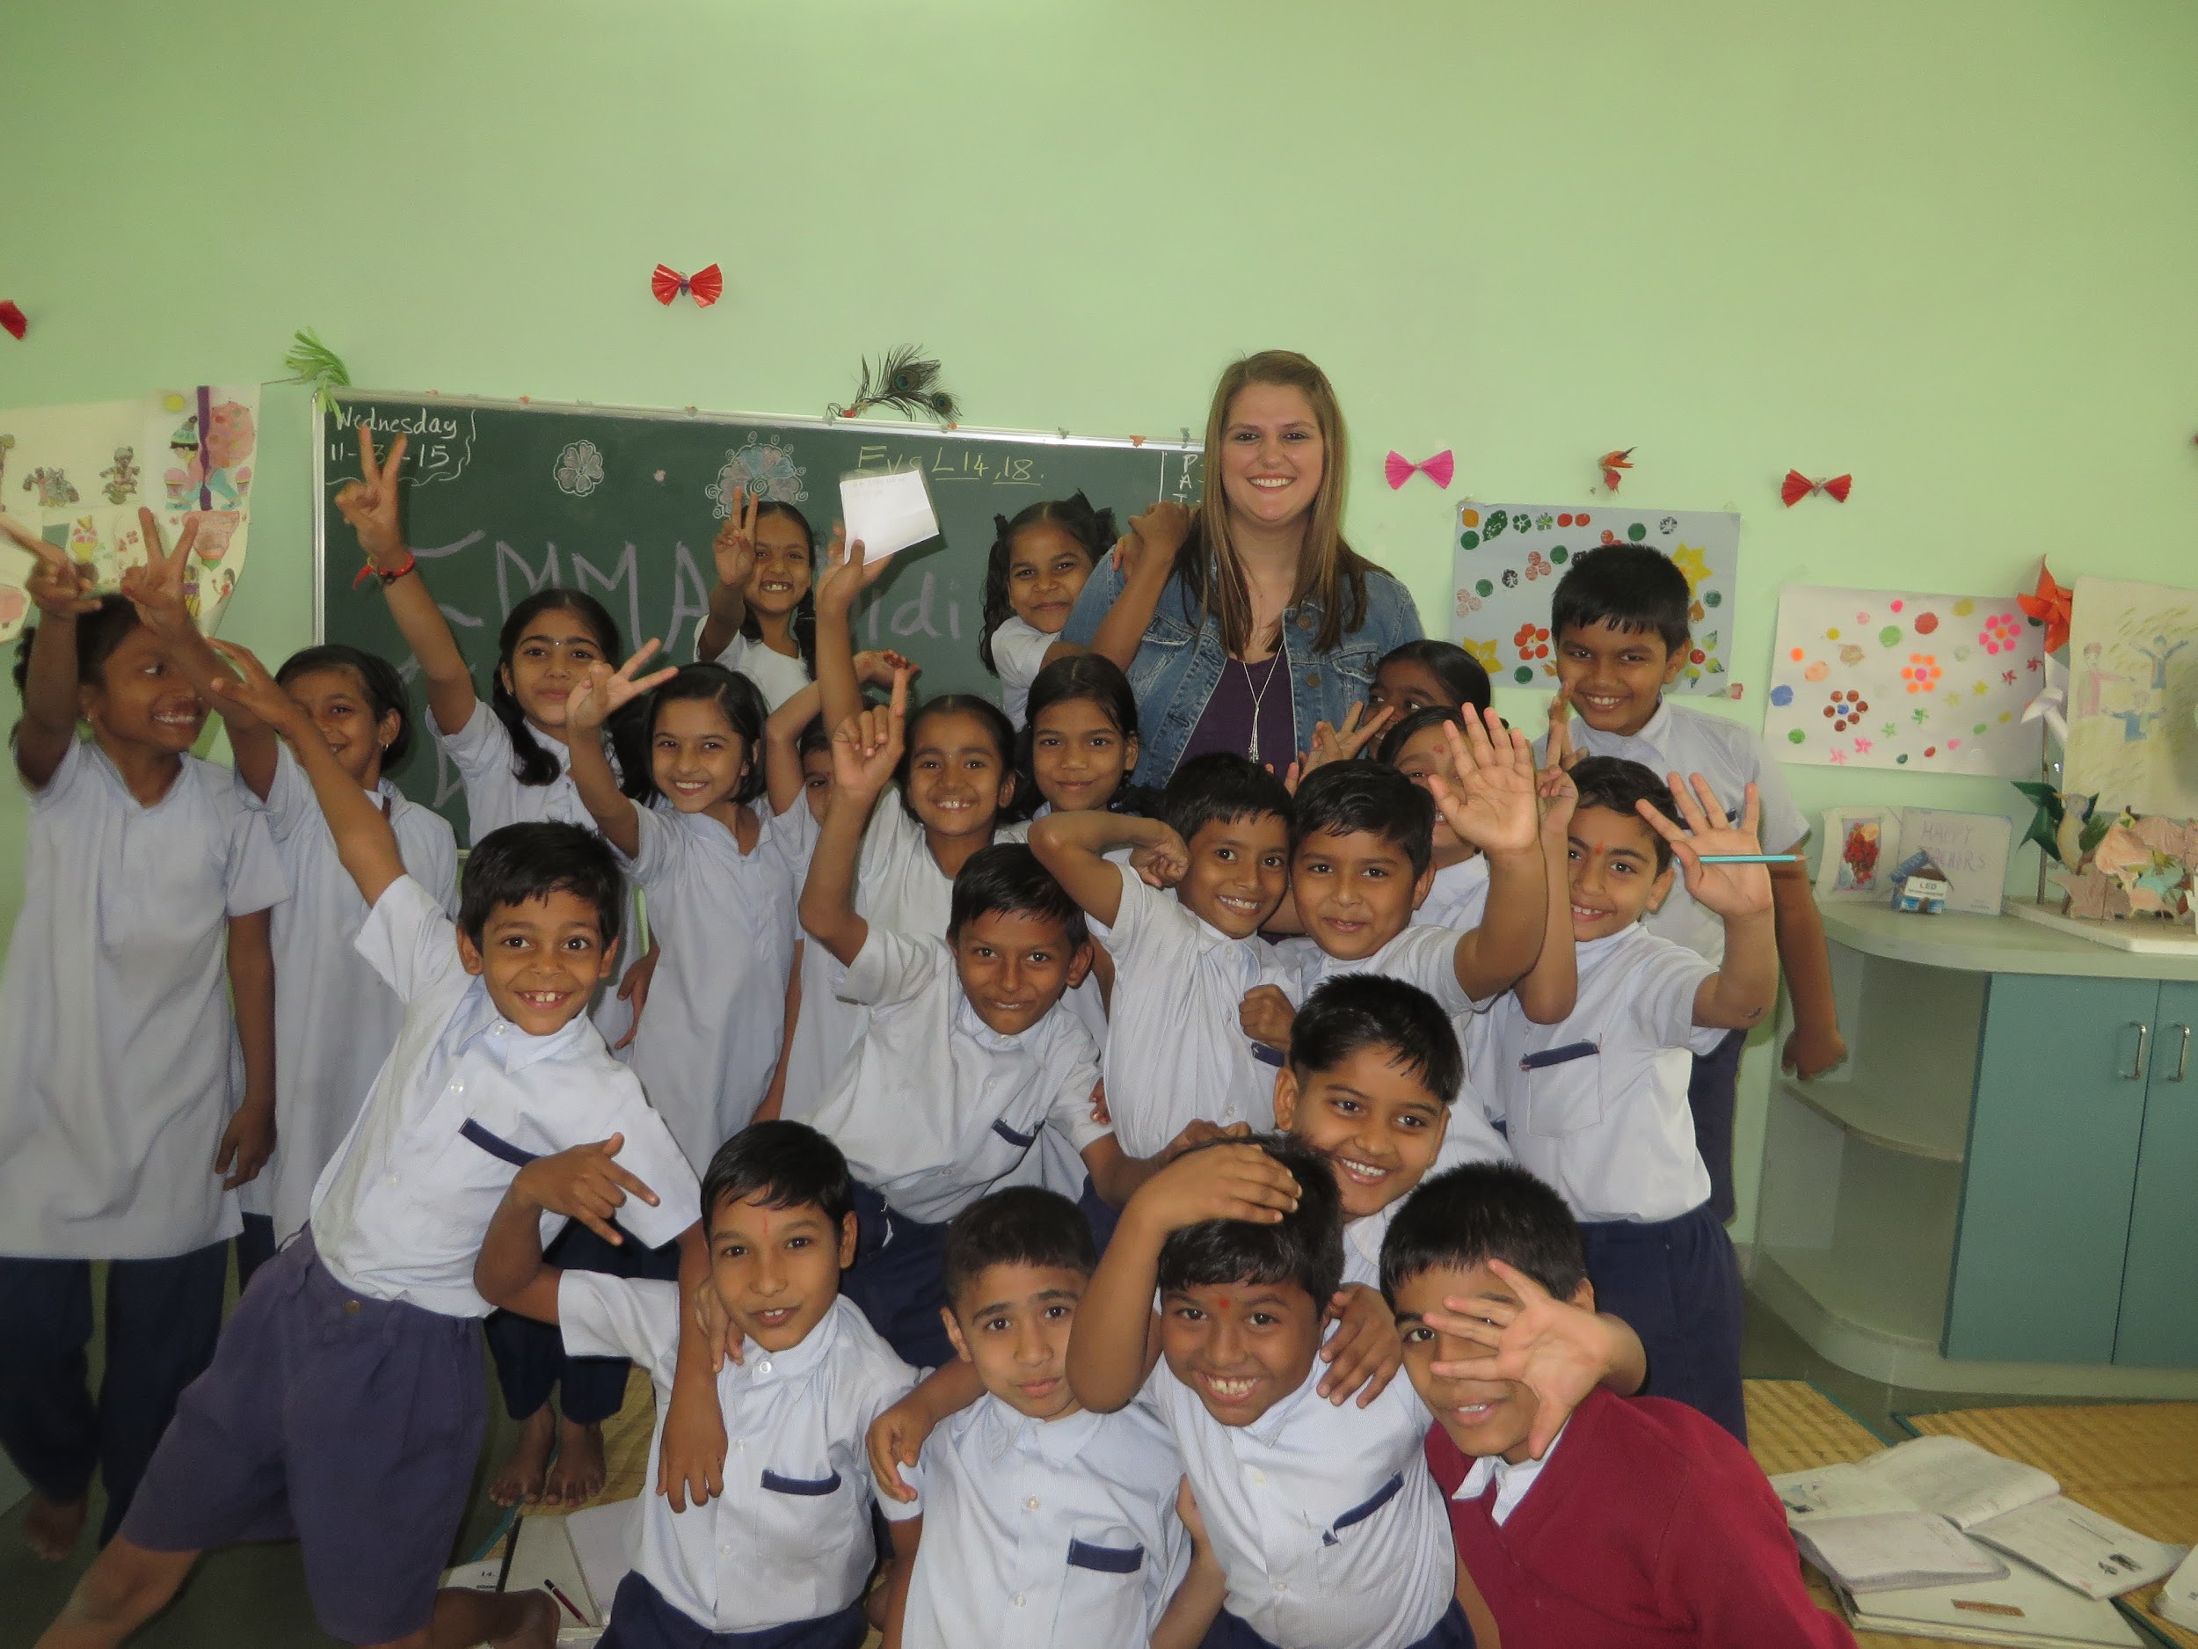
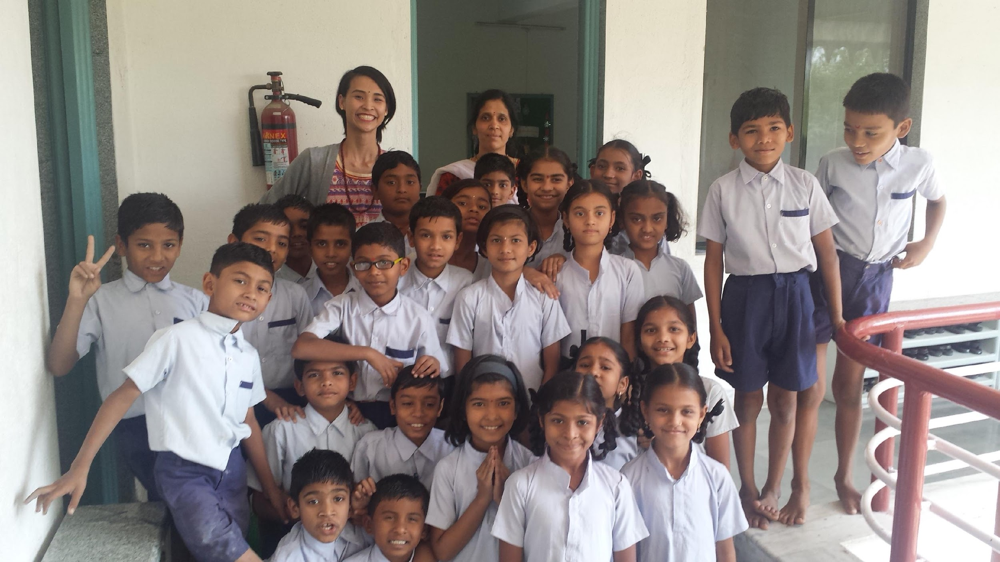
Our Primary Classrooms
5A
3A
4B

Slide 13
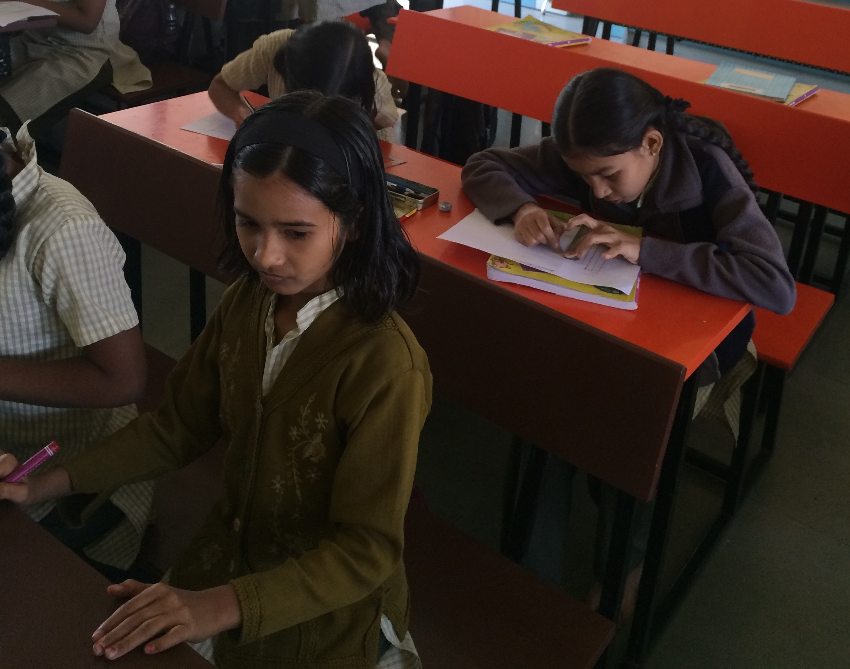
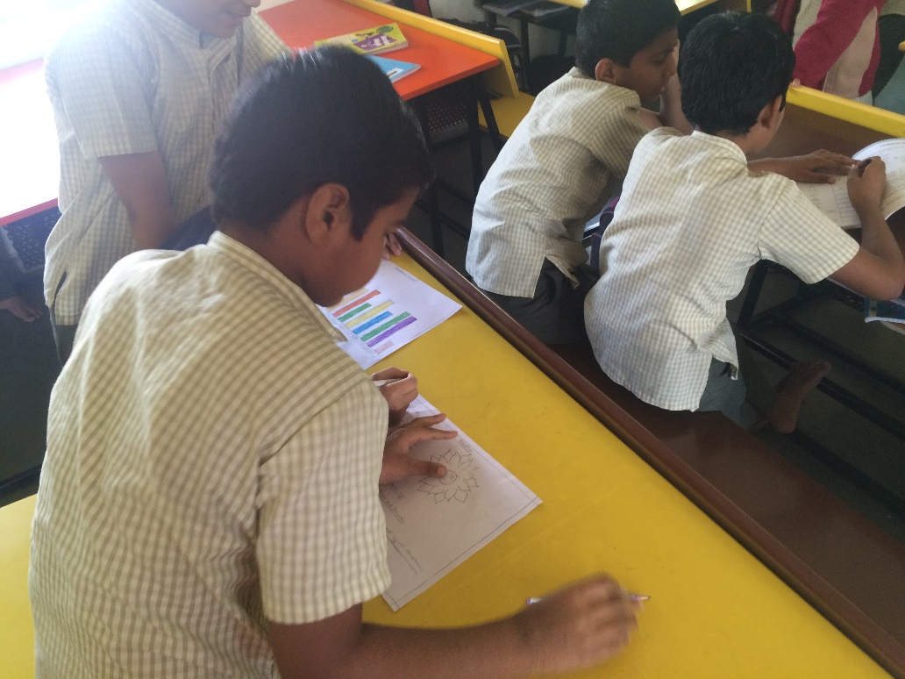
Leading a Math Activity: Bar Graphs
Students formed groups and interviewed their classmates to collect data about a question they chose. They then graphed the data in a bar graph.
The students worked very carefully on the project, taking their time and using their ruler to ensure everything was neat.

Slide 14
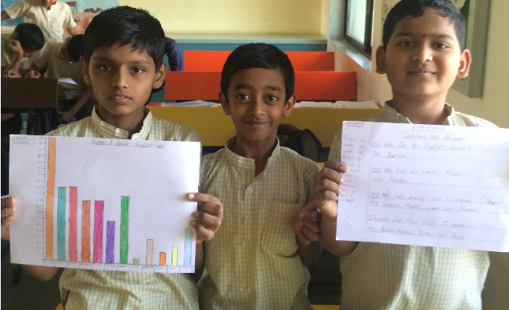
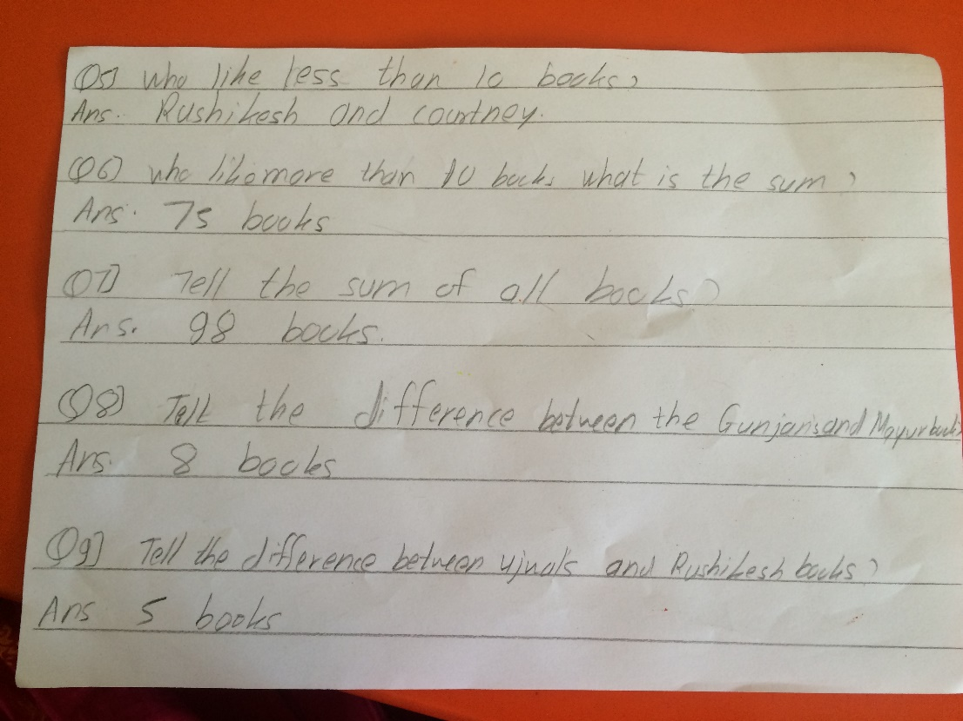
Students Expanded the Activity
Once the boys finished making their graphs, they asked me if they could create questions and answers about their work.
It is so wonderful to see students taking such an active role in their own learning!

Slide 15
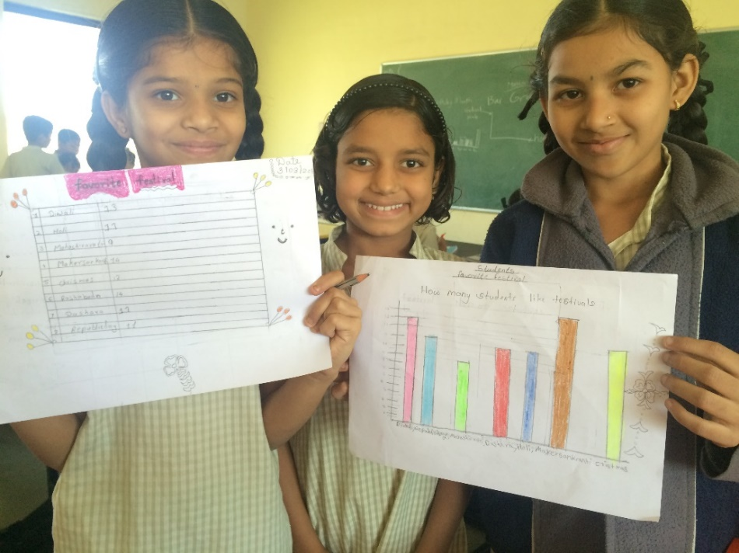
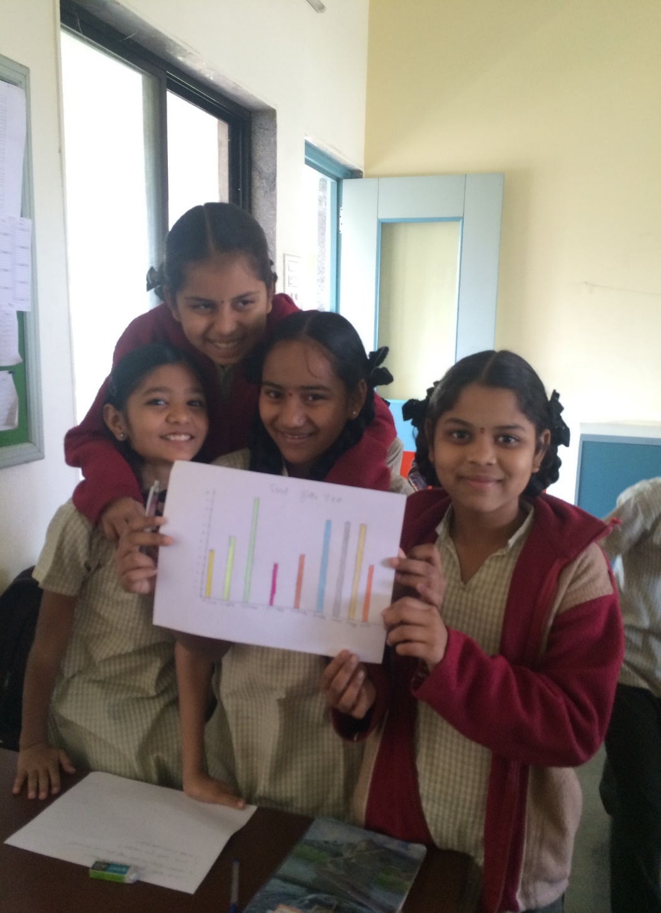
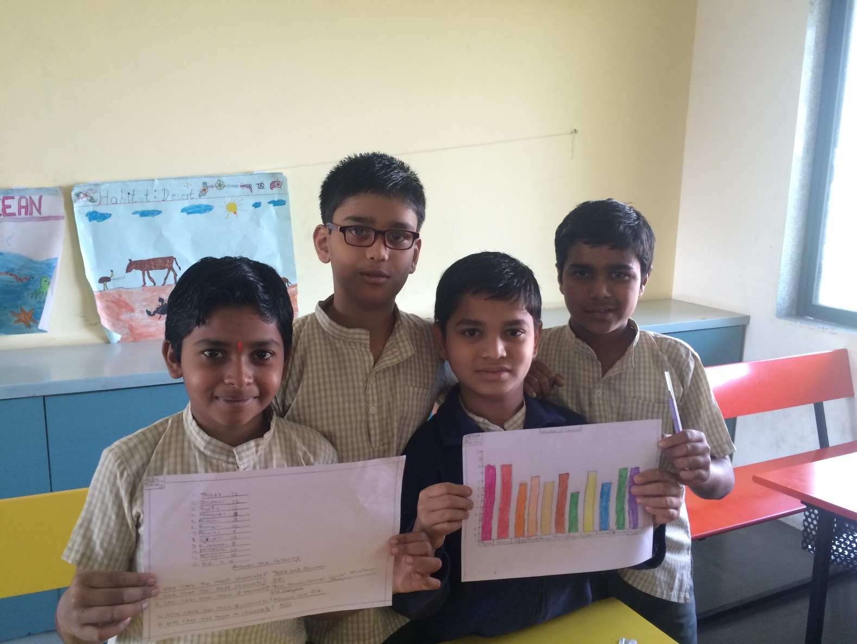
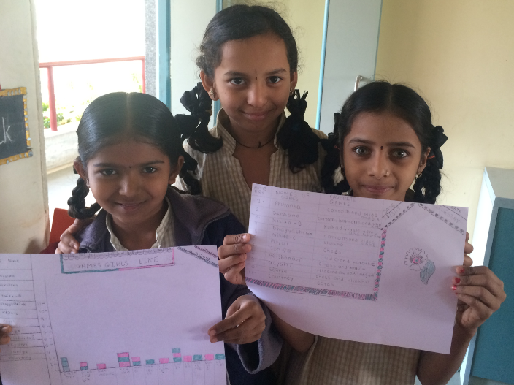
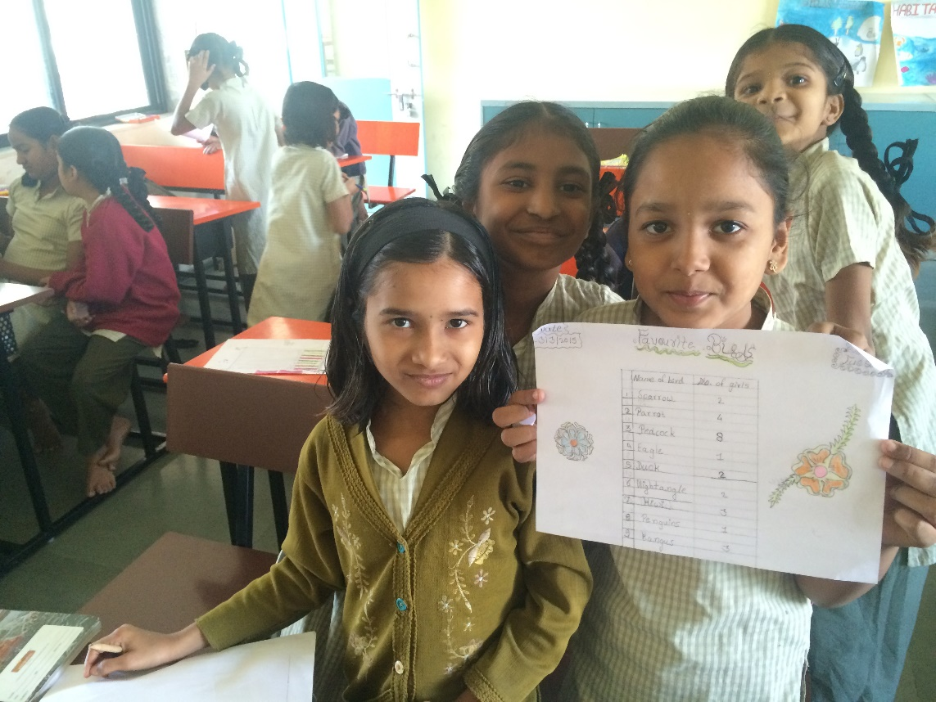

Slide 16
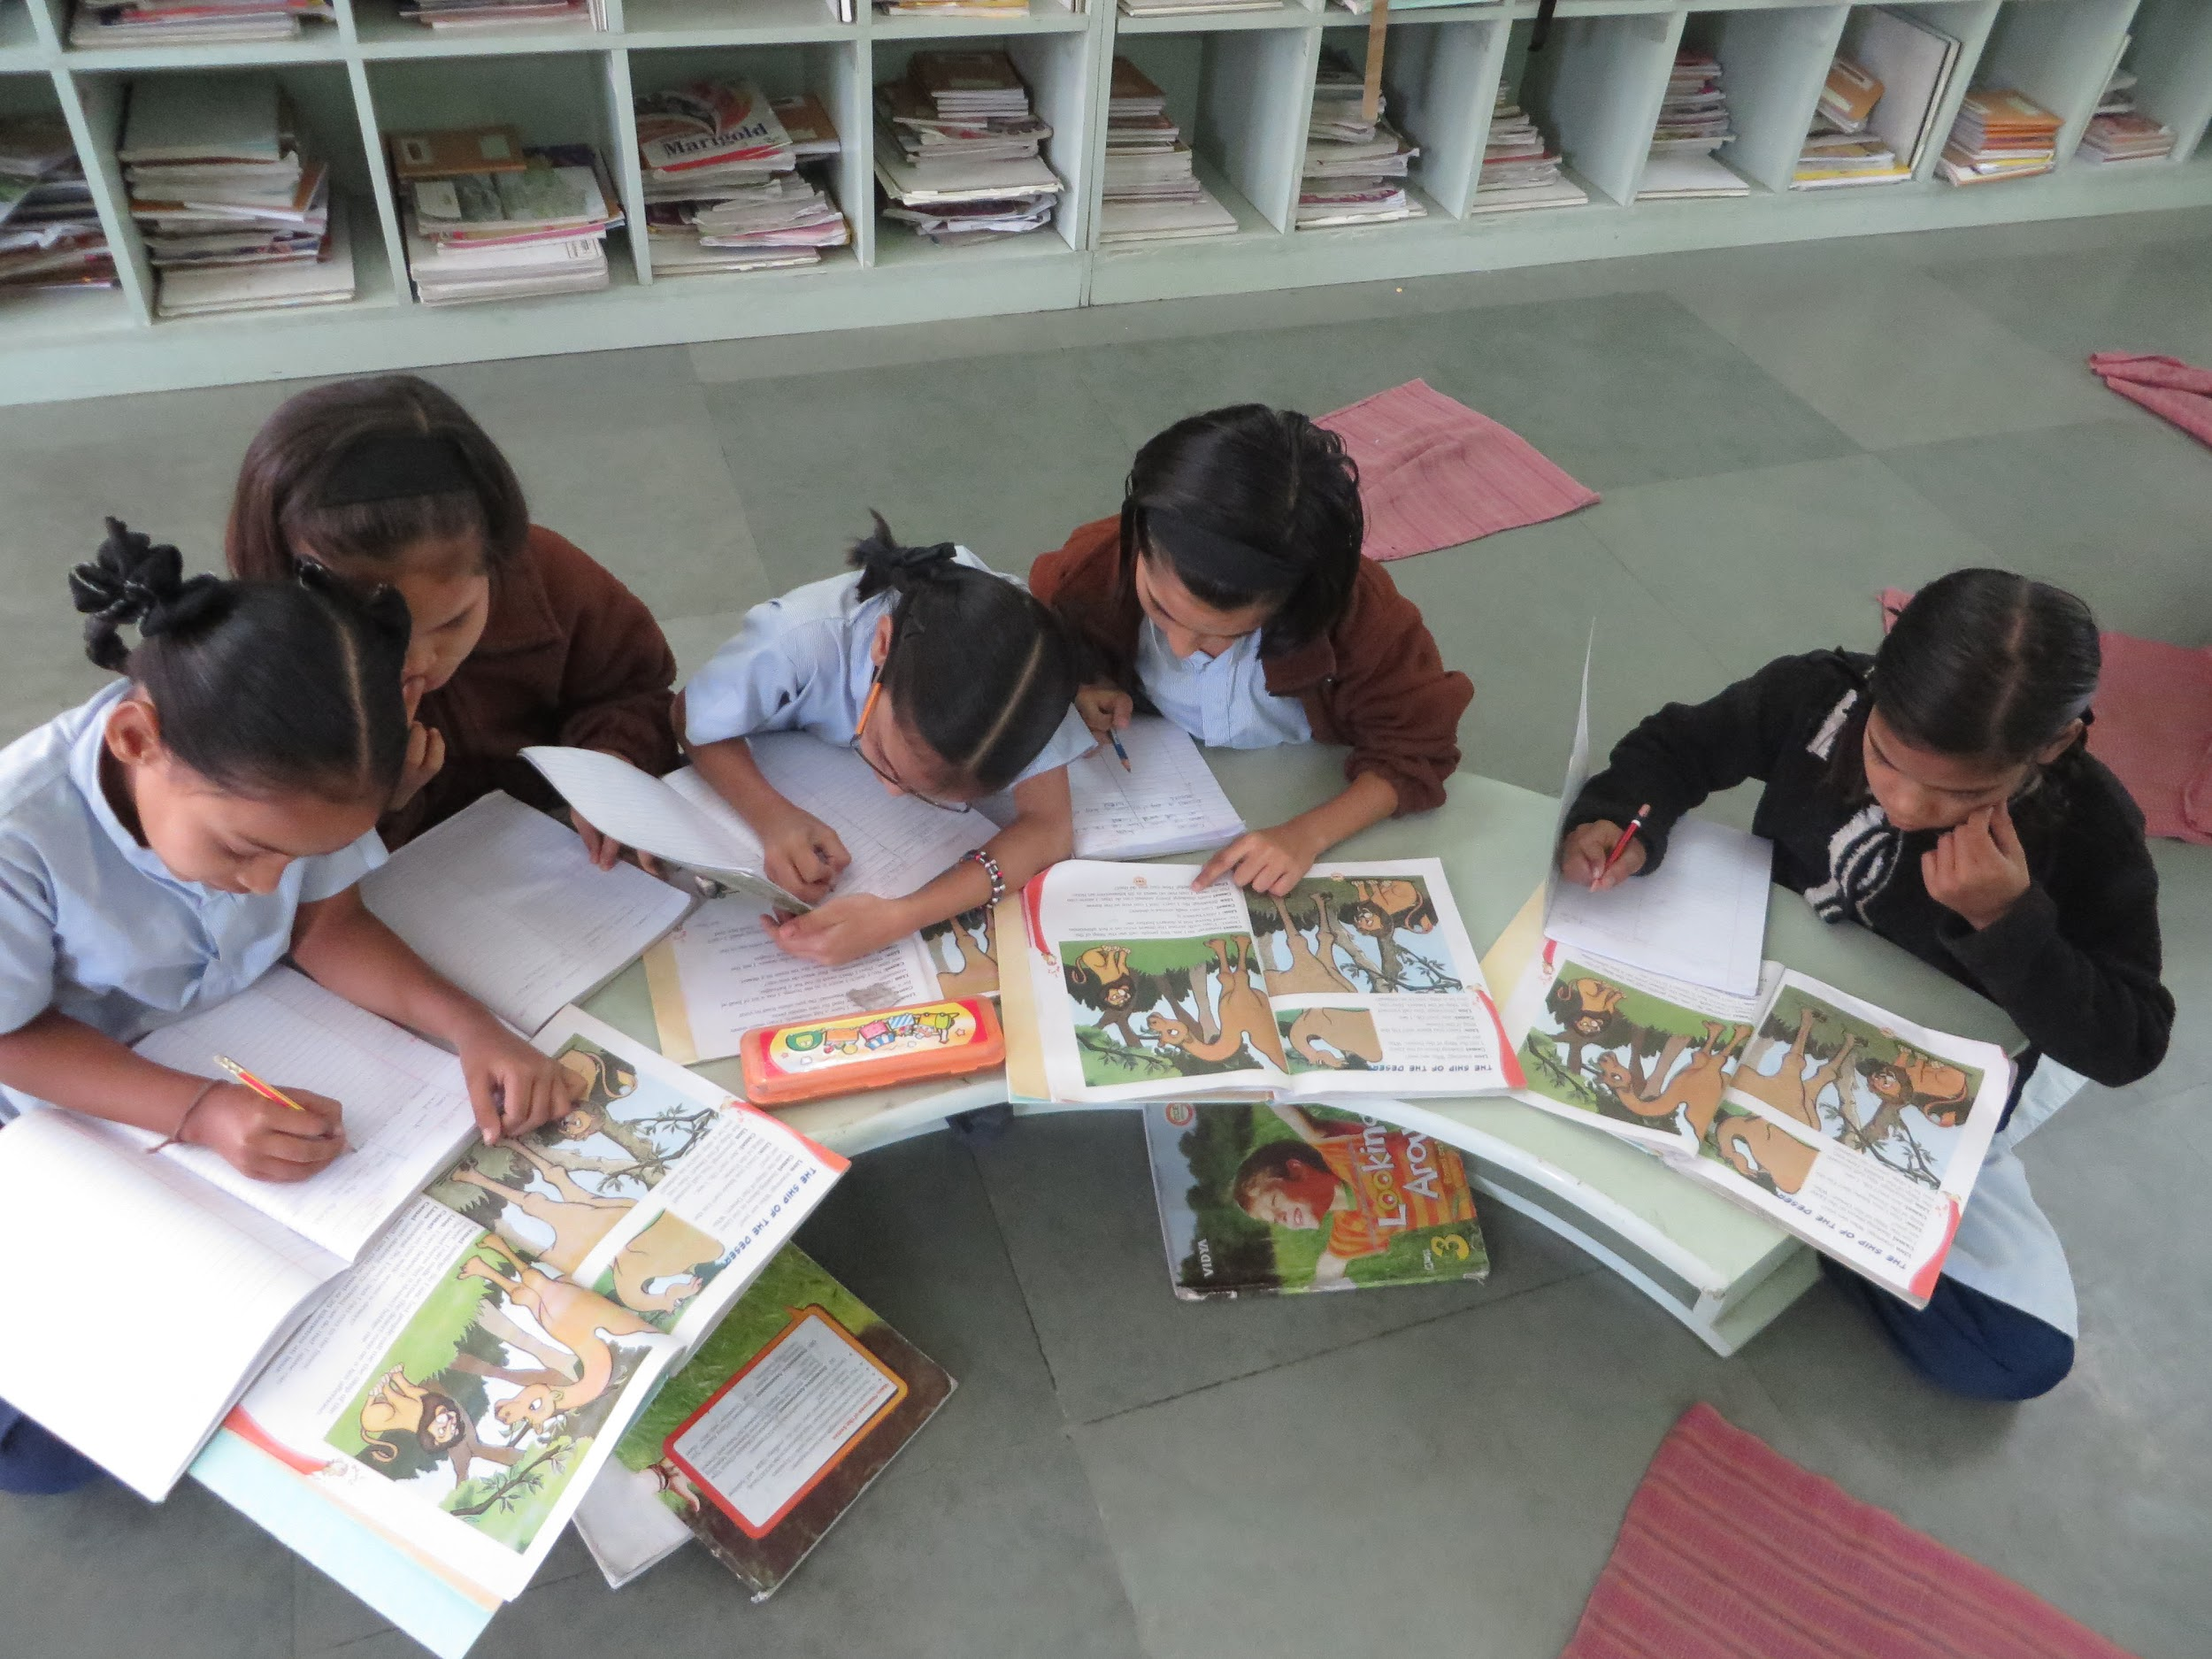
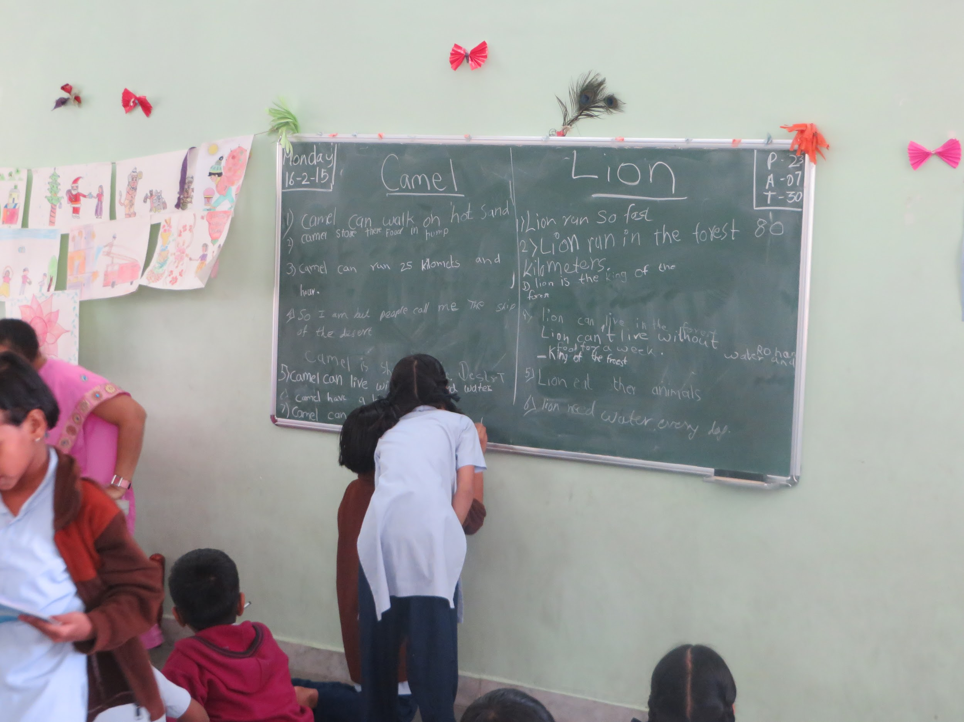
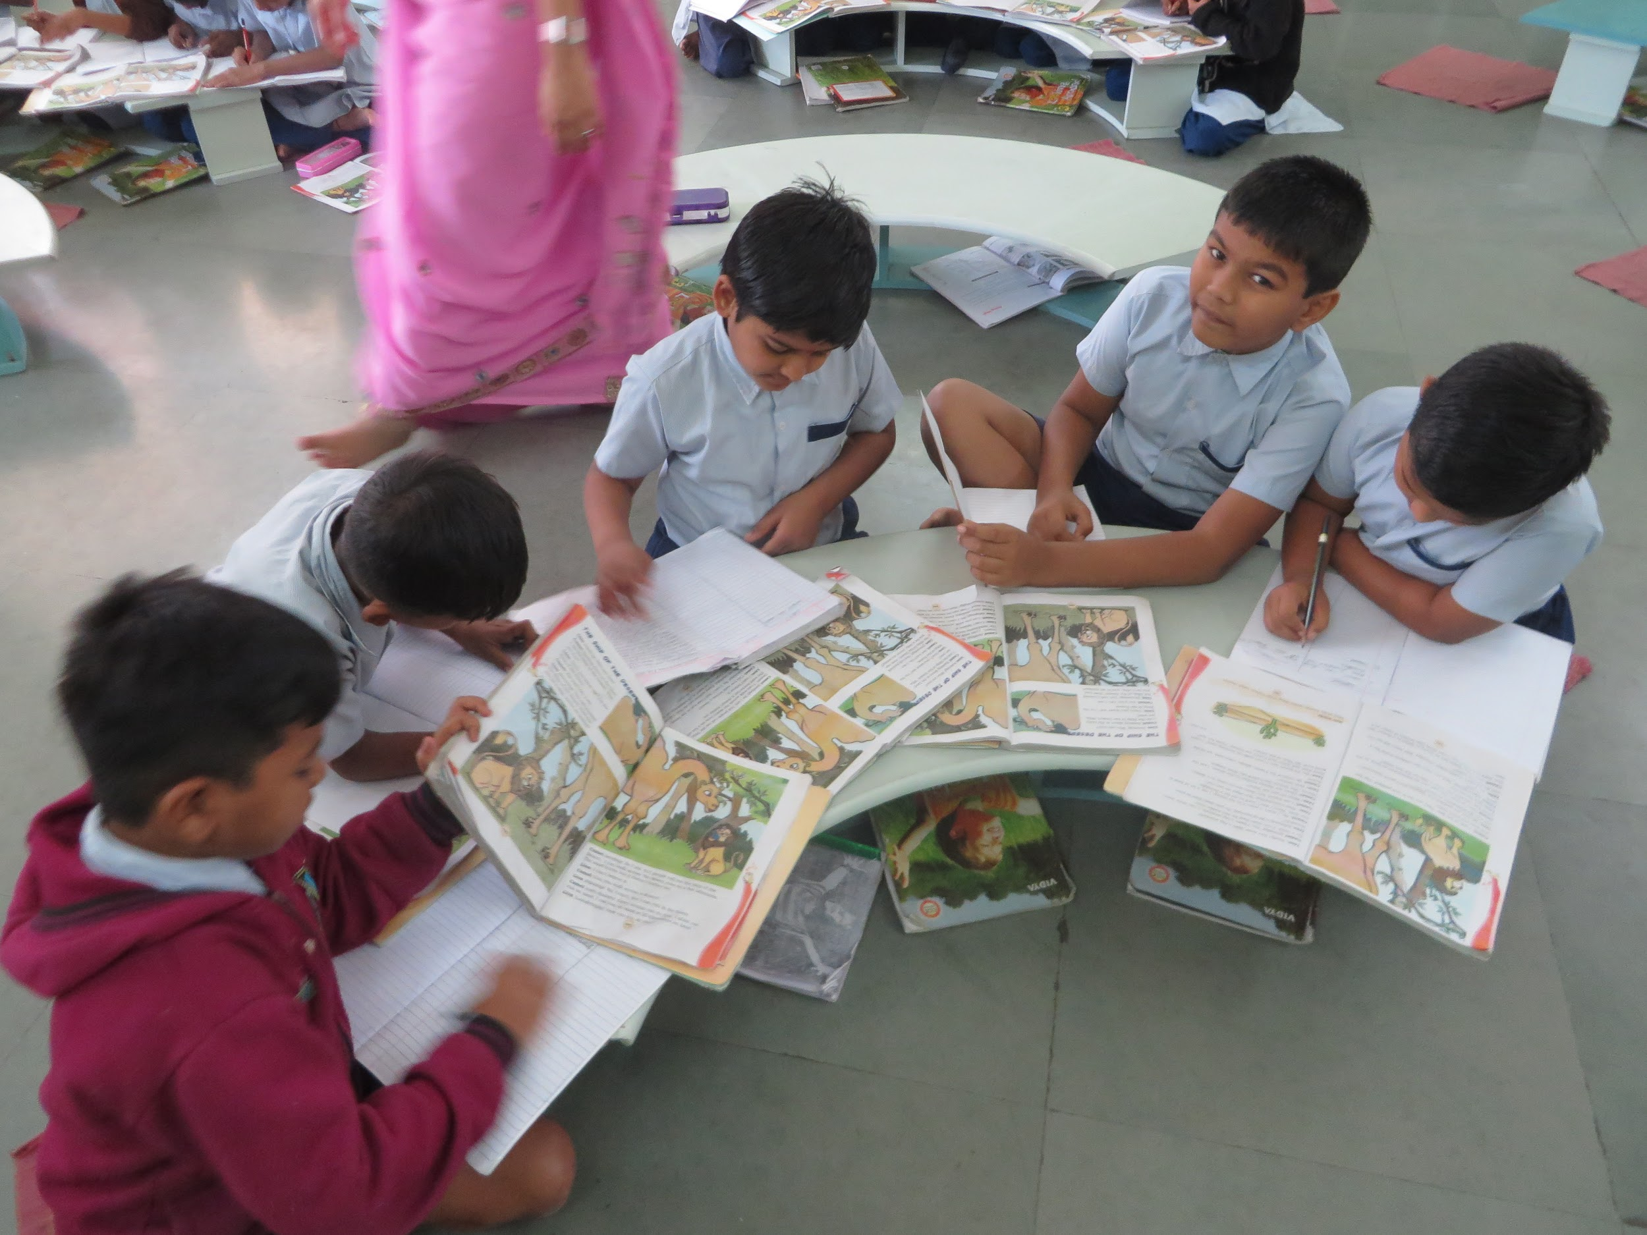
Teaching a Lesson
Lesson- The Ship of Desert
The students were put into groups for this activity. They worked on finding information about the main characters in the story
It was a huge learning experience for me in many ways. It was also really fun watching the kids work in groups and come up with new ideas.

Slide 17
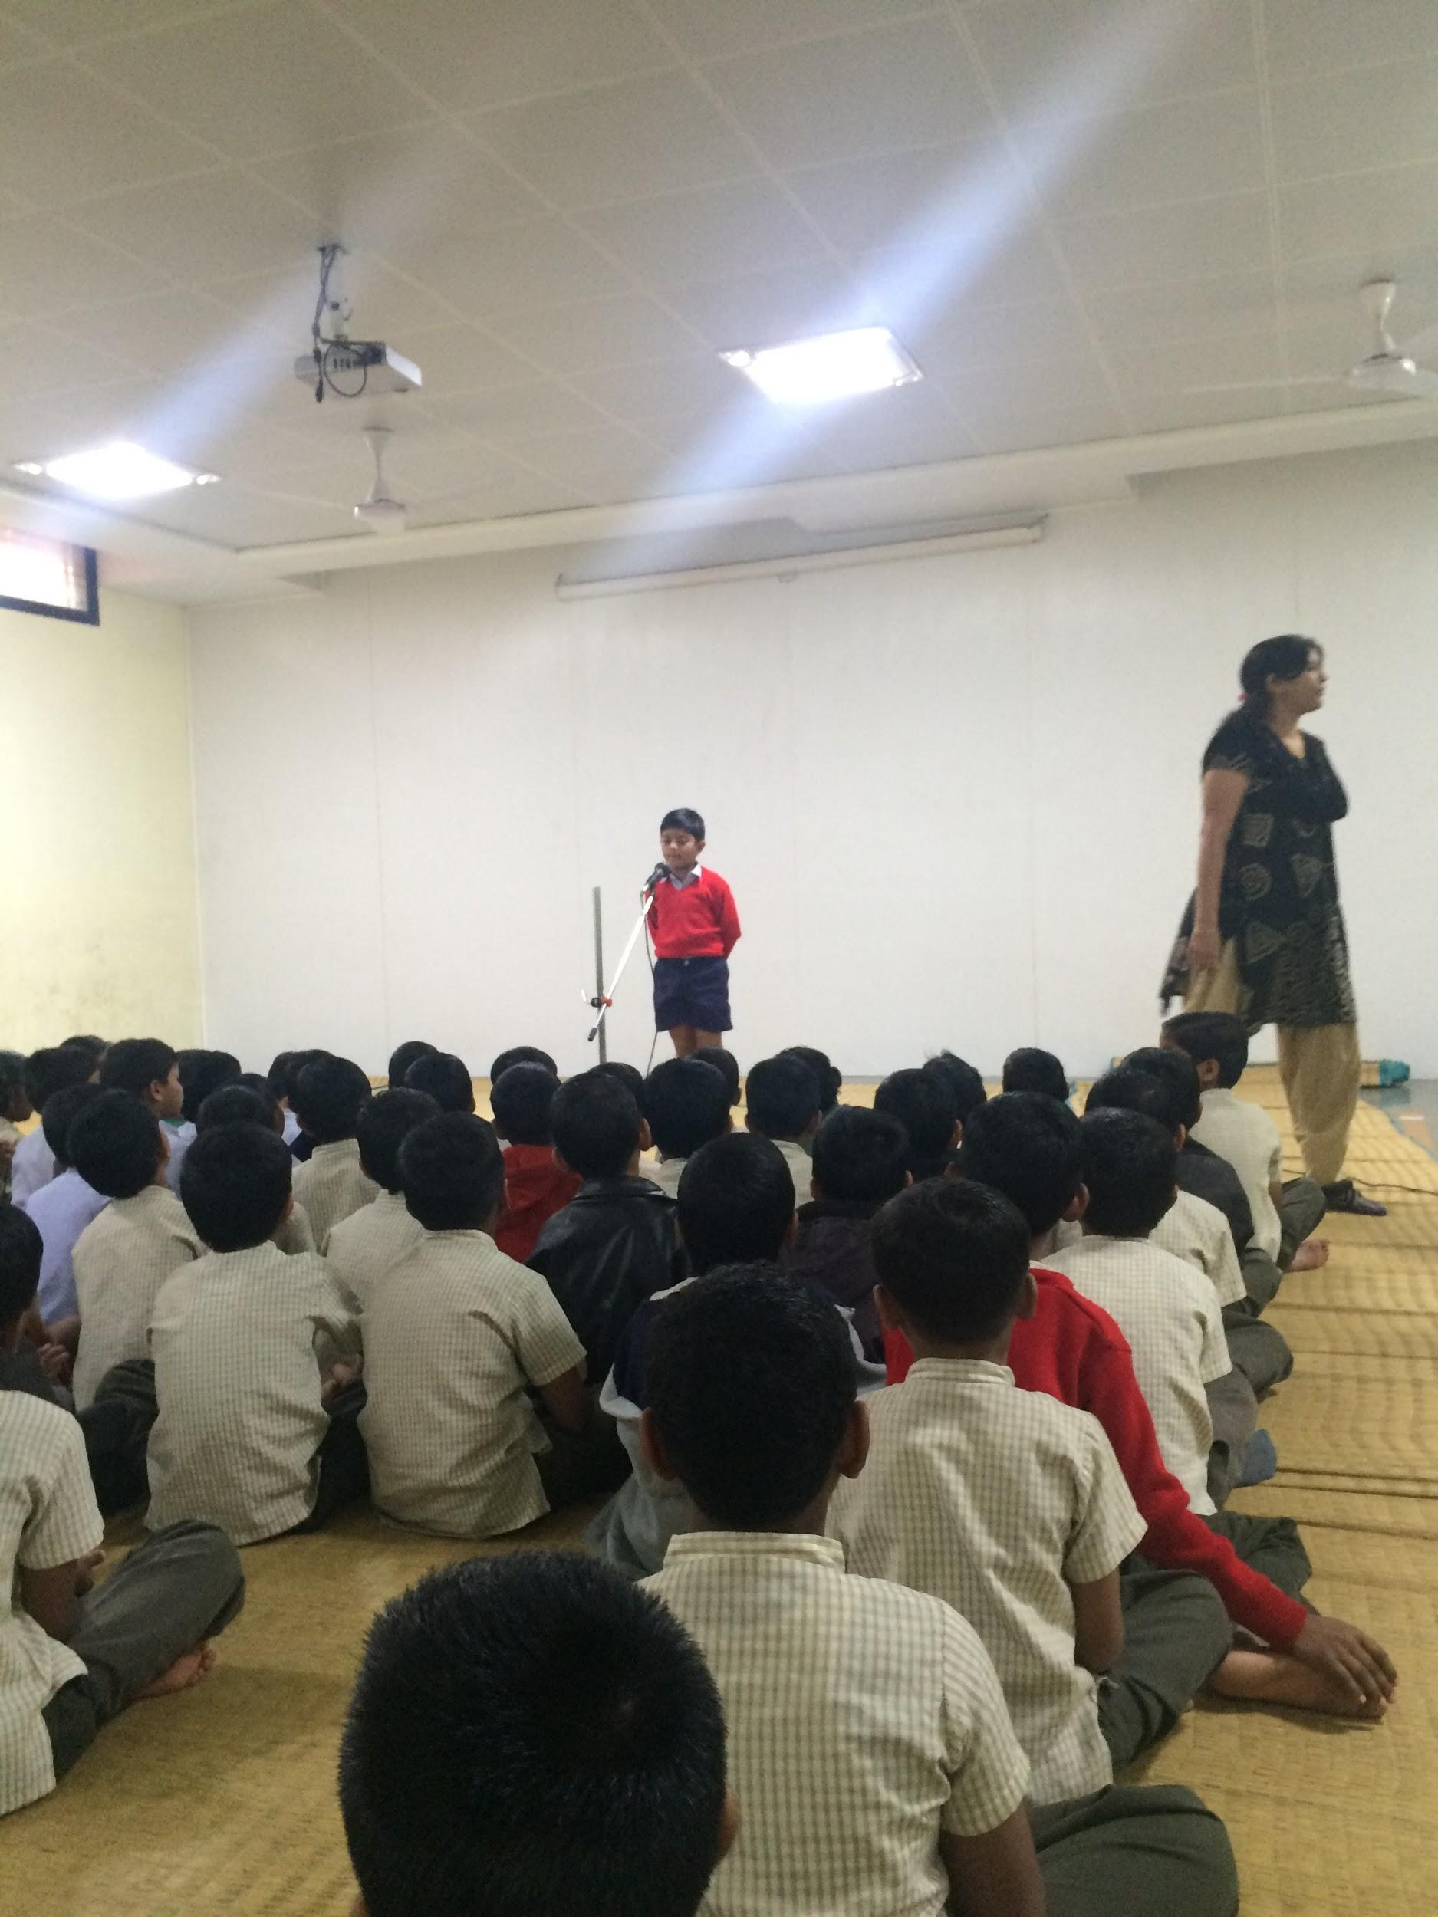
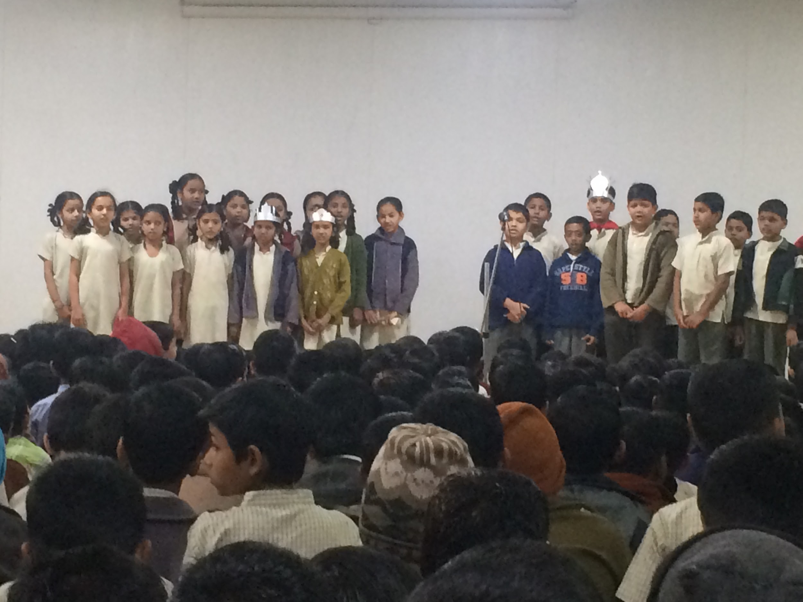
Assemblies
Assemblies took place every morning before class started.
Once a week one class was responsible for putting on the assembly. In the assembly the class would perform skits, sing songs, tell jokes and do short speeches. They were done primarily in English but they would also do some of it in Marathi.

Slide 18
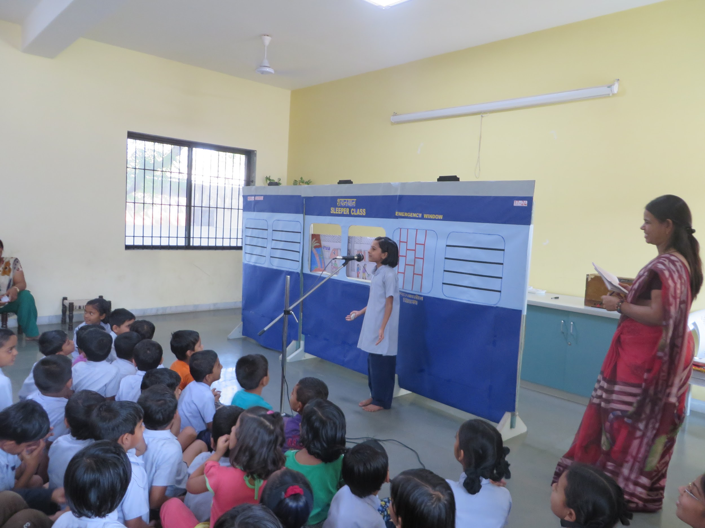
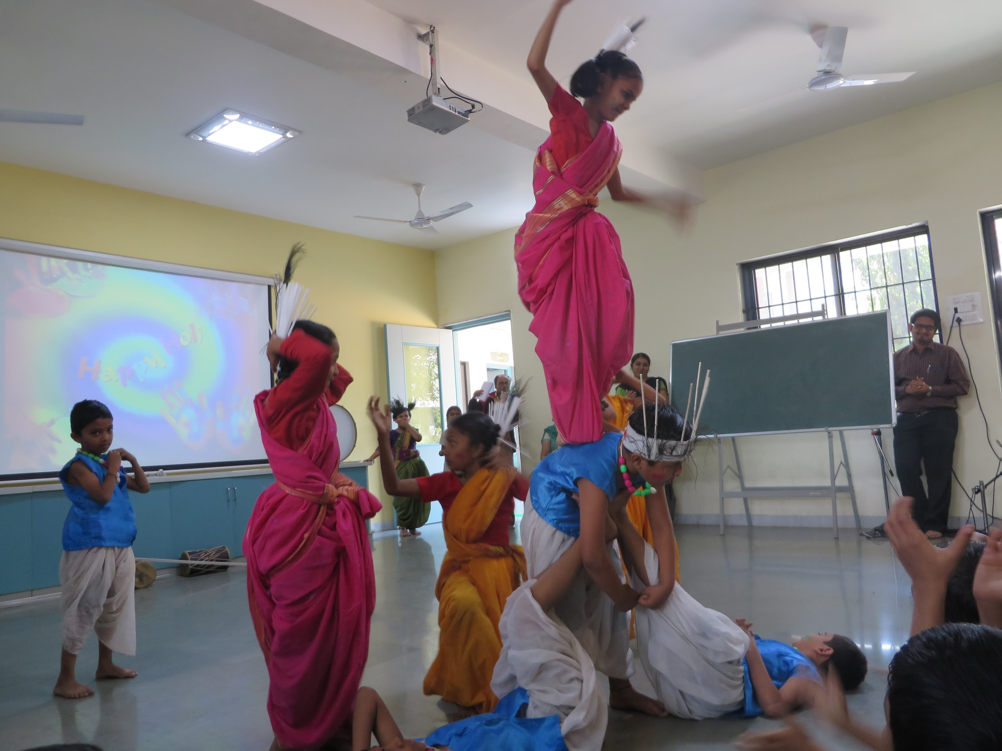
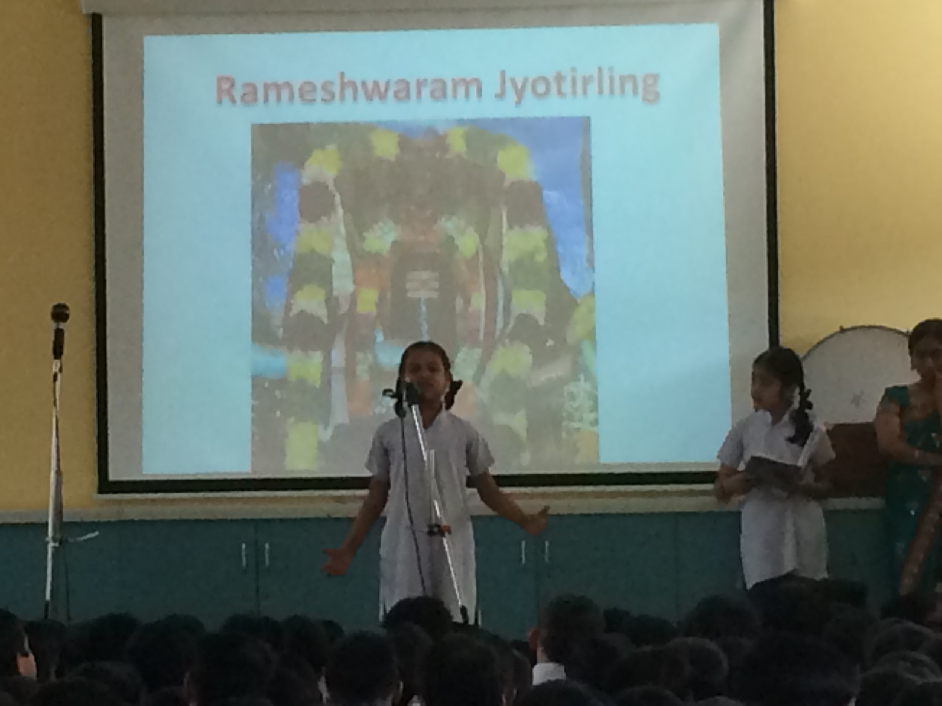
Special Assemblies

Slide 19
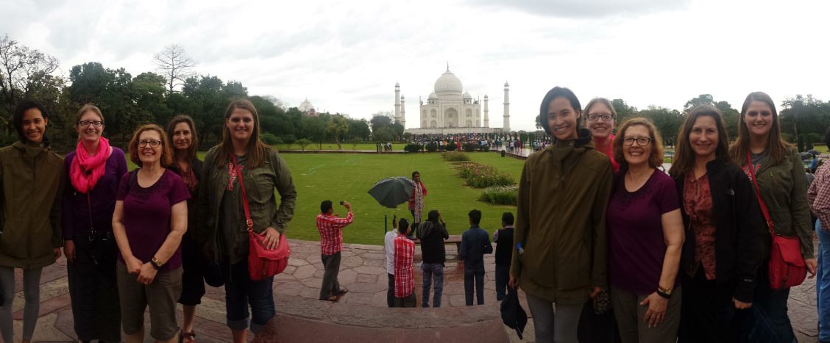
Back Page
Thank you to UNL, Jain Irrigation, & the Anubhuti Schools!

