Slide 1
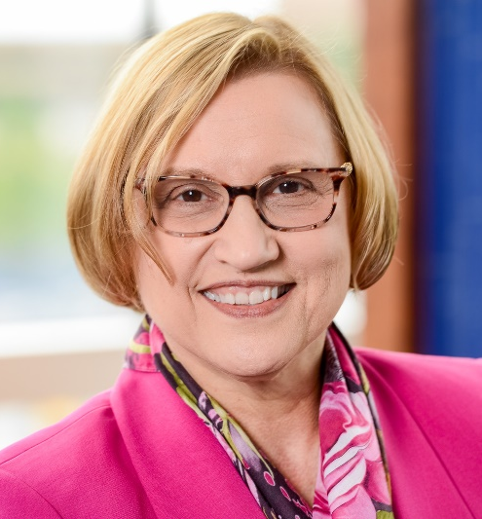
Success in Graduate and Professional Programs in the Department of Nutrition and Health Sciences
Mary Ann Johnson, PhD
Chair, Nutrition and Health Sciences
Jean Sundell Tinstman Professor of Nutrition
Rm 110 Leverton Hall, East Campus
College of Education and Human Sciences
University of Nebraska Lincoln
majohnson@unl.edu
Session 1 - Welcome and Overview

Slide 2
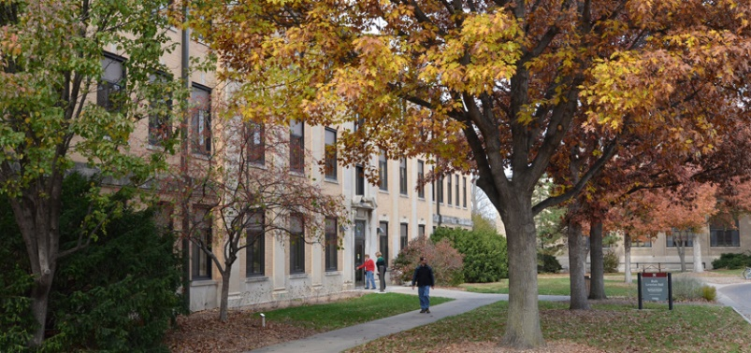
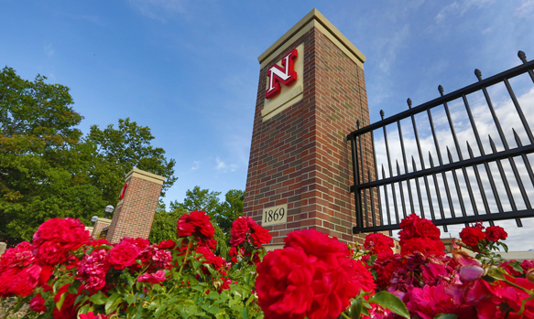
Welcome to Nutrition and Health Sciences at UNL!
Introduction to our values, people, programs, best practices for success, finding and being a mentor
What led you to NHS and UNL?
Leverton Hall Gates to Campus

Slide 3
Values of College of Education and Human Sciences
Innovation, creativity, and curiosity as we address complex issues facing individuals, families, schools, and communities;
Respect diverse people, ideas, voices, and perspectives;
Multidisciplinary approaches to scholarship that integrate teaching and learning, research, scholarship, and creative activity, outreach, and service;
Working together to positively impact the lives of individuals, families, schools, and communities, and health;
Partnering with people in the community to support the mission and vision of CEHS;
Emphasizing creation of new knowledge and its application to human and community needs thereby combining the strengths of a research and a land-grant university.

Slide 4
NHS – Our People Supporting Learning
More than 30 faculty including Extension educators, 5-10 temporary lecturers
Preceptors, supervisors for internships and experiential learning
UNL in Coliseum, athletics, and research laboratories in our department and across campus
Off-campus in healthcare and community settings
70 graduate and professional students
900 undergraduate students

Slide 5
NHS – Our People Supporting Graduate and Professional Students https://cehs.unl.edu/nhs/nhs-faculty-and-staff/
Staff
Diane Brown, Graduate Coordinator, primary staff person who assists graduate students, diane.brown@unl.edu
Melinda Nolan, can help you find the right person to talk with, mnolan8@unl.edu
Amy Brown, abrown2@unl.edu
Mentor, Advisor, Program Director
Dr. Weiwen Chai, Chair of Graduate Program
Helps NHS students, staff, and faculty and Graduate Studies regarding policies and procedures, wchai2@unl.edu

Slide 6
NHS – Locations
City Campus and East Campus
Coliseum
Neihardt Hall and in Mabel Lee Hall in a few years
Human Sciences Building (Home Economics Building)
Filley Hall
Leverton Hall – most faculty and staff
Hotel on Nebraska Innovation Campus
2021 Hospitality, Restaurant and Tourism Management
NHS in both CEHS & IANR (Extension, Research)

Slide 7
NHS – Graduate and Professional Programs, https://cehs.unl.edu/nhs/graduate-programs/
Professional Programs – healthcare oriented
Dietetic Internship - last graduates 2021 (1 yr)
Fall 2021 Masters with Dietetic Internship (2 yrs)
Online Masters in Dietetics with Great Plains IDEA, https://cehs.unl.edu/nhs/programs/dietetics-distance-program/
Athletic Training will be Masters in 2023

Slide 8
NHS – Graduate and Professional Programs, https://cehs.unl.edu/nhs/graduate-programs/
Graduate Programs – MS and Doctorate
Nebraska Center for Prevention of Obesity Diseases (NPOD), Dr. Janos Zempleni
Biochemical and Molecular Nutrition, Dr. Sathish Natarajan
Community Nutrition and Health Promotion, Dr. Weiwen Chai
Exercise Physiology, Dr. Terry Housh
Nutrition and Exercise, Dr. Shinya Takahashi
Food Literacy, Quality and Safety, Dr. Georgia Jones
Hospitality, Restaurant and Tourism Management, Dr. Kristin Malek, Dr. Ajai Ammachathram, Dr. Shannon Rowen
Started enrolling graduate students in 2019 (MS)

Slide 9
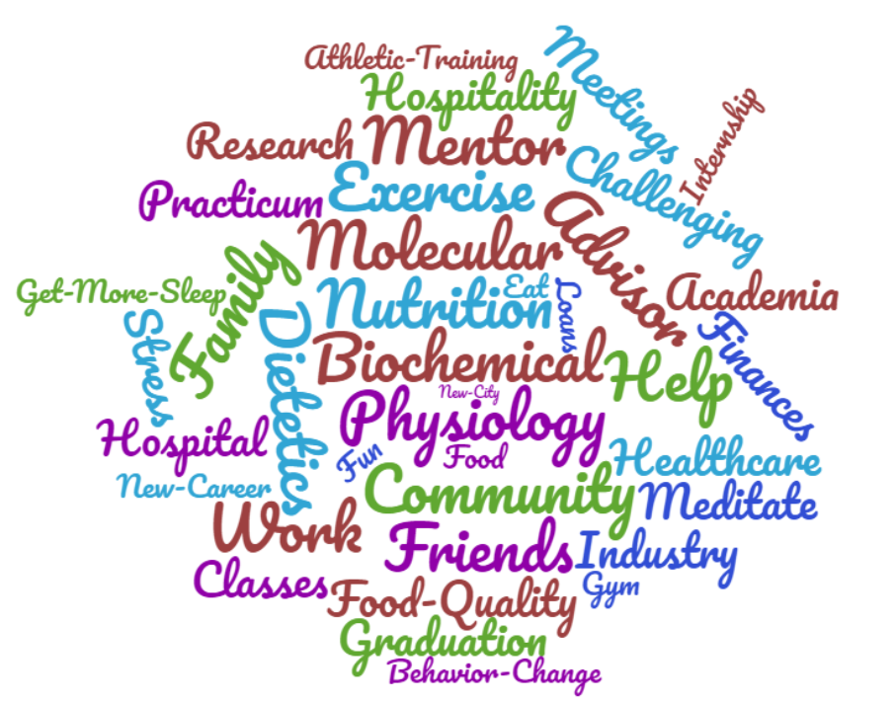
Discussion and Questions?

