Slide 1
UPCYCLED EXPLORING TEXTILES & ART
By The Robert Hillestad Textile Gallery
Notes:
Photo by Gin Patin

Slide 2
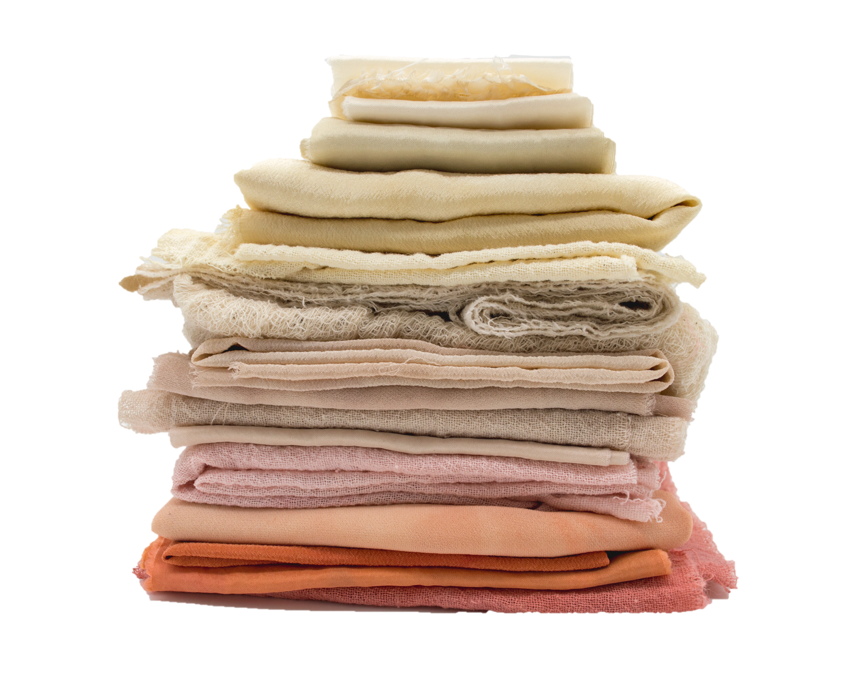
ACKNOWLEDGEMENTS
UPCYCLED: EXPLORING TEXTILES & ART
2
UPCYCLING, ART, & DESIGN
Whether utilizing sculpture, woven, tapestry, knitting, crochet, applique, needlework, needlepoint, surface design, wearable art, fashion design, or haute couture, textiles offer a unique medium in art. Textiles allow the artist to take relatively two-dimensional materials and transform them in three-dimensional forms. Textiles offer innate textures, patterns, movement, colors, pattern, and variety which offer artists and designers a unique “canvas” to work with.
One of the most polluting and wasteful industries in the world is the textile and clothing industry. Additionally, most clothing and textiles end up in landfills especially with the increase of fast fashion. This over abundance of garments and other textile materials, as well as manufacturing waste, offers a unique and available material for artists while participating in sustainable practices.
This project encourages high school age students to explore the textile medium while developing an environmentally conscious mindset and art practices. The Robert Hillestad Textile Gallery will provide a space for students to showcase their work at the annual Student Juried Exhibition (see page 7).
Mel Poole
Curriculum Design & Development Anna Naomi Erdmann, M.A.
Supervised by Michael Burton, M.F.A.
Sponsored by The Robert Hillestad Textile Gallery
Cover Image Gin Patin
Special Thanks to Lincoln Public Schools
Mary Alice Casto, Ph.D.
Sandra Starkey, Ph.D.
Kristen Douglas, M.A.Ed.
The Department of Textiles Merchandising and Fashion Design (UNL)
ROBERT HILLESTAD TEXTILE GALLERY

Slide 3
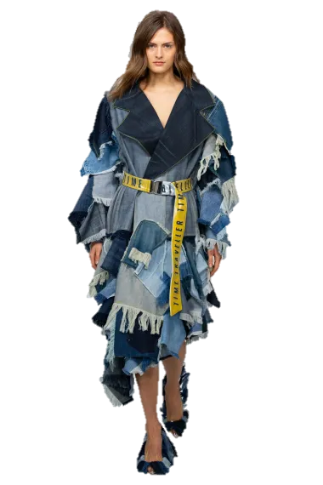
UPCYCLED FASHION
UPCYCLED: EXPLORING TEXTILES & ART
3
Manon Planche Autumn Winter 2020
Overview:
Utilizing preexisting garments and other textiles, students will create a new and wearable garment distinctly different from original materials.
Goals:
Create an upcycled garment(s)
Increase knowledge of design, construction, and patterning while increasing awareness of the environmentally friendly fashion practice of upcycling
Showcase completed garment(s) in the Robert Hillestad Textile Gallery Student Exhibition (see page 6)
Materials:
Sewing Machine
Thread
Notions (zippers, buttons, etc.) - upcycled preferred
Fabric Scraps (large and small - provided)
Discarded or Secondhand Apparel and Textiles
Pattern(s) - purchased or created (as needed)
ROBERT HILLESTAD TEXTILE GALLERY

Slide 4
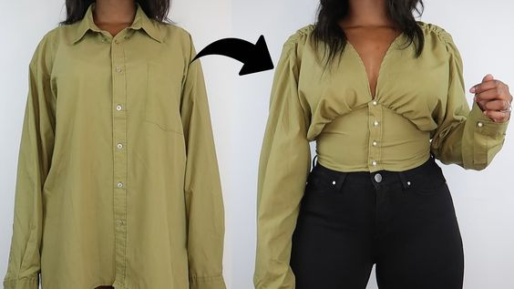
UPCYCLED: EXPLORING TEXTILES & ART
4
Process:
Students will gather available textile materials. They will use these materials to develop a concept for a new garment(s). They can draw additional inspiration can from other sources such as fashion designers, art, design, architecture, life, etc. It may be helpful to have students sketch out their idea(s) to further develop their ideas and understand how they can use the existing materials to create a new garment(s).
Once students have a conceptualized design, the students will develop/alter pattern pieces or have a clear process of how to transform the materials into the new garment. Some students will prefer to work structurally with flat patterns, others may have organic process by playing with the materials, but both should be able to communicate clearly their design and construction process. A sketch of the final look (even though it may change) and a short list of their intended process may be helpful to guide this process. Students will then construct their designs.
Possible ways to modify garments :
Removing sections of a garment and replacing it with sections of another garment
Making a symmetrical garment asymmetrical by removing one sleeve or section
Changing the shape by taking in (altering, adding darts) to sections of the garment or adding in sections of fabric to add fullness (gussets, gores)
Gathering, pleating, rouching, to add textures and change shape within areas of a garment
Appliques, adding elements on top of the existing garments such as pockets, trims or other design details
Your creativity can guide the project and you can develop designs organically while working on a form
Credit Dr. Sandra Starkey
Men’s Shirt Refashion
by Matildah (@Fashion Wizardry)
ROBERT HILLESTAD TEXTILE GALLERY

Slide 5
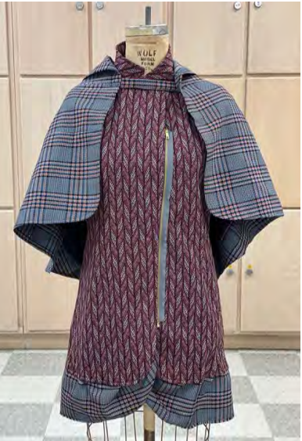
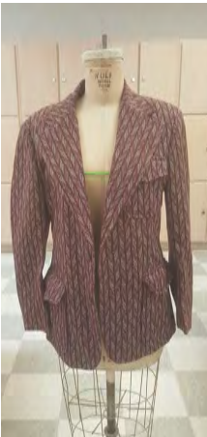
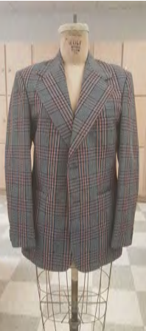
UPCYCLED: EXPLORING TEXTILES & ART
5
Helpful Tips:
Encourage students to develop a completed ensemble (I.e. dress OR blouse and pants, etc.). In relation to time and skill level, if students have a multi garment ensemble, they may need to simplify one of the garments or pair it with an existing garment.
Encourage students to think beyond the stereotypical “patchwork” appearance often associated with upcycling.
It can be helpful to utilize only a few garments or focus on similar types of fabrics. This will help create a cohesive, creative, and well thought out garment(s).
Remind them to be conscious of construction (how will these pieces be sewn together), closures, and fit.
Students may not have a design/pattern development background and understanding and creating pattern shapes may be a new and challenging experience. It may be helpful for them to utilize, combine, and/or alter existing patterns. Another helpful approach is to put the garments on a body (or dress form if available) and explore different configurations by draping, folding, pinning, and cutting.
Erin Smith
ROBERT HILLESTAD TEXTILE GALLERY

Slide 6
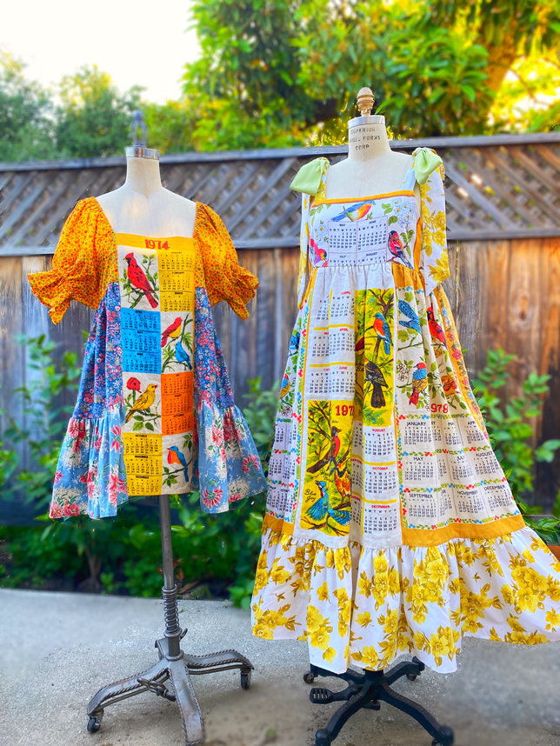
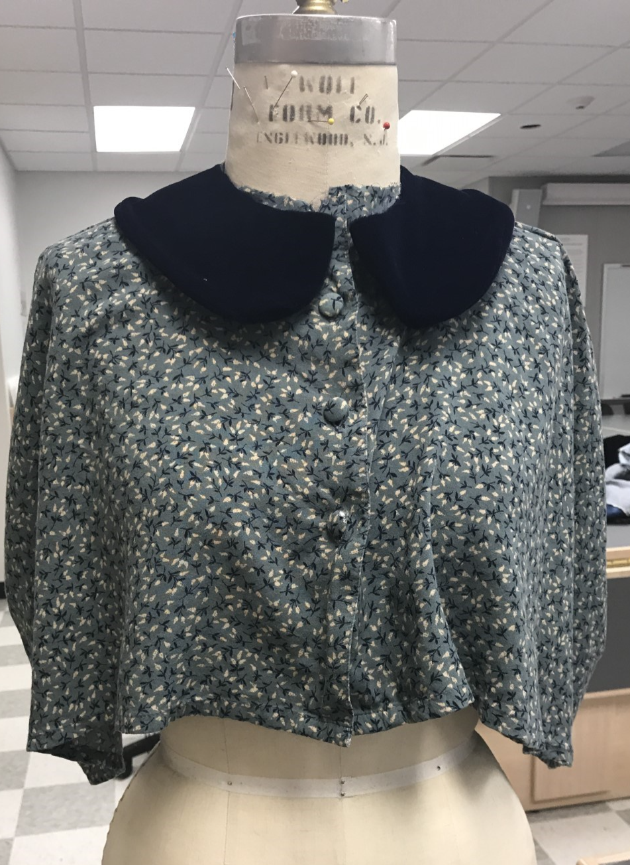
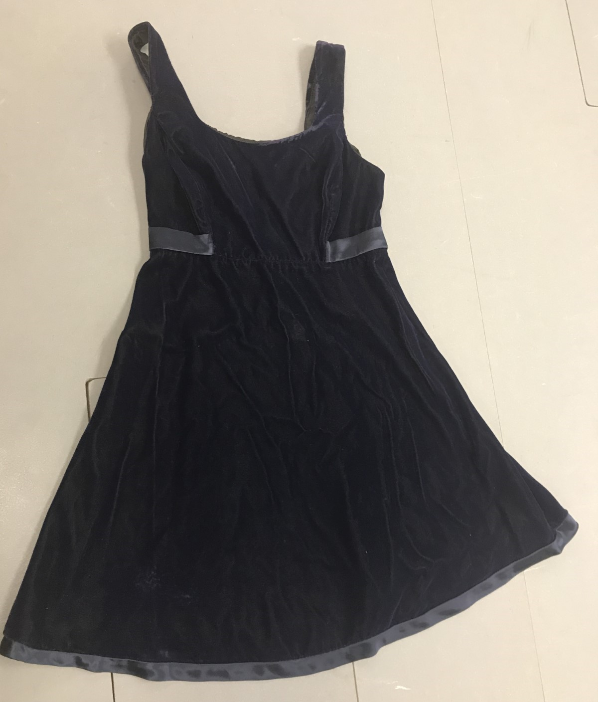
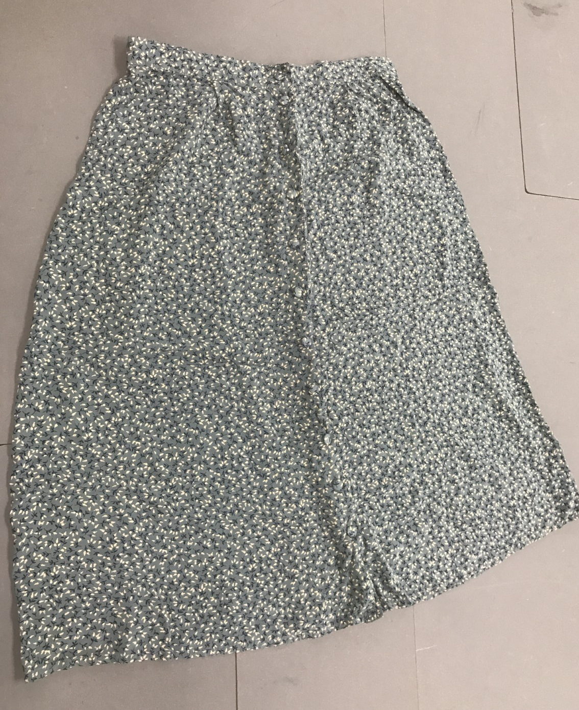
ADDITIONAL EXAMPLES
UPCYCLED: EXPLORING TEXTILES & ART
6
Sample Grading Criteria:
Overall Design (40%) - The finished garment(s) are interesting and distinctly different from the original materials. Sketches and other development processes show intentional develop of a design based on materials and other influences. Time was taken to alter/develop a pattern/method accordingly to match artistic vision.
Craft (20%) - The garment(s) is carefully and thoughtfully constructed. The garment is wearable (can be easily taken on and off) and has finished seams.
Sensitivity to Materials (40%) - The materials used to create the garment(s) are thoughtfully chosen. There is intentional use of upcycled garments and other materials to create interesting new garment(s).
Tea Towel Dresses by Selina Sanders
Anna Naomi
ROBERT HILLESTAD TEXTILE GALLERY

Slide 7
UPCYCLING!
A Fashion & Textile Exhibition
of Remaking and Reinventing
Robert Hillested Textile Gallery Student Juried Exhibition
WHAT: The Robert Hillestad Textiles Gallery in the Department of Textiles, Merchandising, and Fashion Design invites high school students to showcase their textile art and fashion designs! Students can submit textile art including apparel design, fiber art, and surface design work. This exhibition seeks to promote and celebrate the creative work of young artists, designers, and makers working with textile or fiber materials or techniques.
Submitted works will be judged on creativity, originality, craft, and innovation.
The exhibition will run February 2023 to April 2024 at the Robert Hillestad Textile Gallery, located on the 2nd floor of the Gwendolyn Newkirk Human Sciences bldg. on East Campus, is open to the public M-F 9am – 4pm.
SUPPORT: This curriculum guide, “Upcycled: Exploring Textiles & Art,” provides a unit lesson plan and curriculum developed by our faculty that is focused on upcycling for fashion design and art students. Schools with limited access to materials can use this option to teach their students. All participants in the program are eligible to show their work in the gallery!
DEADLINE: DEC 22, 2023 Entries will be submitted to https://unlarts.slideroom.com/#/permalink/program/72199
7
Photo by Pew Nguyen

