Slide 1
UPCYCLED EXPLORING TEXTILES & ART
By The Robert Hillestad Textile Gallery
Notes:
Photo by Gin Patin

Slide 2
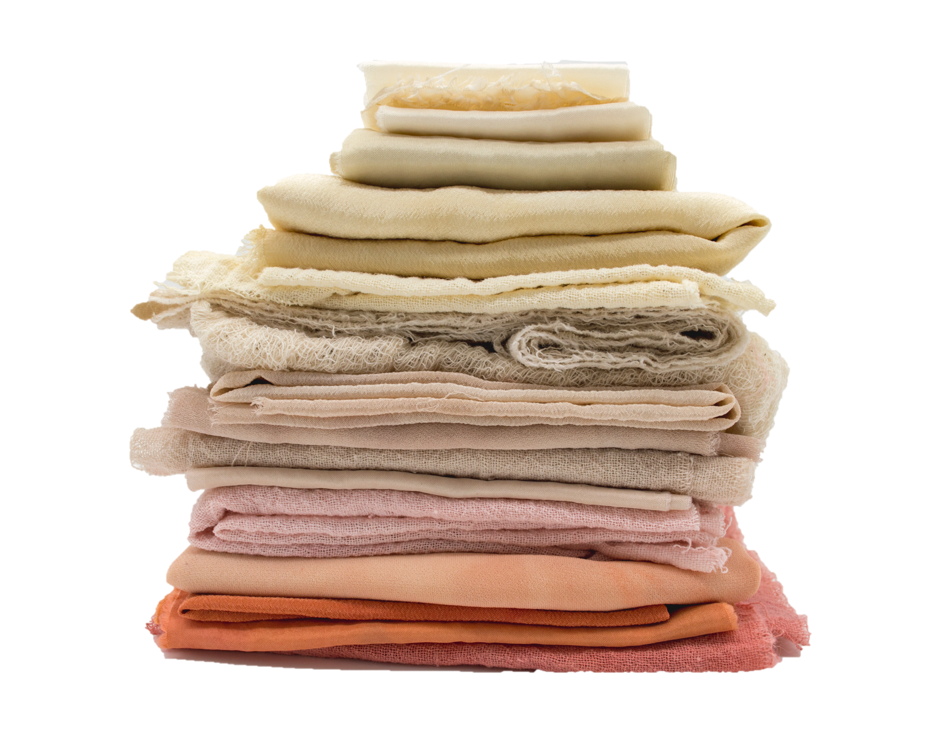
ACKNOWLEDGEMENTS
UPCYCLED: EXPLORING TEXTILES & ART
2
UPCYCLING, ART, & DESIGN
Whether utilizing sculpture, woven, tapestry, knitting, crochet, applique, needlework, needlepoint, surface design, wearable art, fashion design, or haute couture, textiles offer a unique medium in art. Textiles allow the artist to take relatively two-dimensional materials and transform them in three-dimensional forms. Textiles offer innate textures, patterns, movement, colors, pattern, and variety which offer artists and designers a unique “canvas” to work with.
One of the most polluting and wasteful industries in the world is the textile and clothing industry. Additionally, most clothing and textiles end up in landfills especially with the increase of fast fashion. This over abundance of garments and other textile materials, as well as manufacturing waste, offers a unique and available material for artists while participating in sustainable practices.
This project encourages high school age students to explore the textile medium while developing an environmentally conscious mindset and art practices. The Robert Hillestad Textile Gallery will provide a space for students to showcase their work at the annual Student Juried Exhibition (see page 6).
Mel Poole
Curriculum Design & Development Anna Naomi Erdmann, M.A.
Supervised by Michael Burton, M.F.A.
Sponsored by The Robert Hillestad Textile Gallery
Cover Image Gin Patin
Special Thanks to Lincoln Public Schools
Mary Alice Casto, Ph.D.
Sandra Starkey, Ph.D.
Kristen Douglas, M.A.Ed.
The Department of Textiles Merchandising and Fashion Design (UNL)
ROBERT HILLESTAD TEXTILE GALLERY

Slide 3
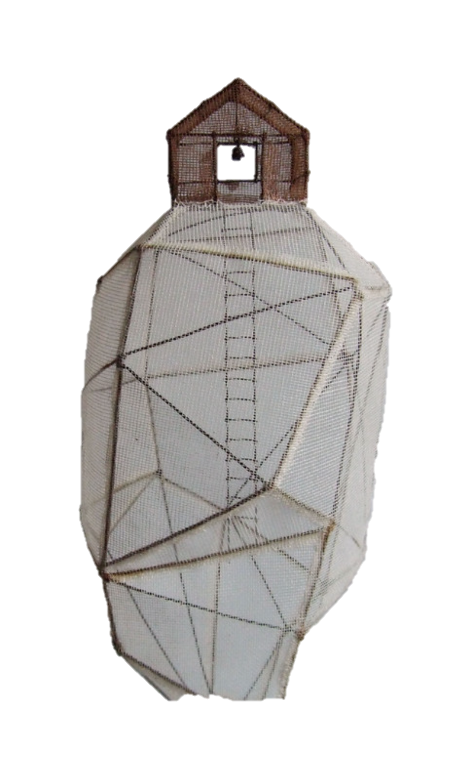
TEXTILE SCULPTURE
UPCYCLED: EXPLORING TEXTILES & ART
3
“rocher habité” 01 (“inhabited rock”)
By Isabelle Bonte
Overview:
Create a 3-dimensional form using found objects or armature wire that is at least 50% covered by upcycled textile materials.
Goals:
Creating a textile sculpture with armature wire or found objects
Explore textile mediums and 3-dimensional forms utilizing environmentally conscious upcycled materials
Showcase completed sculpture in the Robert Hillestad Textile Gallery Student Exhibition (see page 6)
Materials:
Armature Wire (32 gauge or above) AND/OR found objects
Needle Nose Pliers
Scissors / other cutting tools
Fabric Scraps (provided)
Fabric Sheers
Fabric Glue / PVA Glue / Rice Paste
Various types of glues (different fabric’s will respond differently), I.e. Craft Glue, Rubber Cement
Fray Check
Upcycled textile related materials: buttons, sequins, lace, zippers, trims, applique, etc.
Hand sewing needles and thread (optional)
ROBERT HILLESTAD TEXTILE GALLERY

Slide 4
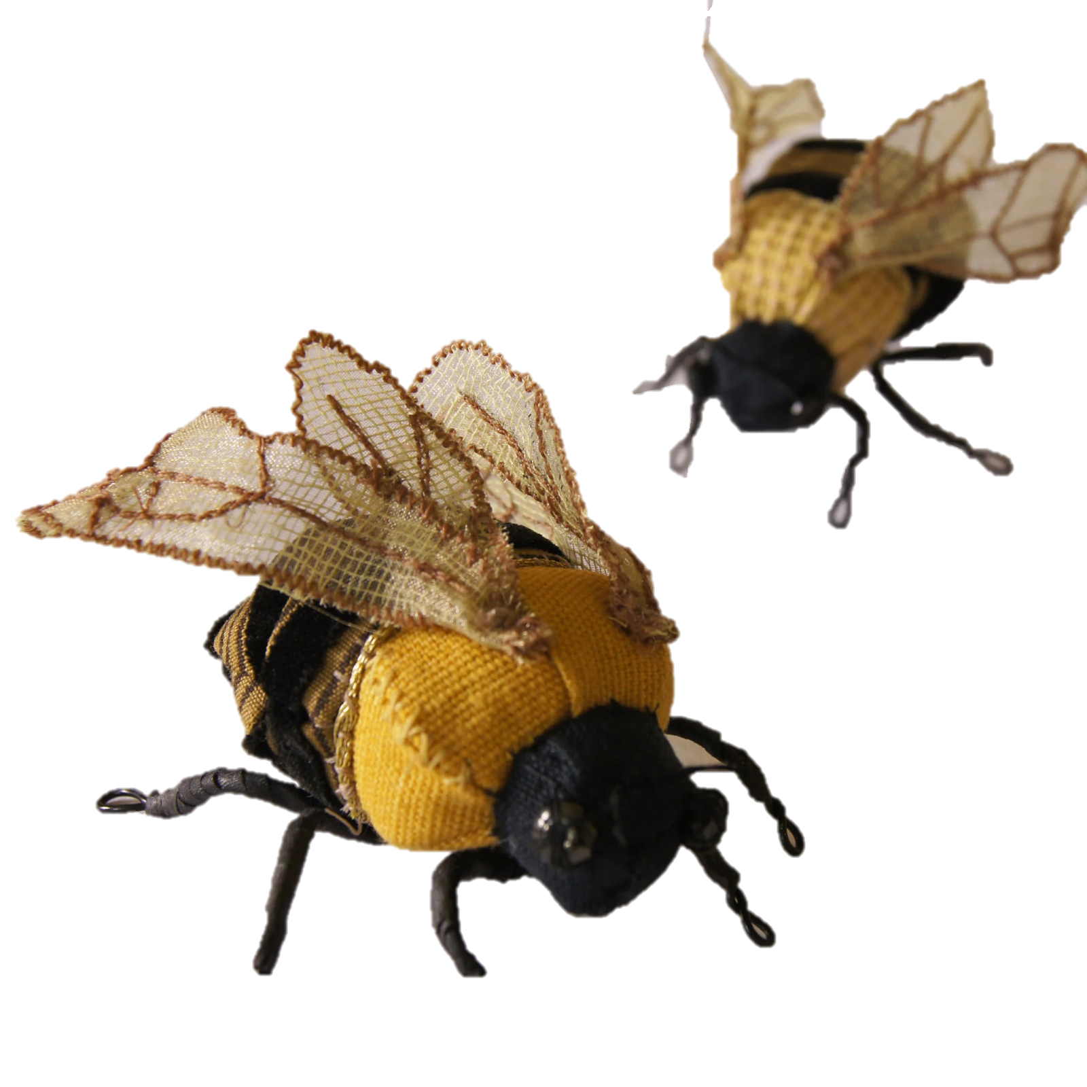
UPCYCLED: EXPLORING TEXTILES & ART
4
Process:
Students will create a recognizable form of their choosing utilizing found object(s) or armature wire. If using wire, make sure to loop ends back on themselves to avoid sharp ends. Students can alter and combine found objects to create their form.
Cover the form with upcycled textile scraps and textile related materials by methods such as wrapping, gluing, tying, or sewing. Students can combine or alter textiles before and/or after they are put on the form.
Use the textiles to enhance the form and create visual interest. The students can either do this abstractly or representability but should support what the form is representing (I.e. a basketball form shouldn't look like a watermelon).
Helpful Tips:
Encourage students to play with color, texture, line, shape, perspective, movement, variety, balance, emphasis.
Encourage students to think beyond the stereotypical “patchwork” appearance often associated with upcycling.
Deciding a color palette or theme may help break out of this mold.
An example would be if one was making a whale, try utilize flowing blue fabrics reminiscent of the ocean, instead of filling in the space with any blue fabric available.
Forms can range in size but should be large enough to demonstrate adequate understanding and completion of the prompt but small enough to be completed within the time frame and with the resources provided. No smaller than ∼5” x 5” or larger than ∼20” x 20” is a good measure.
Golden Bumblebee Textile Soft Sculpture
By Blue Terrocotta
ROBERT HILLESTAD TEXTILE GALLERY

Slide 5
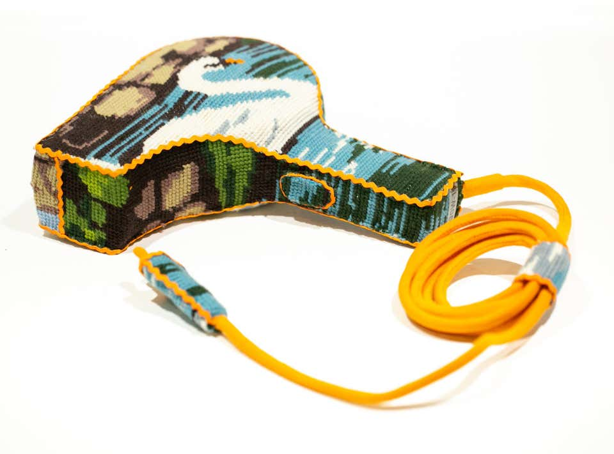
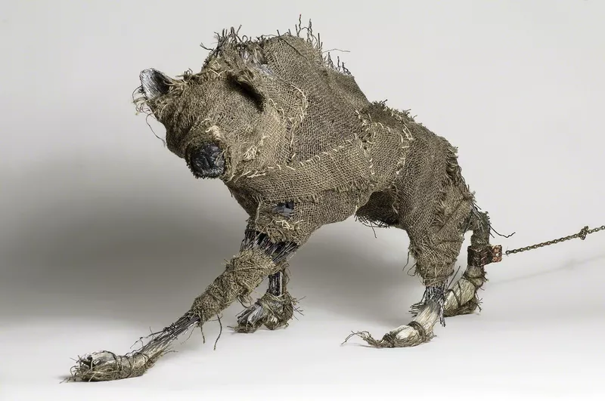
ADDITIONAL EXAMPLES
UPCYCLED: EXPLORING TEXTILES & ART
5
Sample Grading Criteria:
Overall Design (40%) - The sculpture clearly depicts a recognizable form and is conscious of the principles and elements of art – color, texture, line, shape, perspective, movement, variety, balance, emphasis.
Craft (20%) - The sculpture is clean and thoughtfully constructed – there are not unintentional chunks of glue, odd wrinkles, or other poorly executed techniques that distract from the appearance overall sculpture
Sensitivity to Materials (40%) - The materials used to create the sculpture are thoughtfully chosen. There is a sensitive and intentional use of texture, layers, fabrics, and/or other materials (beads, sequins, lace, buttons, etc.) to create an interesting surface. At least 50% of the sculpture is covered in textile material.
Swan Hairdryer
By Ulla-Stina Wikander
The Queens Beast
By Elizabeth Jordan
ROBERT HILLESTAD TEXTILE GALLERY

Slide 6
UPCYCLING!
A Fashion & Textile Exhibition
of Remaking and Reinventing
Robert Hillested Textile Gallery Student Juried Exhibition
WHAT: The Robert Hillestad Textiles Gallery in the Department of Textiles, Merchandising, and Fashion Design invites high school students to showcase their textile art and fashion designs! Students can submit textile art including apparel design, fiber art, and surface design work. This exhibition seeks to promote and celebrate the creative work of young artists, designers, and makers working with textile or fiber materials or techniques.
Submitted works will be judged on creativity, originality, craft, and innovation.
The exhibition will run February 2023 to April 2024 at the Robert Hillestad Textile Gallery, located on the 2nd floor of the Gwendolyn Newkirk Human Sciences bldg. on East Campus, is open to the public M-F 9am – 4pm.
SUPPORT: This curriculum guide, “Upcycled: Exploring Textiles & Art,” provides a unit lesson plan and curriculum developed by our faculty that is focused on upcycling for fashion design and art students. Schools with limited access to materials can use this option to teach their students. All participants in the program are eligible to show their work in the gallery!
DEADLINE: DEC 22, 2023 Entries will be submitted to https://unlarts.slideroom.com/#/permalink/program/72199
6
Photo by Pew Nguyen

