Slide 1
University of Nebraska Office Supplies Training with Amazon Business
Kyle Burdette and Ryan Foust
August 4, 2025

Slide 2
Introductions
Finding Contract Office Supplies on Amazon Business
Live Demo
Specialty Focus – Copy Paper
Transition Support Services
Order History and Lists
Order Tracking and Returns
Best Practices
Requesting Bulk Quotes (office and other categories)
Q&A
Agenda

Slide 3



Introductions
Kyle Burdette
Sr. Account Executive BigTen+
dkburd@amazon.com
312-952-8560
Ryan Foust
Strategic Adoption Manager
rfoust@amazon.com
847-830-8200

Slide 4

Finding Contract Office Supplies on Amazon Business
Regardless of the icon, the message is the same…
“This office supply has a custom discount negotiated by the University of Nebraska. Purchasing discounted office supplies from the contract is encouraged!”

Slide 5
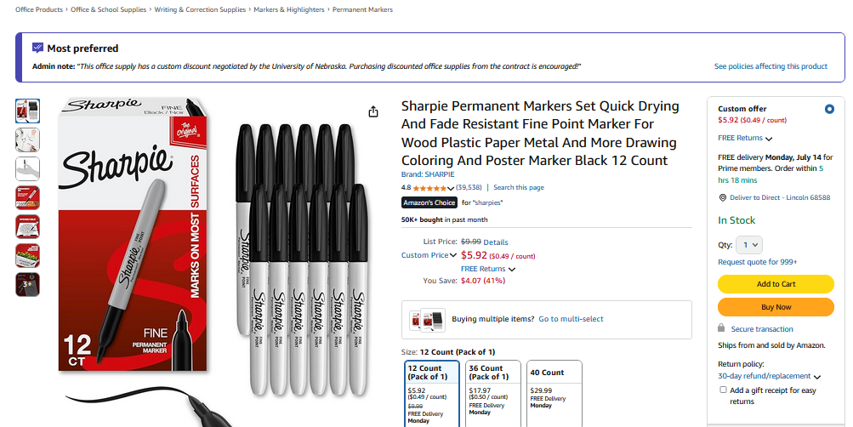
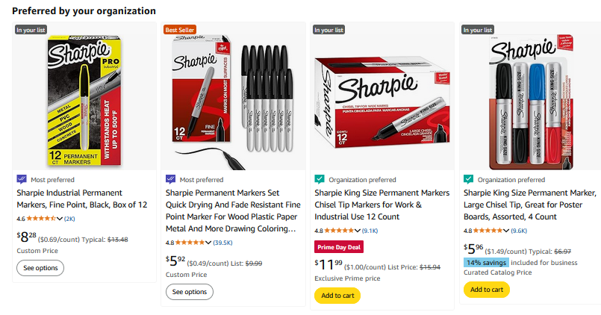
Finding Contract Office Supplies on Amazon Business

Slide 6
Live Demo
Let’s go live!

Slide 7
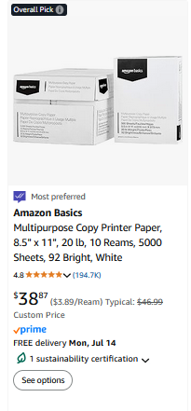
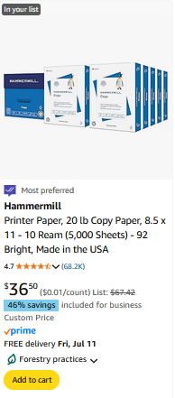
Special Focus – Copy Paper
Amazon Basics 10 Reams
$38.87
Hammermill 10 Reams
$36.50

Slide 8
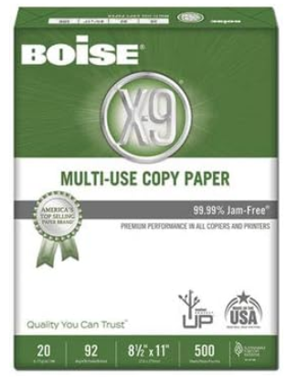
Special Focus – Copy Paper
Amazon Basics 10 Reams
$38.87
Hammermill 10 Reams
$36.50

Slide 9
Transition Support Services
Transitioning to Amazon Business for Office Supplies
Larger marketplace of options with contracted savings
Find the exact product you’ve been purchasing as well as alternatives at better pricing
Strategic Adoption Manager at your service!
Help with building lists to mirror your current department needs
Department level trainings
Here to assist with orders, returns, tracking
On campus engagements

Slide 10
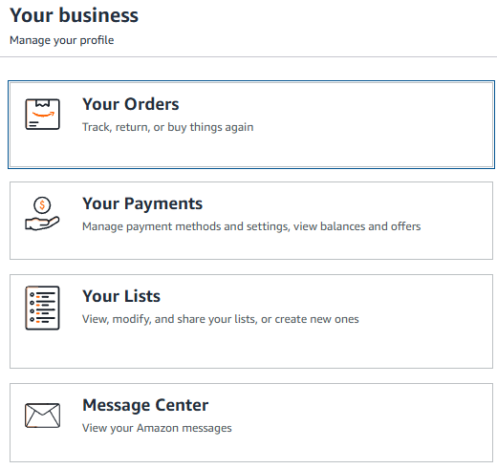
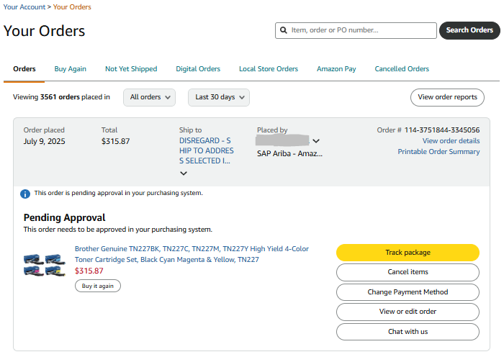
Order History and Tracking
Find your orders, track orders, manage quotes, and more

Slide 11
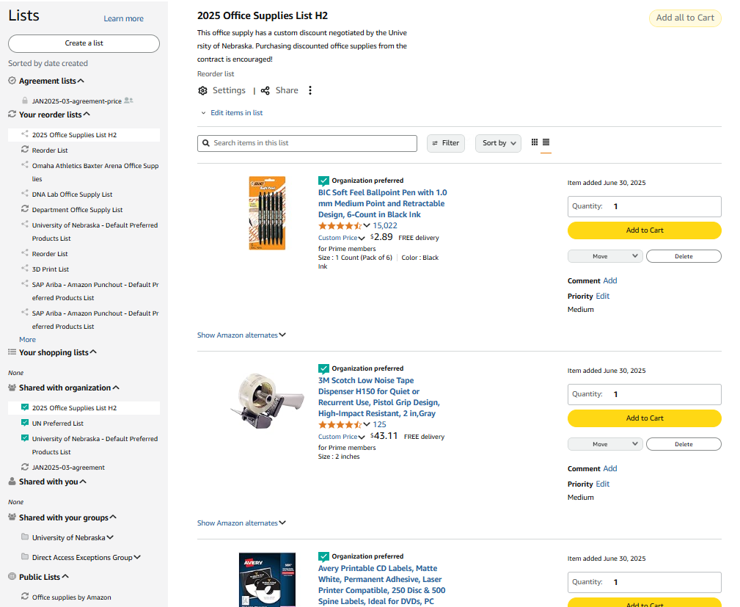
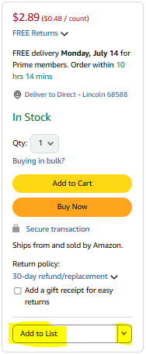
Building Lists and Lists Shared with You

Slide 12
Best Practices for Buying Amazon Office Supplies via Ariba
Common Causes for Carts Breaking:
Add/Removing Quantities in Ariba
Add/Removing Items in Ariba
Combining Multiple Amazon Carts Into 1 Ariba Cart
Delay in Processing Ariba Cart (2-Fold)
Why is it BAD when a cart breaks?
Price Lock Breaks
Inventory Lock Breaks
Order Can Fail

Slide 13
Requesting Bulk Quotes
The Request for Quote Tool (RFQ) is a new tool which helps Amazon Business Customers request a specific, discounted price on higher volume purchases.
Parameters:
>$7,500 of 1 item
>$10,000 for multiple items

Slide 14
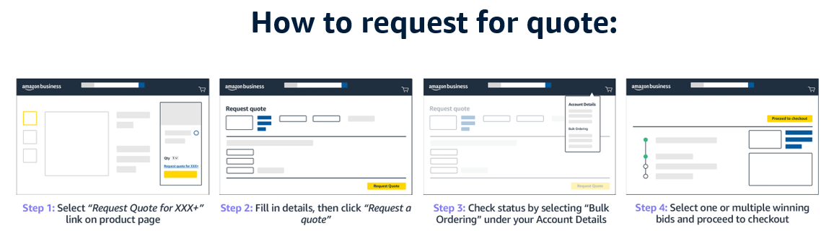
Self-Service Quotes

Slide 15
Requesting Bulk Quotes
Live Demo
Link to Recording: https://youtu.be/u-Yp7eDktiA

Slide 16
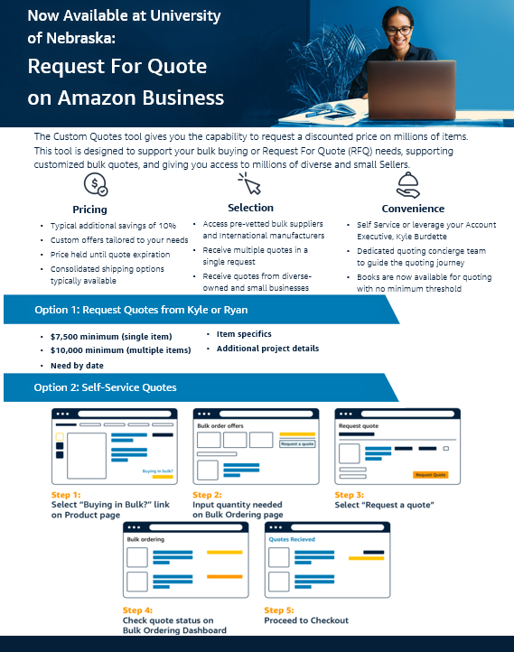
Requesting Bulk Quotes - Takeaway
Key Advantages:
One Request = Many Quotes
Quote Discounts
Guaranteed Pricing/Inventory
Quantity Limit Exceptions
“Sold by Amazon” Items (return advantage)
Grant Funded Special Projects

Slide 17
Q&A

Slide 18
Thank You!
Kyle Burdette – dkburd@amazon.com
Ryan Foust – rfoust@amazon.com
Request a Return Label: B2BenterpriseExperts@amazon.com

