Slide 1
CEHS Financial Process Update 2023

Slide 2
Agenda
If someone pays us
If we pay someone
Food payments
Contracts
Reconciliation documentation
Year-end
Timeline & Resources
Q&A

Slide 3
If someone pays us

Slide 4
If someone pays us
Cash/checks
Credit card: in-person or online
Business team’s credit card terminal: available in CPEH 135L or phone call to Yadah Mukendi Muamba
Employees handling credit card payments need complete security awareness training
Wire transfer
IBT if payment from a NE state agency
Internal charge/JE if internal client

Slide 5
Cash Handling Policies and Procedures

Slide 6
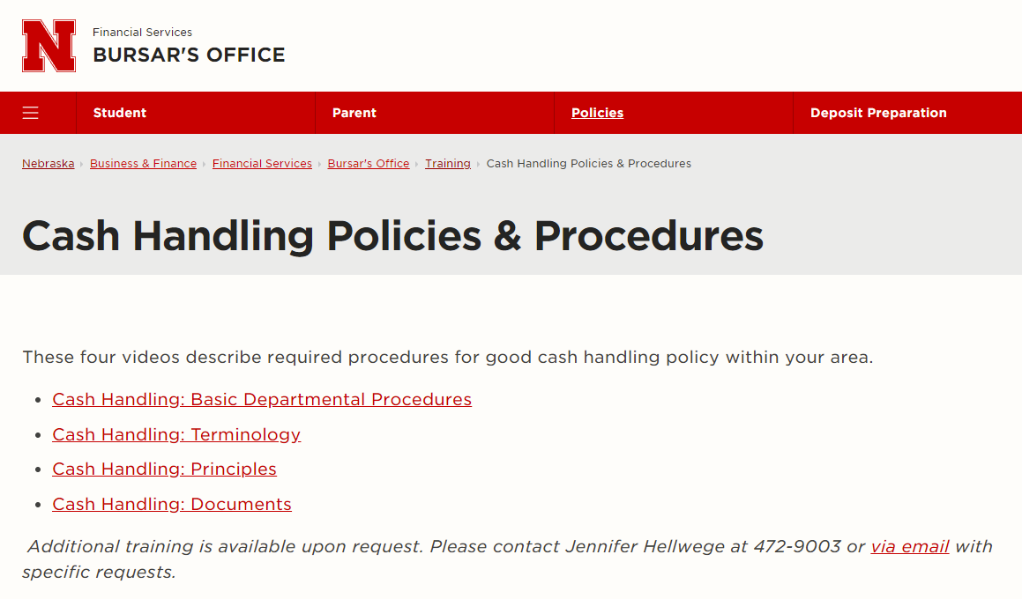
Cash Handling Policies and Procedures
Employees with cash handling responsibility must review at least annually the UNL Cash Handling Policies and Procedures
Notes:
.

Slide 7
Receipting Monies
All monies should be deposited promptly and intact to the Bursar’s Office.
Departments must deposit all collections with the Bursar's Office within two business days, and more frequently as activity warrants. For some departments, a daily deposit schedule has been established.
Any check of $10,000 or greater must be delivered with the appropriate form for deposit to the Bursar or Post Awards Administration office within one business day of receipt.
Notes:
Departments must maintain receipting systems or daily check logs which document adherence to the timeliness of deposits. Random campus units will be periodically asked by the UNL Bursar’s Office to produce their check log for the previous month. If one cannot be produced, UNL’s Bursar’s Office will inform Internal Audit and a report will be made to the Audit Committee.

Slide 8
Check Acceptance
Made payable to the "University of Nebraska–Lincoln".
All checks should be accepted only in the amount of the sale. Checks may not be cashed or written for more than the sale.
Post-dated (dated in the future) or two-party (payee is not the University) checks are not accepted
Checks, traveler’s checks and money orders are restrictively endorsed as received.
All checks need to be payable through a US Bank in US Dollars. Contact the Bursar’s Office with any questions about receiving international payments.
Notes:
Endorsement stamps are only to be obtained from the Bursar's Office or upon approval by the Bursar’s Office.

Slide 9
Change Funds
Change funds may be obtained, increased or decreased only by approval of the Associate Vice Chancellor for Business and Finance through the Bursar’s Office.
The Bursar's Office must be notified immediately when a change in fund custodian occurs. The new fund custodian completes the appropriate forms at the Bursar's Office.
Cash cannot be withheld from a deposit for the purpose of adding to or creating a change fund.
Use of change funds or undeposited receipts for petty cash purchases, loans, advances, or check cashing for any individual (including employees and students) is strictly prohibited.

Slide 10
Security of Funds / Equipment
All funds will be kept in a lockable metal box, out of public view, and should be available for inspection by an authorized representative of the Vice Chancellor for Business and Finance.
When not in use, funds will be stored in a locked safe or other suitable place. If stored in a desk, the desk should be lockable and the key to the desk should be secured in another location in the office.

Slide 11
Security of Funds / Equipment
Access to individual department safes is restricted to a small, essential number of employees. Whenever there is a turnover in personnel who had access to the safe, the combination to the safe must be changed within two (2) days.
Contact the Bursar’s Office if new or additional cash registers/receipt systems are to be obtained by a department. Certain locked-in totals and audit trails must be verified by the Bursar’s Office in the systems used

Slide 12
Cash Handling Staffing
Duties of opening mail, processing cash received by mail, collecting cash, preparing receipts and account reconciliation are separated among individuals (i.e., one individual is not responsible for two or more of these activities) to the extent allowed by staffing resources.
Departmental cash handlers must take at least five (5) consecutive business days of vacation annually, during which time another individual performs his/her duties. Any significant change in dollar volume during these times should be reported to the Office of Internal Audit immediately.

Slide 13
Other Policies and Procedures
All departmental activity with Financial Institutions must be approved by the Associate Vice Chancellor for Business and Finance through the Bursar’s Office.
No bank accounts can be opened by anyone outside of the Bursar’s Office. Procedures for bank account management are available on the Bursar’s web site and considered part of these instructions.

Slide 14
If we pay someone

Slide 15
If we pay someone
Payment methods:
eSHOP
Direct pay
Purchasing card (P-card)
Employee reimbursement
Non-employee reimbursement
Foundation direct payment
Student payment
Payroll
Other special circumstances

Slide 16
Before paying someone
Regardless of the payment method, if paying $5,000 or more contact the Business Team BEFORE making the payment/purchase as special processing is required.
Payment cannot be made until the good or service has been received. Not allowed to prepay (unless a contract specifically requires prepayment).
Ask questions upfront to save time and avoid problems later.

Slide 17
Purchase Documents
Documents generally involved when making a purchase via eSHOP or Direct Pay.
Quote – document from the supplier listing the price for the goods or service.
DO NOT SIGN if requires signature. Send it to the Business Team and we will determine if the quote constitutes a contract based on terms/conditions and who has signature authority based on the dollar amount.
Purchase Order (PO) – legal document sent to a supplier/vendor to authorize a purchase. A PO is not issued for Direct Pays.
Invoice – financial document requesting payment (references PO number, if applicable). Must include itemized detail.
Statement – document listing all unpaid invoices at a specific date. Payment cannot be made from a statement; the invoice referenced on the statement is required.
Packing Slip - document including list of items shipped. See Reconciliation Documentation slide below for additional info.

Slide 18
eSHOP
The University’s web-based purchasing system.
Contains both catalog and non-catalog suppliers.
Creates and distributes a purchase order (PO) to the supplier.
If you receive an invoice, send it to the Business Team.
Do NOT attach invoices in eSHOP - this will not trigger payment.
If you or a supplier cancel any part of an order, the PO or specific lines need to be cancelled on the University side by completing a Change Order Request.
Check the Ways to Pay document for more detailed instruction.

Slide 19
eSHOP Quantity Receipt
Indicates the good/service has been received and invoice can be paid.
A quantity receipt is required for:
Any purchase order (not shopping cart) totaling $5,000 or more.
All orders from a Science Catalog supplier (indicated by next to vendor name)
All Non-Catalog orders (indicated by )

Slide 20
Direct Pay
Goods and services with a total cost of less than $5,000. Vendor sends an invoice without requiring a PO.
Code each invoice by including “Ok to Pay,” your signature (manual or electronic using DocuSign), date and cost object(s).
Provide attendee listing and agenda/event flyer if invoice includes food and/or beverage.
Email or mail invoice to the Business Team.
Let the Business Team know if payment is for faculty recruitment as costs are split with Dean’s office.

Slide 21
Purchasing Card
For purchasing small-dollar ($4,999 or less), low-risk goods and services for departmental needs; this does not include travel expenses.
Before purchasing an item, inform the vendor that the University of Nebraska is sales tax exempt in eight states including: NE, ND, KS, TX, MO, IL, MA & FL. Tax charged over $25 requires refunding.
Use Eshop to request tax exemption forms.
Cannot be shared or used for personal or prohibited purchases.

Slide 22
Purchasing Card
Submit documentation within 20 days of transaction date, or right upon receipt of goods/services. Should use Firefly - Pcard tile to attach.
Conference registration should be paid with a P-card whenever possible. Attach agenda & payment confirmation. Include Concur Trip No. on form if traveling.
P-card purchases for software are not allowed without prior approval from NU IT Procurement. If you want to use a P-card for software, please contact CEHS IT (regardless of dollar amount).
Hardware under $150 ok/No external memory allowed.
Let the Business Team know if payment is for faculty recruitment as costs are split with Dean’s office.

Slide 23
Employee Reimbursement
Employee Reimbursement for Travel
Complete a Travel Request before traveling or incurring any travel expenses.
Submit expense reports with all required receipts as soon as you return from your trip. Will not get reimbursed if not submitted within 60 days.
No personal credit cards for meals paid for others allowed as of 1-1-2021.
Adjusted daily per diem rates for meals as of 1-1-2021. Do not attach meal receipts. Work with the Grants Specialist for grant funding receipt requirements.
Personal Days: Traveling early or returning days after business trip requires cost comparison.
Employee Reimbursement for Non-Travel
Only use if not available through eSHOP/Direct Pay/P-card as employees have to pay sales tax.
Submit expense reports within 60 days of receipt date.

Slide 24
Non-Employee Payments/Reimbursements
Processed with Visiting Personnel Forms (visiting scholars) or Warrant Requests (research subject payments).
Do not email any forms with SSNs. Retain in secured place for when needed by Accounts Payable during processing.
Submit VP forms on or after “event” date. Include location of services provided.
VPs are subject to NU Travel policies, including meal per diem rules.
Subject payments over $100 – W9 required. Do not email with SSNs.

Slide 25
Foundation Direct Payment
The following may NOT be purchased using University funds. These expenses must be paid directly by the Foundation and include sales tax.
Alcohol
Employee Gifts/Awards (including Alumni and Retirees)
Flowers or Decorations
Parties and Retirement Events
Fund-Raising Events

Slide 26
Food payments

Slide 27
Food Service on Campus
Due to health safety concerns, all food served on campus must be furnished by a UNL contracted food caterer or from the list of Approved Food Providers.

Slide 28
Food payments
Food for the following events can be paid from on a State cost object (21-, 22-, 23-). No sales tax included on the invoice.
Student functions
Recruiting new faculty/staff members meals/receptions
Faculty/Staff retreats/training sessions with external presenter(s) and agenda
Other training/educational programs with prior written approval of the Vice Chancellor of Business and Finance
Reference Website – Funding Non-Travel Related Meals and Receptions | Business & Finance | Nebraska (unl.edu)

Slide 29
Food payments
Food for Official Functions (employee only events/meetings with a business purpose) has to be paid on a Foundation cost object (starting with 27) unless written approval to use state funds is obtained from VCBF prior to the event. No sales tax included on the invoice.
Food for parties and retirement events that are personal in nature must be paid directly by the Foundation. Sales Tax included on the invoice. The Foundation is NOT tax exempt.

Slide 30
Food Payments
Payment options:
Direct Bill
Pcard:
Contact P-card office unlock the MCC.
For official functions only
Personal funds
The following restaurants in Lincoln have direct billed us. Please contact them in advance to confirm if that has changed.
+Blue Orchid
+DISH
+Goodcents
+Green Gateau
+Hy-Vee catering
+JTK Cuisine
+Lazlo’s
+McAlister’s Deli
+Misty’s Steakhouse
+Oven
+Panera
+Premier Catering
+Valentino’s
+Venue Restaurant & Lounge
+Wilderness Ridge
Notes:
The merchant category code (MCC) for restaurants for P-card holders is locked. Need to contact the business center so we can have the P-card office unlock the MCC.
In January, Procurement put out the guidelines that all “official function” meals would have to be put on the p-card. Then, after the fact, once they really started looking at it, it was decided that although the p-card was the preferred method for paying for “official function” meals that they would still reimburse. If a person has a p-card, that is what they should be using.

Slide 31
Contracts Technology Purchases Reconciliation

Slide 32
Contracts
Send any contract to CEHScontracts@unl.edu
Usually requires signatures from both parties, but not always. Some quotes only ask for one signature but still may be considered a contract.
DO NOT SIGN ANYTHING WITHOUT CONSULTING WITH THE BUSINESS TEAM
UNL has specific signature authority rules
Some can take weeks or even months to complete, send any contracts ASAP to get them in the workflow, even if the start date is a long way out

Slide 33
Expense Contracts (we pay someone else)
Legally bind UNL to purchase goods or services
Speakers, repairs, hotels/conferences, software licenses, consultants, etc.
UNL has required legal language for expense contract. We’ll use UNL’s standard contract template or add UNL’s legal addendum to a supplier’s contract
Business Team will review supplier terms and conditions
Contracts $5,000 or more must be sent to NU Procurement
Business Team will coordinate with NU Procurement to review and finalize
Must be uploaded to state website per Nebraska state law

Slide 34
Revenue/Fee-for-Service (someone else pays us)
All revenue or Fee-for-Service contracts go to OSP to review
Subject to UNL’s federally-negotiated F&A rates
Similar to grants/other external funding
Business team will advise on which rate, if applicable
UNL also has a standard Fee-for-Service contract template
Service Center contracts are case-by-case, must be reviewed by the Business Team
If a revenue-generating contract involved student experiences, the Dean may be able to sign. The Business Team will make that determination.

Slide 35
Other Contracts
Zero Dollar – Clinical practicums, student teacher contracts
Business Associate Agreement (BAA) – Involves HIPAA compliance
MOUs/Internal –signed by the Dean. MOUs are internal agreements with another University of Nebraska party.
When in doubt, ask questions!

Slide 36
Technology Purchases
ALL software and MOST technology hardware purchases must go through CEHS IT
Software:
Check the catalog first: https://itprocurement.unl.edu/software-catalog
Many enterprise software licenses (Adobe, Microsoft) are available at no cost to faculty, staff, and students.
Submit software requests at http://cehshelp.unl.edu. CEHS IT will contact NU IT Procurement for a quote. Plan for several weeks to be processed through Procurement as software may need to be vetted by ITS Security and the accommodation office.
Many software quotes ask for a signature – DO NOT SIGN, send to CEHS IT.
Cannot purchase with a p-card or personal credit card without advanced written approval from NU IT Procurement. Includes renewals, subscriptions and web-based services. Attach approval from IT procurement to p-card voucher.

Slide 37
Technology Purchases
Hardware Purchases Under $150:
Either CEHS IT or department staff can submit the orders with the following exceptions.
Computers, tablets, printers and external storage devices (hard drives and flash drives) must go through CEHS IT.
Contract with CDW-G which includes significant discounts and rebates. Strongly encouraged to purchase all technology items, including printer toner, through CDW-G in eSHOP.
Hardware Purchases $150 and over:
Must be ordered through CEHS IT.
Submit your request at http://cehshelp.unl.edu.
Notes:
This is to ensure the products meet university requirements and best meet your needs.

Slide 38
Reconciliation Documentation
We need backup documentation for all revenues and expenses
Send packing slips to the Business Team
Scan and email to CEHS-Reconciliation@unl.edu
Mail to the Business Team addressed to CEHS Reconciliation, CPEH 135, 0234
Sign and record date shipment was received
If no packing slip, email to confirm items/services were received as ordered
List cost object, PO # (if applicable), vendor/supplier, and what was ordered

Slide 39
Year-end Processing Timeline Resources

Slide 40
Year-end
Fiscal Year 2023 ends 6/30/2023
Submit your P-card documentation as soon as possible
To pay an expense belonging to FY23, department mark invoice as FY23, write the date item is received and route it to the business team
Review commitments on SAP Index Reports

Slide 41
Year-end Reports
- Inventory:
Notify Accounting inventory count date: first week of June
Inventory report due to Accounting: first week of July
- Accounts Receivable balance: due to Accounting the first week of July
- Deferred Revenue and prepaid expenses: due to Accounting the third week of July

Slide 42
Processing Timeline
P-card application: 3 weeks – 1 month
Direct Pay invoices: 1 week – 2 weeks
PO invoices/Visiting Personnel/Warrant Requests: 3 weeks – over one month
When paperwork is received by Business Team, we process and send to Accounting.
In Accounting, it is audited, entered into SAP and sent to the state for a check (warrant) to be cut using the Invoice/Voucher process.
The Department of Administrative Services (DAS) sends the warrant directly to the vendor unless the department requests otherwise.

Slide 43
Resources
CEHS Business Center website
https://cehs.unl.edu/cehs/cehs-business-center/
Ways-to-Pay Document

Slide 44
Contact Information
eSHOP question: Erin Stoddard
Direct Pay & PO invoice/Visiting Personnel/Warrant Request: Yadah Mukendi Muamba (City Campus and Dean’s office), Carrie Brownyard (East Campus)
P-card/Concur: Yadah Mukendi Muamba (City Campus and Dean’s office), Carrie Brownyard (East Campus)
Cash/Check Deposits: Yadah Mukendi Muamba (City Campus), Carrie Brownyard (East Campus)
Credit card payment: Yadah Mukendi Muamba
Packing Slip/Backup documentation: send to CEHS-Reconciliation@unl.edu
Contract: send to CEHScontracts@unl.edu

