Slide 1
Visiting Personnel Process
For Individual Payments

Slide 2
1. Initial Form Submission and Verification
Grants Specialist(GS)/Department (Dept) receives a Visiting Personnel (VP) form from the VP via DocuSign, or a paper form with the top section completed. GS/Department completes the department section.
GS/Dept must verify that the form:
Is legible.
Includes the location of service.
Is completely filled out.
Is fully signed.
If the General Ledger (GL) account is known, enter it.
Attach receipts as required.

Slide 3
2. Department Cost Object Process
The Department sends the fully completed VP form to the Finance Coordinator (FC).
The FC submits a Supplier Request Form in Ariba, which must include:
Individual’s name.
Email address.
Phone number.
Physical address.
The FC also uploads a completed W9, W8, or Visiting Personnel form to a secure folder.
The FC completes the parking process once the vendor is set up in Ariba.

Slide 4
3. Grants-Related Process
The Grants Specialist (GS) submits a Supplier Request Form in Ariba, which must include:
Individual’s name
Email address
Phone number
Physical address
GS must also upload a completed W9, W8, or Visiting Personnel form to a secure folder. A link to the folder is provided in the Supplier Request Form after selecting "Yes" for the question, "Is this Supplier Request for an Individual?“
Once the vendor is set up in Ariba, GS redacts the SSN on the VP forms and sends them to the Finance Coordinator (FC) for parking.

Slide 5
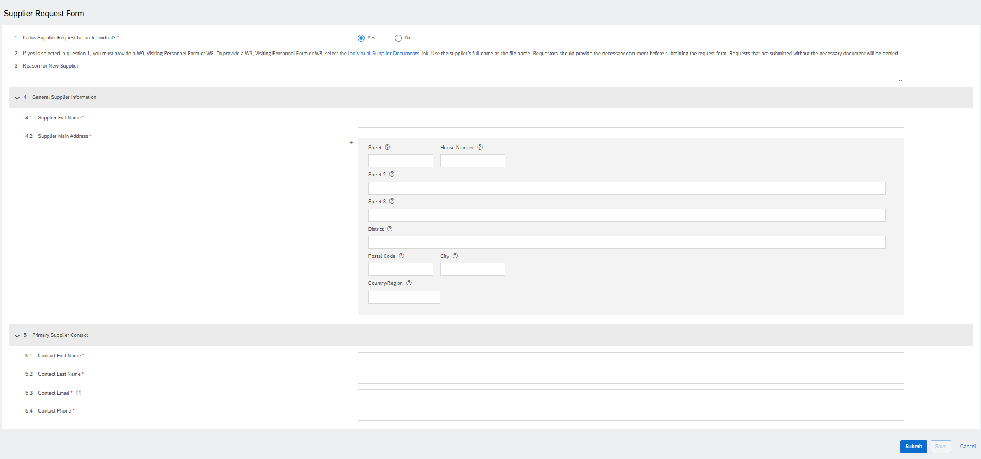
Supplier Request Form in Ariba

Slide 6
Company Payment Process
For Company Payments

Slide 7
1. Request New Company Supplier
If the company has not been set up in Ariba, Grants Specialist(GS)/Department (Dept) provides the Finance Coordinator (FC) the following information (if not available on the invoice)
Supplier Full Name
Supplier Contact First Name
Supplier Contact Last Name
Supplier Contact Email
The FC submits a Supplier Request Form in Ariba
P2P reviews the request and send the company a supplier registration invitation email
The company completes the registration
P2P reviews the registration and approves

Slide 8
2. Process Payments
Grants Specialist(GS)/Department (Dept) sends the FC the invoice to process payment (if this has not been done in step 1), including the following information:
Cost object (CO#) - if split funding, include amount to be charged to each CO#.
Write “Ok to Pay”
Signature AND print your name
Date

Slide 9
Warrant Request Process
For Research Participant Payments and Refunds

Slide 10
1. Single Warrant Request
The Grant Specialist or Department provides the Finance Coordinator with payment information, including the explanation, name, address, amount, cost center, and GL account, using a warrant request form.
For payments over $100, a W-9 form, including the payee's Social Security Number (SSN), is required and should be sent through DocuSign to the Finance Coordinator.
The Finance Coordinator completes the One-Time Refund Form (Warrant Request) in Ariba and attaches the paper warrant request form.
The form is routed to the financial approver in Ariba.

Slide 11
2. Multiple Warrant Request
The Grant Specialist or Department provides the Finance Coordinator with payment information, including the explanation, name, address, amount, cost center, and GL account, using the mass refund spreadsheet.
For payments over $100, a W-9 form, including the payee's Social Security Number (SSN), is required and should be sent through DocuSign to the Finance Coordinator.
The form is routed to the financial approver in DocuSign.
The Finance Coordinator emails the form to Pamela Boyle and Andrew Armatys in P2P.

Slide 12
3. Single Refund
The Grant Specialist or Department provides the Finance Coordinator with payment information, including the explanation, name, address, amount, cost center, and GL account in an email or a department's form.
The Finance Coordinator completes a warrant request form.
The Finance Coordinator fills out the One-Time Refund Form (Warrant Request) in Ariba and attaches the warrant request form.
The form is then routed to the financial approver in Ariba.

Slide 13
4. Mass Refund
The Grant Specialist or Department provides the Finance Coordinator with payment information, including the explanation, name, address, amount, cost center, and GL account, using the mass refund spreadsheet.
The Finance Coordinator completes a warrant request form and attaches the mass refund spreadsheet.
Form is routed to financial approver in DocuSign.
The Finance Coordinator emails the form to Pamela Boyle and Andrew Armatys in P2P

